Slide 1
In Pursuit of Fluency
Information Literacy, Technology and
Language Learning
Dr. Sue E. K. Otto
University of Iowa
Workshop on Information Literacy in the Foreign Languages
September 24, 2010
Notes:
The title of this talk could just as well have been The Dynamics of Change in the Digital Age and the implications for language teaching in learning. Today I am going talk about various perspectives on information literacy – what it is and how it relates to our use of technology in language learning. I am going to situate this within the broader context of general trends in education reform, the current state of higher education, and SLA theory.

Slide 2
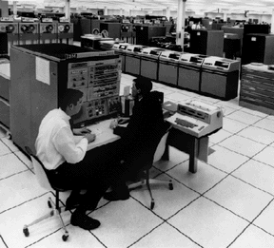
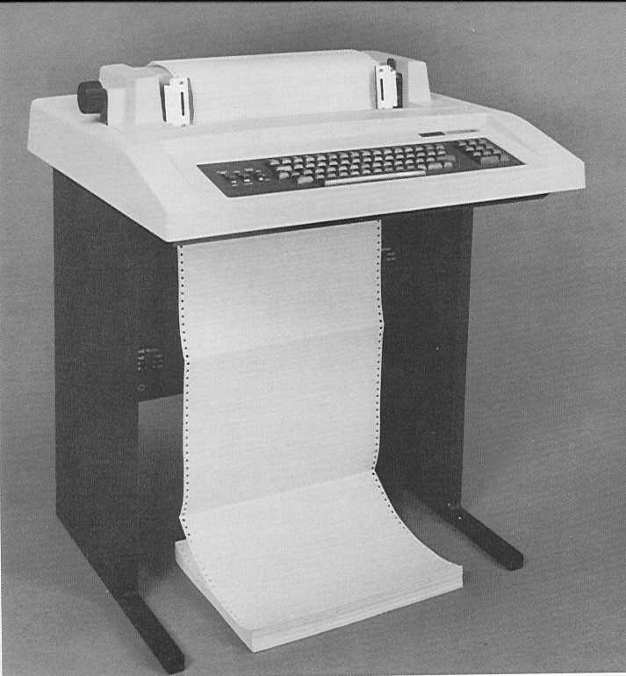
Perspectives of a 70’s CAI Digital Settler
When computers looked like this:
and workstations looked like this:

Slide 3
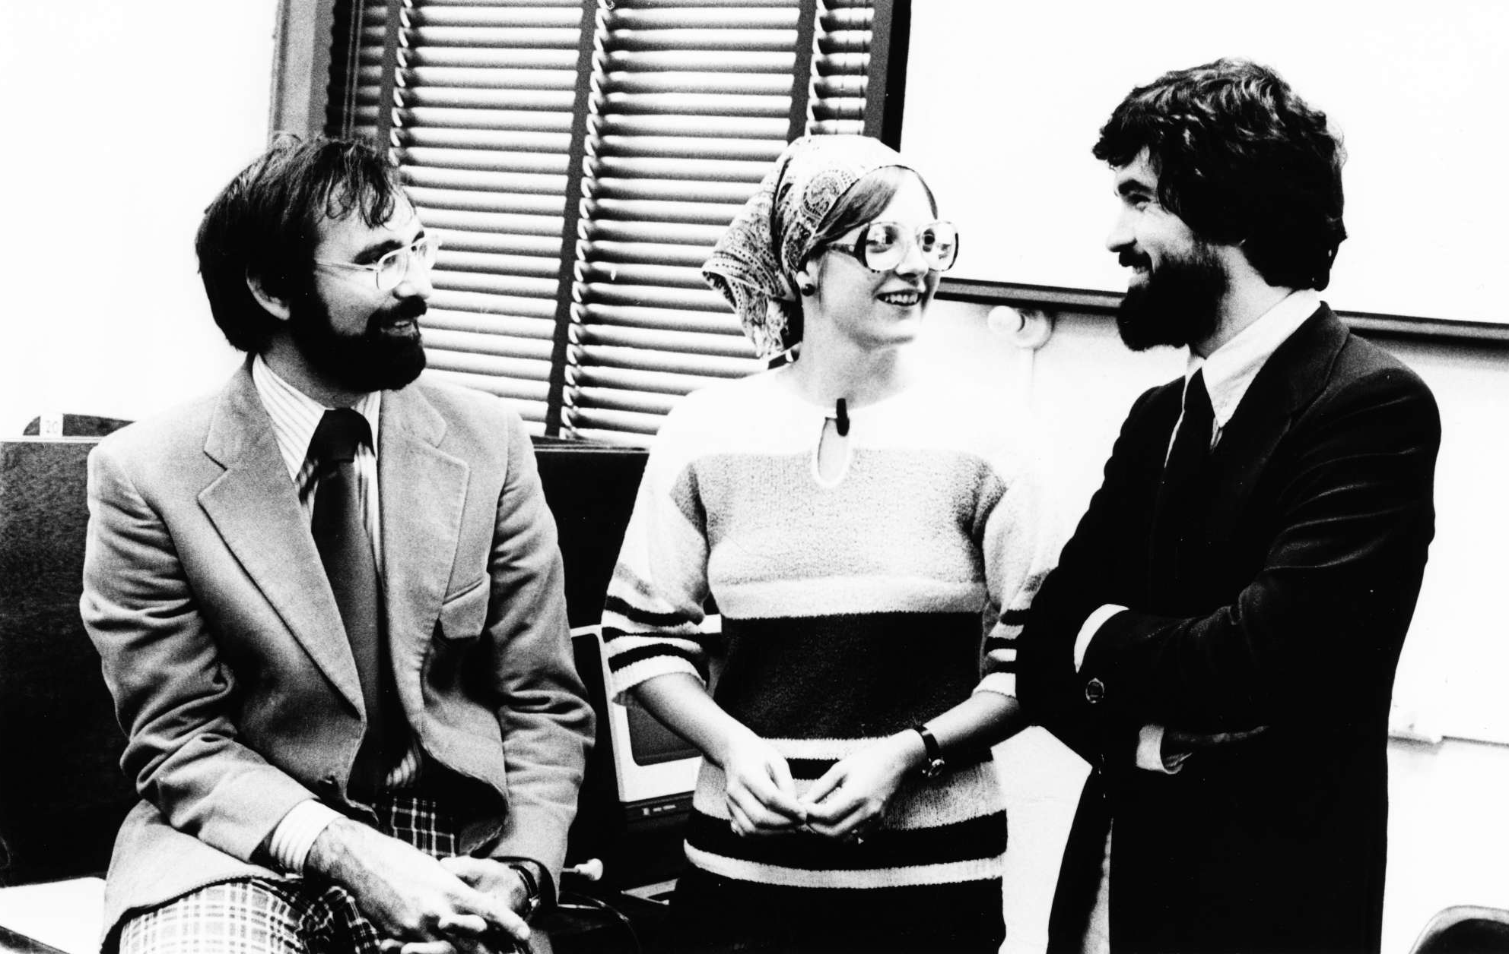
And I looked like this…
James Pusack Sue Otto Giulio Ongaro
circa 1976

Slide 4
Literacy
The condition or quality of being literate, especially the ability to read and write.
Notes:
Literacy has traditionally been described as the ability to read and write. In some updated definitions, it also included the ability to do arithmetic as the third of the basic survival skills needed to function in society. But the meaning of that term has been elaborated in recent years as evidenced by the topic of this workshop – information literacy.

Slide 5
Information Literacy
Skills needed to find, retrieve, analyze, and use information that include the abilities to:
  Determine the extent of information needed
  Access information sources in many formats effectively and efficiently
  Critically evaluate information and sources
  Use information to achieve a specific goal
  Understand the legal and social issues involved in using information and making ethical and legal use of it
Association of College and Research Libraries
Notes:
From ACRL’s Information literacy competency standards for higher education.
Information literacy is the solution to Data Smog.
In the next slide I will show you a video that amplifies a bit on this definition in a lively and colorful fashion.

Slide 6
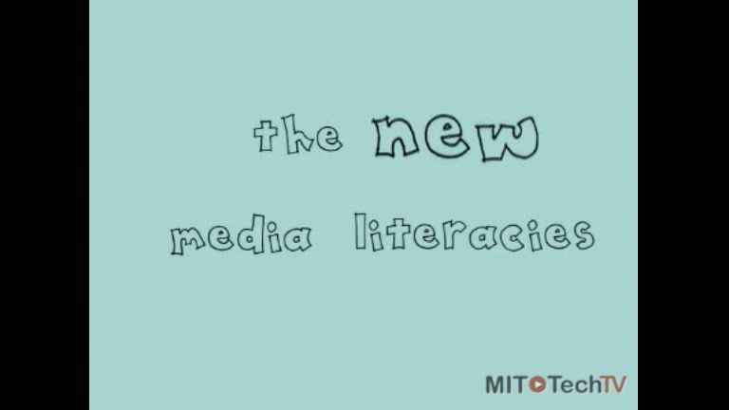
New Media Literacies – MIT Style
Notes:
As you can tell from listening from this movie, there are a lot of variations of the term “literacies” plural. Here they term them “media literacies” – but they really include visual literacy, cultural literacy, and information literacy in their use of the term.

Slide 7
Information Literacy Skills
They are not just skills for the classroom. And they’re not just skills for the workplace. They’re skills that involve creative expression, they’re skills that involve citizenship, they’re skills that connect people together at something larger than the individual level.
Henry Jenkins, MIT
Notes:
As educators – and particularly as language professionals - we must help our students become literate citizens of the world.

Slide 8
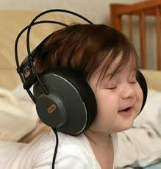

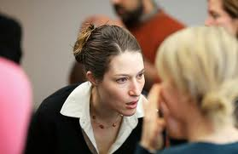

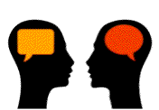

Information literacy & language learning:
Ability to find, retrieve, analyze, and use information in the target language, interpreting it in the context of the target culture.
Notes:
Literacy is expanded in a number of different ways to address specific skill sets - including visual literacy, multimedia literacy, rhetorical literacy. Especially digital information technologies – or new media technologies.
Texts of all kinds.
Listen and interpret

Slide 9
Contextual Factors: The Broad View
“Digital native” students
Education reform, current trends/demands
Second language teaching and learning
Notes:
Now I am going to pull back a bit to situate information literacy in the broader context by looking at our digital native students (who they are and what they expect), what’s happening in education – both in terms of reforms and from the standpoint of current demands on educators, and .

Slide 10
Digital Immigrants and Natives
The single biggest problem facing education today is that our Digital Immigrant instructors, who speak an outdated language (that of the pre-digital age), are struggling to teach a population that speaks an entirely new language. . . . Digital Immigrant teachers assume that learners are the same as they have always been, and that the same methods that worked for the teachers when they were students will work for their students now. But that assumption is no longer valid. Today's learners are different.
Marc Prensky, Digital Natives, Digital Immigrants
http://www.marcprensky.com/writing/
Notes:
The term digital native was popularized by Marc Prensky, a self-described visionary and futurist, and this is what he has to say about digital immigrant teachers and the challenges of teaching digital native students.
One researches (Ian Jukes) uses the acronyms DFL and DSL – to refer to speakers of digital as a first language and digital as a second language.
There is even research (cited in part 2 Prensky’s digital native article) that investigates actual neurological changes in the brains of the current generation. This is based on the notion that cells and connections that are
underused or unused get pruned away. Underutilized neural pathways die off. The neural connections become hard-wired for frequent pursuits that are most used and most useful – for example in areas such as visual memory and visual processing, from the constant bombardment of visual digital information.
A 2005 study found that the average American spends more time using media devices - television, radio, iPods, cell phones, and computers – than any other activity while awake,

Slide 11
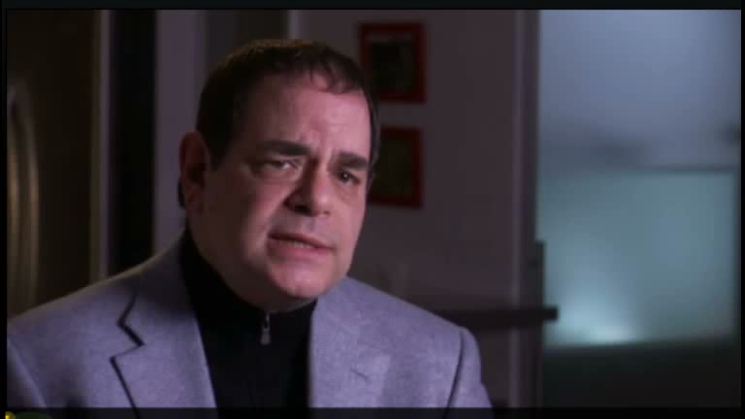
What is a digital native?
Marc Prensky
Frontline: digital_nation – life on the virtual frontier
Aired on PBS, February, 2010

Slide 12
Digital Natives Described
Take technology for granted because they’ve always had it; they seem to be:
  Connected all the time to a world-wide community
  Cyber-sophisticates, who trust technology
Notes:
Let’s return to Prensky’s basic basic description of Digital Natives, which is a fairly commonly held view. Like most generalizations, this view is partly true and partly false.

Slide 13
Connected most of the time?
93% of teens from 12 to 17 go online
83% of 17 year olds have cell phones; 93% of young adults own cell phones
79% of teens have their own digital media devices
69% of teens 12-17 have their own computer
73% of American teens now use social networking sites
38% of online teens from 12-17 are content creators
Data from 2009 survey conducted by the Pew Internet and American Life Project.
Notes:
Yes!
Young adults are people ages
How many of you have rules about what mobile technology students can be using when they’re in your space? (lab, classroom, other) How many of you are aware of your students communicating with the outside world while they are supposed to be engaged in other classtime activities? Outside of class how many students do you see with cell phones to their ears, laptops open, and other mobile devices engage? At Iowa, anyway, the students spend a lot of time connected via mobile technologies. Wireless access is pretty much ubiquitous on campus and in many Iowa City locations, as well. At the Java House those cups of coffee almost always sit next to a laptop or other device.
Mark Bauerlein quotes survey of High School Student Engagement, conducted by the National School Board Association, that reported that high school students spend an average of 9 hours per week on social networking sites and 55% of them spend less than one hour a week reading and studying for class. He points out that it there were good content on those social networking sites, we as educators could tap into these habits to our advantage.

Slide 14
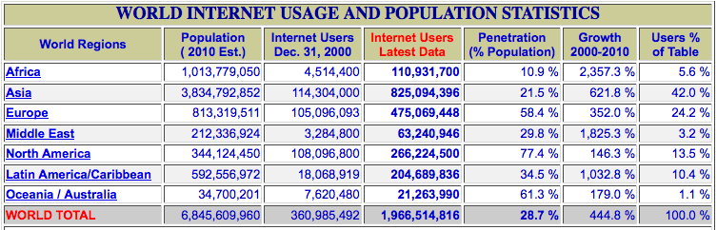
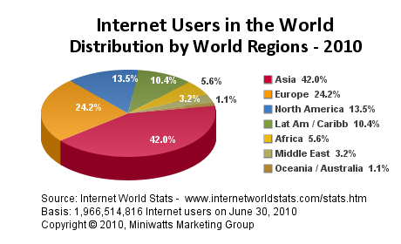
World Community: Internet Usage
http://www.internetworldstats.com/stats.htm
Notes:
From our perspective there is still a digital divide that separates information technology haves and have-nots. There is still a significant digital divide. For example, for the Asian statistics – Of the 36 countries included in the statistical measures, China, Japan and India represent the lion’s share of the usage with 73%. However, only about a fourth of China’s total estimated population are internet users, whereas in the U.S. 75% of the population are users.

Slide 15
Cyber-sophisticates?
Are often inefficient
Are not good at discerning the quality of information they find on the web
Freely download and upload content without much regard for copyright
Have less concern for personal privacy
Notes:
These problems are an indication of how important good Information Literacy training is – despite the fact that our digital natives think they know what they are doing. Inefficient: Example from NPR: Interview with Allison Druin is the director of the Human-Computer Interaction Lab at the University of Maryland headlined “All kids are not computer whizzes.” She did a study of how children look for information on the internet. She found that many children do not have a clue how to refine a search. Some kids, when asked to find out what dolphins eat, thought they could find it on the Miami Dolphins.
According to a report entitled Lessons learned: How college students seek information in the digital age, written by researchers at the Information school at the University of Washington, students tend to think of information seeking as a rote process and tend to use the same small set of information resources regardless of the question they have. The primary sources they use for course work are course readings and Google. They rely on their professors to identify sources for them They use Google and Wikipedia for research about most topics. They tend not to use library services that require interacting with librarians. In addition, they often become frustrated and overwhelmed as the research process progresses and generally tend to do just enough to complete assignments, missing opportunities for exploration, discovery, and deep learning.
So what we as educators must do is guide them toward genuine sophistication in their use of the technology and raise their awareness about best practices.

Slide 16
Changes in Education
Education reform
Educational imperatives
Notes:
So, what’s happening in education? We have distinct movements toward new models of instruction as well as educational imperatives thrust on us by the realities of society and the economy.

Slide 17
Education Reform for the 21st Century
Conventional
  Teacher-directed
  Didactic teaching
  Short blocks of instruction on a single subject
  Individual work
  Teacher as knowledge dispenser
  Ability groupings
  Assessment of fact knowledge and discrete skills
Reform
  Student exploration
  Interactive instruction
  Extended blocks of authentic and multidisciplinary work
  Collaborative work
  Teacher as facilitator and mentor
  Heterogeneous groupings
  Performance-based assessment
From Using Technology to Support Education Reform, a report by Means et al. for the U.S. Department of Education, 1993.
Notes:
http://www2.ed.gov/pubs/EdReformStudies/TechReforms/index.html

Slide 18
Recent Imperatives in Higher Ed
Teach more students
Do it for less money
Respond to
  needs of individual students
  demands of the globalized marketplace
Use technology and a variety of information resources to accomplish the above
Notes:
Sound familiar? Of course, the last imperative has resulted in the hybridization of many first- and second-year language courses, especially in Spanish, where meeting the demand for instruction has become too costly.
Of course, what I would like to emphasize in all of this (and probably many of you do too) is that technology can move us toward new and better paradigms of instruction – not just for the first couple of years, but for all levels of language, literature, linguistics, and culture and our research in these areas.

Slide 19
SLA theories, approaches and issues
Sociocultural Theory
Associate-Cognitive CREED
pragmatics
Processability Theory
Universal Grammar
interlanguage development
Input Processing
Complexity Theory
feedback
learner characteristics
Autonomous Induction Theory
Language Socialization
Systemic-Functional
motivation, beliefs
Skill Acquisition Theory
Interactionist Theory
Concept-Oriented Approach
Conversation Analysis
critical period
Notes:
The language landscape is cluttered with differing views and emphases. Cognitive Linguistic Approaches: Universal Grammar, Autonomous Induction Theory, Concept-Oriented Approach, Processability Theory, Input Processing, Interactionist
General human learning: Associate-Cognitive CREED (Construction-based, Rational, Exemplar-driven, Emergent, and Dialectic); Skill Acquisition
Approaches to Language in Social Context: Sociocultural, Language Socialization, Conversation Analysis, Systemic-Functional, Complexity Theory
And a whole raft of other aspects of sla that are of interest and have been researched.
While we often think of these as being related solely to language learning, language learning does not stop with those entry level courses, but continues through any coursework in advanced language, literature, linguistics, translation, language for special purposes, civilization or culture. They can and ideally do influence our pedagogy at all levels. The point I always like to make in regard to the variety of deeply held beliefs about how things happen or are best done, is that technology can assist in any of the applications of these theoretical domains or research on them and for any kind of course involving the students’ second language.

Slide 20
The “Big Picture”
The need to educate an information literate population
Digital natives: their skills and expectations
Education reform
Changing realities and expectations of educational institutions
Current trends in language pedagogy, changes prompted by SLA research
Notes:
In the face of all of these things, we are being seriously challenged to change our mode of operation. ( Or how do we make lemonade from these realities and pressures that are the lemons of our existence.)

Slide 21
Fundamental changes
Instructional goals
Class time
Time outside of class
(Assessment)
Notes:
We are being challenged to change in fundamental ways and we can't be afraid of it:
Fundamentally change what we teach and how we teach it
Michael Wesch: There is something in the air, and it is nothing less than the digital artifacts of over one billion people and computers networked together collectively producing over 2,000 gigabytes of new information per second. While most of our classrooms were built under the assumption that information is scarce and hard to find, nearly the entire body of human knowledge now flows through and around these rooms in one form or another, ready to be accessed by laptops, cellphones, and iPods. Classrooms built to re-enforce the top-down authoritative knowledge of the teacher are now enveloped by a cloud of ubiquitous digital information where knowledge is made, not found, and authority is continuously negotiated through discussion and participation.
Our instructional goals must change (no one can know everything or even come close, so we should stop fronting acquisition of factual knowledge as the primary goal)
Change what we do in class
Change what we ask the students do outside of class
All these things lead to changes in how we will assess our students.

Slide 22
Instructional Goals: move from knowledge to knowledge-able
Focus on how, not what:
  Skills and strategies
    How to communicate
    How to cope, to bootstrap, observe
    How to look for, evaluate and interpret/analyze information
  Practice (DeKeyser: Skill Acquisition Theory)
Notes:
Kansas State University professor Michael Wesch calls this change from knowledge to knowledge-able. (HOT = Higher Order Thinking Skills (active learning – immediate application, practice by doing) LOT = Lower Order Thinking Skills (passive learning through hearing or reading). We can talk about this from several angles and I have a couple of examples that will illustrate a shift away from a focus on “what” toward a focus on “how”
In his article “Understanding Digital Children,” Ian Jukes talks about a “21st Century kind of content”: critical thinking, problem solving and the structured teaching of process skills, combined with personal life skills, interpersonal life skills, team skills, communications skills, information fluency skills, technology fluency skills, visual fluency skills, biotechnology and bioethics skills. We can’t do it all – we have to get rid of some of what is not as important as it was when we went to school to make room for teaching our digital native learners the skills they need for their future lives. (pp. Palfrey and Gasser echo this sentiment in Born Digital: Our children find information in digital formats and are processing it in ways that those who came before them could only have imagined. This information is sometimes surrounded with far less context than in the past, while at other times, it is surrounded by far more. Our challenge is to help them make sense of these new contexts and new meanings, and to think synthetically and critically, rather than letting them lose their way. (p. 253)
We can’t possibly teach students everything in the amount of time that we have with them. So, it’s not a matter of teaching content - facts and information – and assessing recall of that content, but rather teaching how to learn – how to communicate, to observe, to evaluate and to interpret. This is especially true when they are in contact with people from other cultures. This is also how we prepare life-long learners - life-long learners who are true cyber-sophisticates, able to interact with people in other cultures in other languages.
You can’t get good at language or at the skills listed above without practice. Robert DeKeyser’s Skill Acquisition Theory – talks about three knowledge constructs: declarative knowledge (rules or knowledge that), procedural knowledge (knowledge how) and automatization (the result of a gradual improvement in performance in terms of speed, error rate and effort), the importance of practice in proceduralizing declarative knowledge and in the eventual automatization of procedural knowledge (and to some extent in establishing the robustness of declarative knowledge).
Practice: Activities engaged in repeatedly with the goal of becoming better at them. Often called deliberate practice to emphasize this goal-orientedness as opposed to the incidental nature of practice that comes with activities engaged in frequently for work or personal routines. When I learned Latin and Spanish, first with the Grammar Translation method, and later in college Spanish with the Audio-Lingual Method, which is how I taught Spanish all those many years ago, practice was a whole lot different from what it is or should be today, when communicative language instruction is more prevalent. With different emphases naturally come different kinds of practice.

Slide 23
Class time
Less teacher talk/lecturing
More group interaction and exploration
Information technology available to both teacher and students
Notes:
This view of class time reflects a move toward a more student-centered, active learning model of instruction, where there are many opportunities to collaborate and create – to practice learning content and to practice communicating in the language. The teacher role combines aspects of instructional designer, orchestrator/director, mentor, and assessor. Class spaces by and large need to be different from what most of us are familiar with. At the University of Iowa, there is an initiative to build so-called TILE classrooms, TILE standing for: Transform, Interact, Learn, Engage. The TILE classrooms will be flexible spaces with furniture and technology set-up to enable both small group work with 2-3 students or slightly larger group work with 5 or 6 students or whole class interaction. Our campus is following the lead of Minnesota, MIT, and North Carolina, so think multiple plasma screens, moveable chairs, round tables, digital whiteboards, along with an Instructor podium.
You may think that this is hard enough to imagine for language learning, let alone for classes that are traditionally lecture-centered – literature classes, linguistics, civilization, etc. So, let’s try this on for a real literature class…

Slide 24
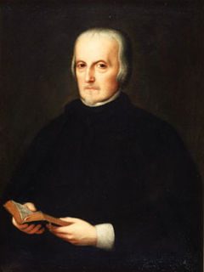
La vida es sueño
Resources:
  A copy of the play La vida es sueño Available free online through http://www.donquijote.org/SpanishLanguage/literature/library/teatro/vidasue/vidasue.pdf
  Internet, multiple computer screens, moveable tables, networked laptops
Learning objectives:
  Demonstrate a deeper understanding of the Golden Age drama in general and of the work, La vida es sueño, in particular.
  Increase oral and written proficiency in the target language, Spanish.
  (Re)assemble and interpret a well-known cultural text, the soliloquy of Seguismundo, a cultural text comparable to Hamlet’s To be or not to be.
  Explain the socio-political and historical context of Calderón de la Barca’s literary pieces and his contemporary audience(s).
  Describe the characters involved in the play, to select contemporary actors for a new interpretation of the play and to defend the selection.
Lesson author:
Elizabeth Deifell, FLARE SLA doctoral student
University of Iowa
Notes:
Here’s a scenario for in student-centered, technology-assisted class on Calderón de la Barca’s play La vida es sueño, the second day of 4 75 minute class periods dedicated to this work in a course on Spanish Renaissance and Golden Age Literature. Elizabeth Deifell, one of our Second Language Acquisition doctoral students recently put her mind to this question in thinking about the possibilities for Iowa’s TILE classrooms.

Slide 25
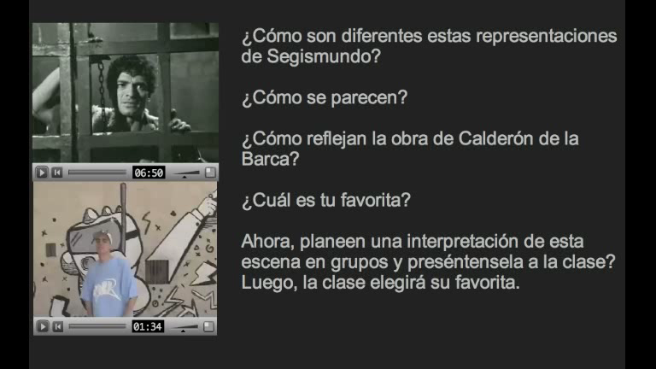
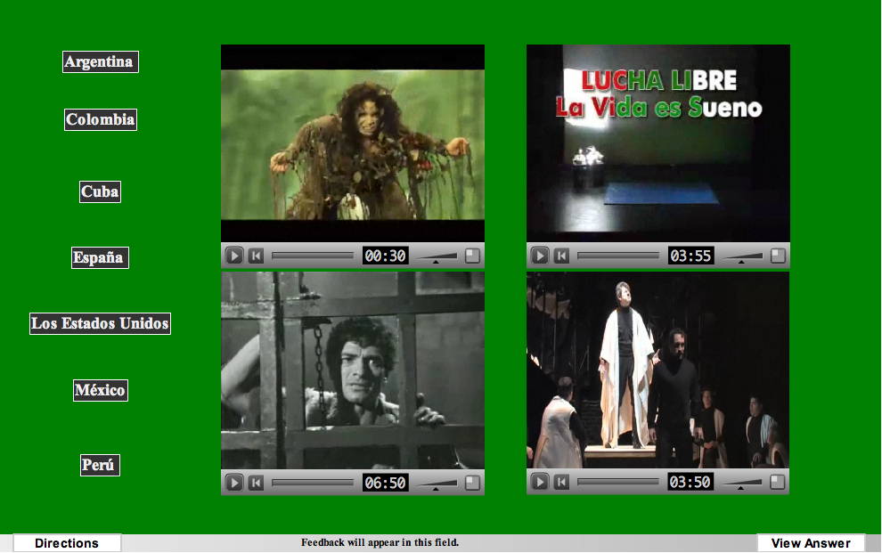
Plan
Before first class:
  Finish reading the play
  Complete online activities:
    vocabulary
    grammatical structures
    background on Calderón de la Barca and the historical period
In class:
  Instructor-led whole class discussion of characters
  Contest between teams: Who said that? (teacher controller computer prompts, answers via clickers or Twitter)
  Recrafting Segismundo’s Soliloquy- groups work with online exercise to unscramble the parts of the famous Act 2 soliloquy
  Where in the world? Students view and discuss videos of various productions of the play (where they are from, which they’d prefer to see)
  Example 1 Example 2

Slide 26
Plan continued…
  Whole class discussion: How does a play differ from other genres?
  Who would you cast? Student teams discuss and upload their decisions for display to the whole class for follow-up discussion and vote.
  Storytelling: Students teams reconstruct the story and post their synopses; can use the online text and internet resources to help, if necessary.
  Whole class discussion about “good” and “bad” kings
  Teacher mini-lecture on the concept of honor.
After class:
  Groups produce collaboratively written “lecture notes” and post them to the class wiki
  Individuals write postings to a discussion about how they would produce the play, given unlimited resources.

Slide 27
75 minute class period:
Student group work: 45 minutes
Class discussion (teacher led): 25 minutes
Teacher lecture: 5 minutes
Technology in play for: 50 minutes
Significant practice with information resources and tools
Notes:
The Promise here Is more active learning, better student engagement, working on critical thinking and analysis skills.
The Predicament here is, of course, radical redesign of existing curricula. Not everyone is willing or prepared to take this path.

Slide 28
Practice outside of class
(CALL exercises)
Podcasts
YouTube
Blogs
Public discussion forums
Wikis
FaceBook
Web research
Concordancers/corpora
Creative projects
Virtual worlds (e.g., Second Life)
Chat, IM, Skype
Twitter, texting
Games
Notes:
In no particular order, here are just a few of the out-of-class use of students’ time – most of them requiring a certainly level of information literacy on the part of both the student and the teacher.

Slide 29
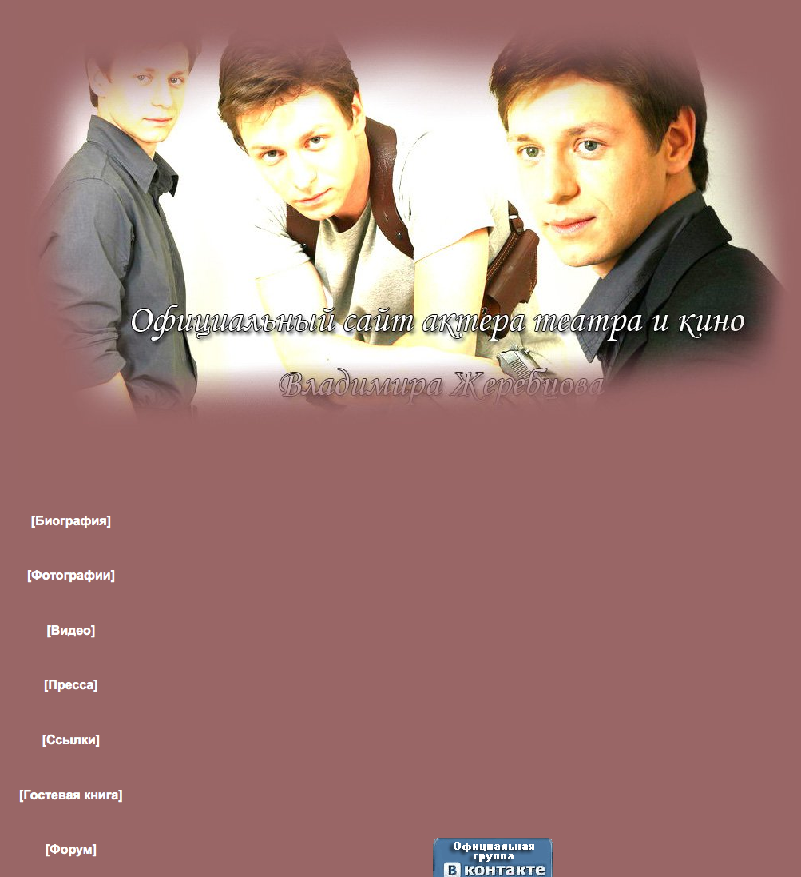
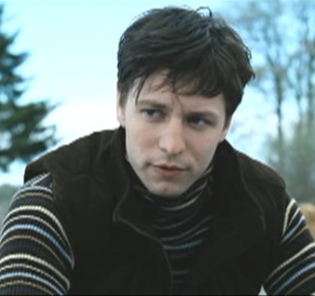
Russian Language in Context
Advanced Russian students
Project on Vladimir Zherebtsov
  Popular actor: http://zherebtsov-vladimir.narod.ru/index2.html
  Forum: http://zherebtsov.borda.ru/
  Main tasks:
    Visit website and gather personal information to answer questions.
    Explore and find out information about the forum; register.
    Students read recent postings for 3 discussion threads, write 1-2 posts per thread, monitor responses to their posts, document their forum activities.
    Culminating reflections: differences between this forum and US forums; thoughts on the various tasks; what students learned/gained
Lesson author:
Lyudmila Klimanova, FLARE SLA doctoral student
University of Iowa
Notes:
Language in Context: Practice in reading, writing, listening, and speaking using a variety of authentic materials from contemporary sources, such as on-line magazines and newspapers, films, interviews, and letters. Emphasis on building vocabulary and comprehension of complex grammatical structures. A one-week project on Vladimir Zherebtsov. Can work individually or in teams of 2 (but not more than 2) – and teams can’t compare their work. In class they watched and discussed an interview with the actor and watched a clip from his movie Вернуть Веру (Faith Restored). Also, during that week, in class they discussed (in Russian) technology and internet use (the chapter in V-puti: Russian Grammar in Context), worked on new vocabulary in conjunction with this topic, had role plays (e.g. "your computer is out of order, explain the problem, and ask a friend to help you fix it"). We also watched a video clip and discussed "online dating".
The Promise of this is engaging in authentic interaction with members of the other culture; communication across linguistic, geographical and cultural borders.
The Predicament is that this is not as easy to implement as we would like. There are many issues to consider: differences in cultural behaviors/practices with technology, participation norms (regulation of the discussion), identities. Among the problems that arose, Lyudmila reported that the Forum monitor became alarmed when this bunch of unknowns showed up. (Their Russian was impeccable, but they weren't really accepted. – Needed a different approach to becoming a participant in the community. Also, it was not easy for the teacher to follow everything the students did in the forum. There was not easy way to search for them, so she had to scan through everything to find their postings and also rely on their reports of their activities. And, in the final analysis, not all students were keen about this assignment and virtually none of them stayed with the forum after the assignment was over. We are going to have to gain a better understanding of communication in the global arena. As Hanna & de Nooy state in the introduction to their book Learning Language and Culture via Public Internet Discussion Forums, The Utopian discourse of the borderless world predicts that ease of communication through shared technologies will erase cultural difference. Studying intercultural Internet exchanges gives the lie to this myth.” p. 15

Slide 30
Up and Down Sides
Students explore/participate in authentic fan forum
  Culturally authentic environment
  Authentic language use
  Interaction with Russian native speakers
  Exposure to Russian pop culture
Student acceptance not immediate
Some students not interested/not engaged
Difficulty in tracking participation (teacher)
Notes:
Cultural literacy skills more important here than language skills. It’s like when you’re the new kid on the playground and you’re not quite sure how to join in the games with the other kids.

Slide 31
Closing thought…
Language is changing around us, and so is our culture of literacy, but that is what languages and cultures always do. What we need to attend to are the fundamental principles that have linked language, technology, and cultures of reading and writing for centuries, that surface in new guises with every new technology that comes along, but that are nevertheless grounded in a common semiotic substrate. In language teaching, an emphasis on analysis and thinking in a literacy-based approach can help prepare our students not only to use, but also to assess critically, new multimodal forms of expression as they continue to evolve.
Richard Kern (2006)
Language is changing around us, and so is our culture of literacy, but that is what languages and cultures always do. What we need to attend to are the fundamental principles that have linked language, technology, and cultures of reading and writing for centuries, that surface in new guises with every new technology that comes along, but that are nevertheless grounded in a common semiotic substrate. In language teaching, an emphasis on analysis and thinking in a literacy-based approach can help prepare our students not only to use, but also to assess critically, new multimodal forms of expression as they continue to evolve.
Richard Kern (2006)

