Slide 1

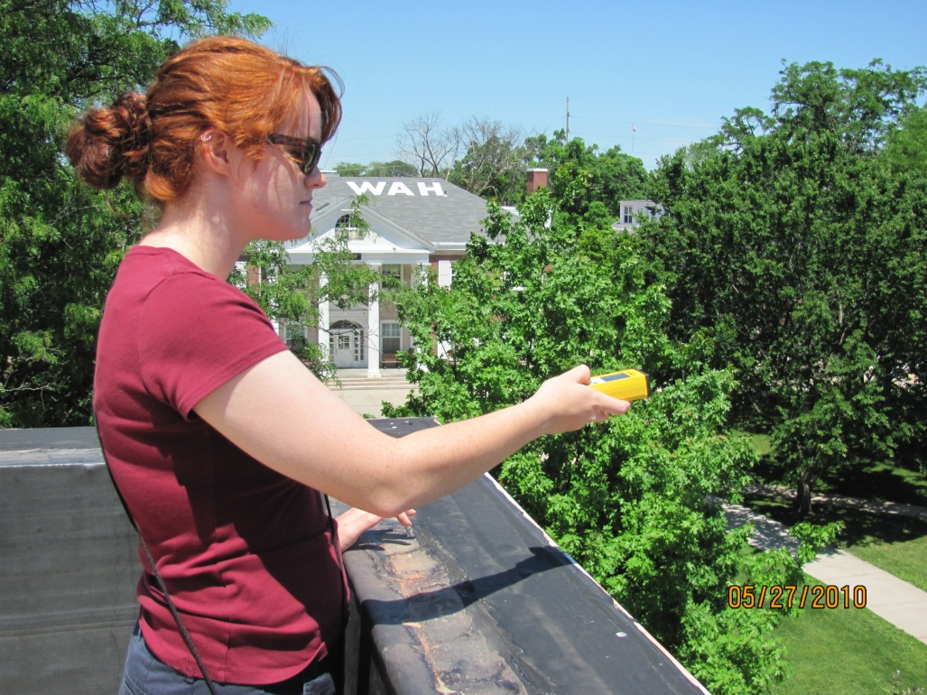
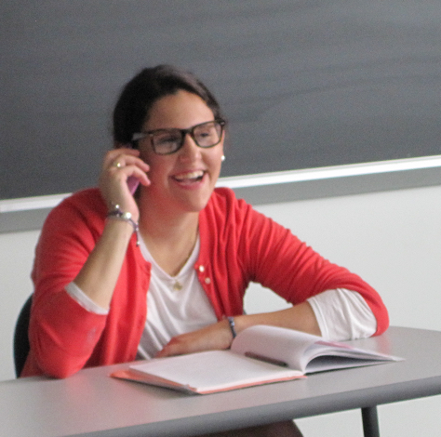
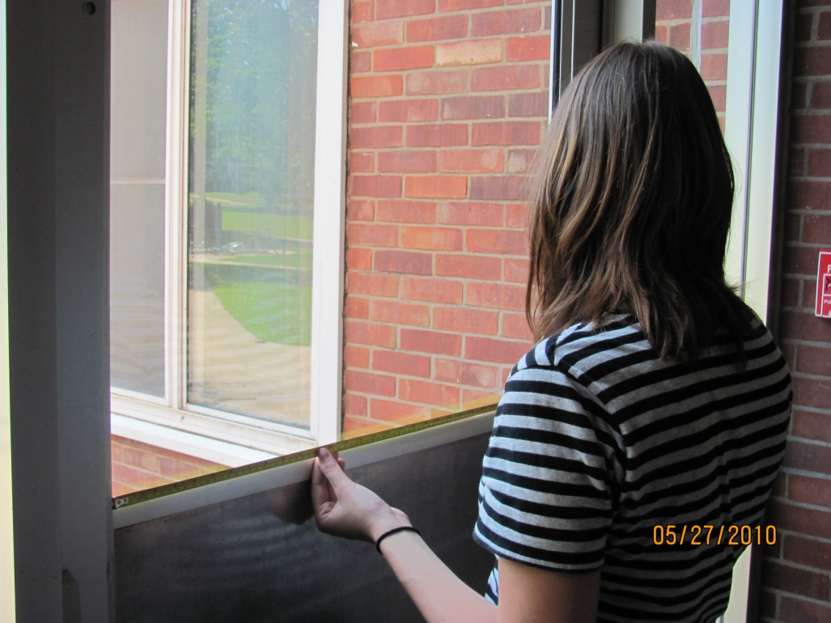
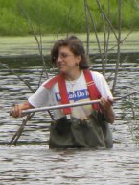
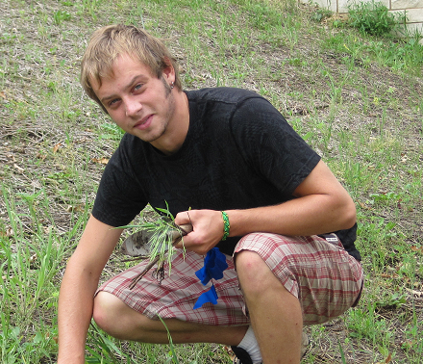
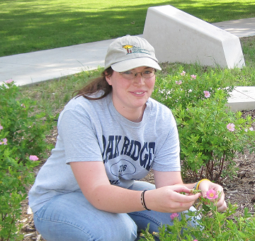
The Beloit College Sustainability Fellows Program:
A College and Community Collaboration
Yaffa L. Grossman
GOALS
Engage students in sustainability activities on the
Beloit College campus and in the community
Design, implement, evaluate sustainability projects
Enhance ability of sites to achieve sustainability goals
Practice community-based learning
FORMAT
Eight-week summer program
Five sites, two on the Beloit campus, three in the
community
Six students, three faculty mentors
Weekly Sustainability Seminar led by Yaffa Grossman,
Director of the Sustainability Fellows Program
Weekly Liberal Arts in Practice Workshop open to all
interns living on campus, led by Carol Wickersham,
Director of Community-based Learning at Beloit
College, and Tammie King, Program Director,
Community Action, Inc.
Funding provided by Beloit College, Margaret A. Cargill Foundation,
Natural Land Institute, and THRIVE.
PARTICIPANTS AND PROJECTS
Bushel and Peck’s Local Market
Regina Willensky is helping to create and market local food products.
Nygren Wetland Preserve
India John is helping to manage a restored wetland.
Welty Environmental Center
Jessica Buchberger is designing and running environmental education programs for children.
Beloit College Physical Plant
Grace Kellogg and Sierra Anseeuw are conducting energy audits on campus buildings. “Window measurements are a big piece of the energy audit puzzle.”
Beloit College Science Center
Nathan Whitley is examining the establishment of a newly planted oak savanna on the Beloit campus and studying the growth rates of several prairie species.

