Slide 1
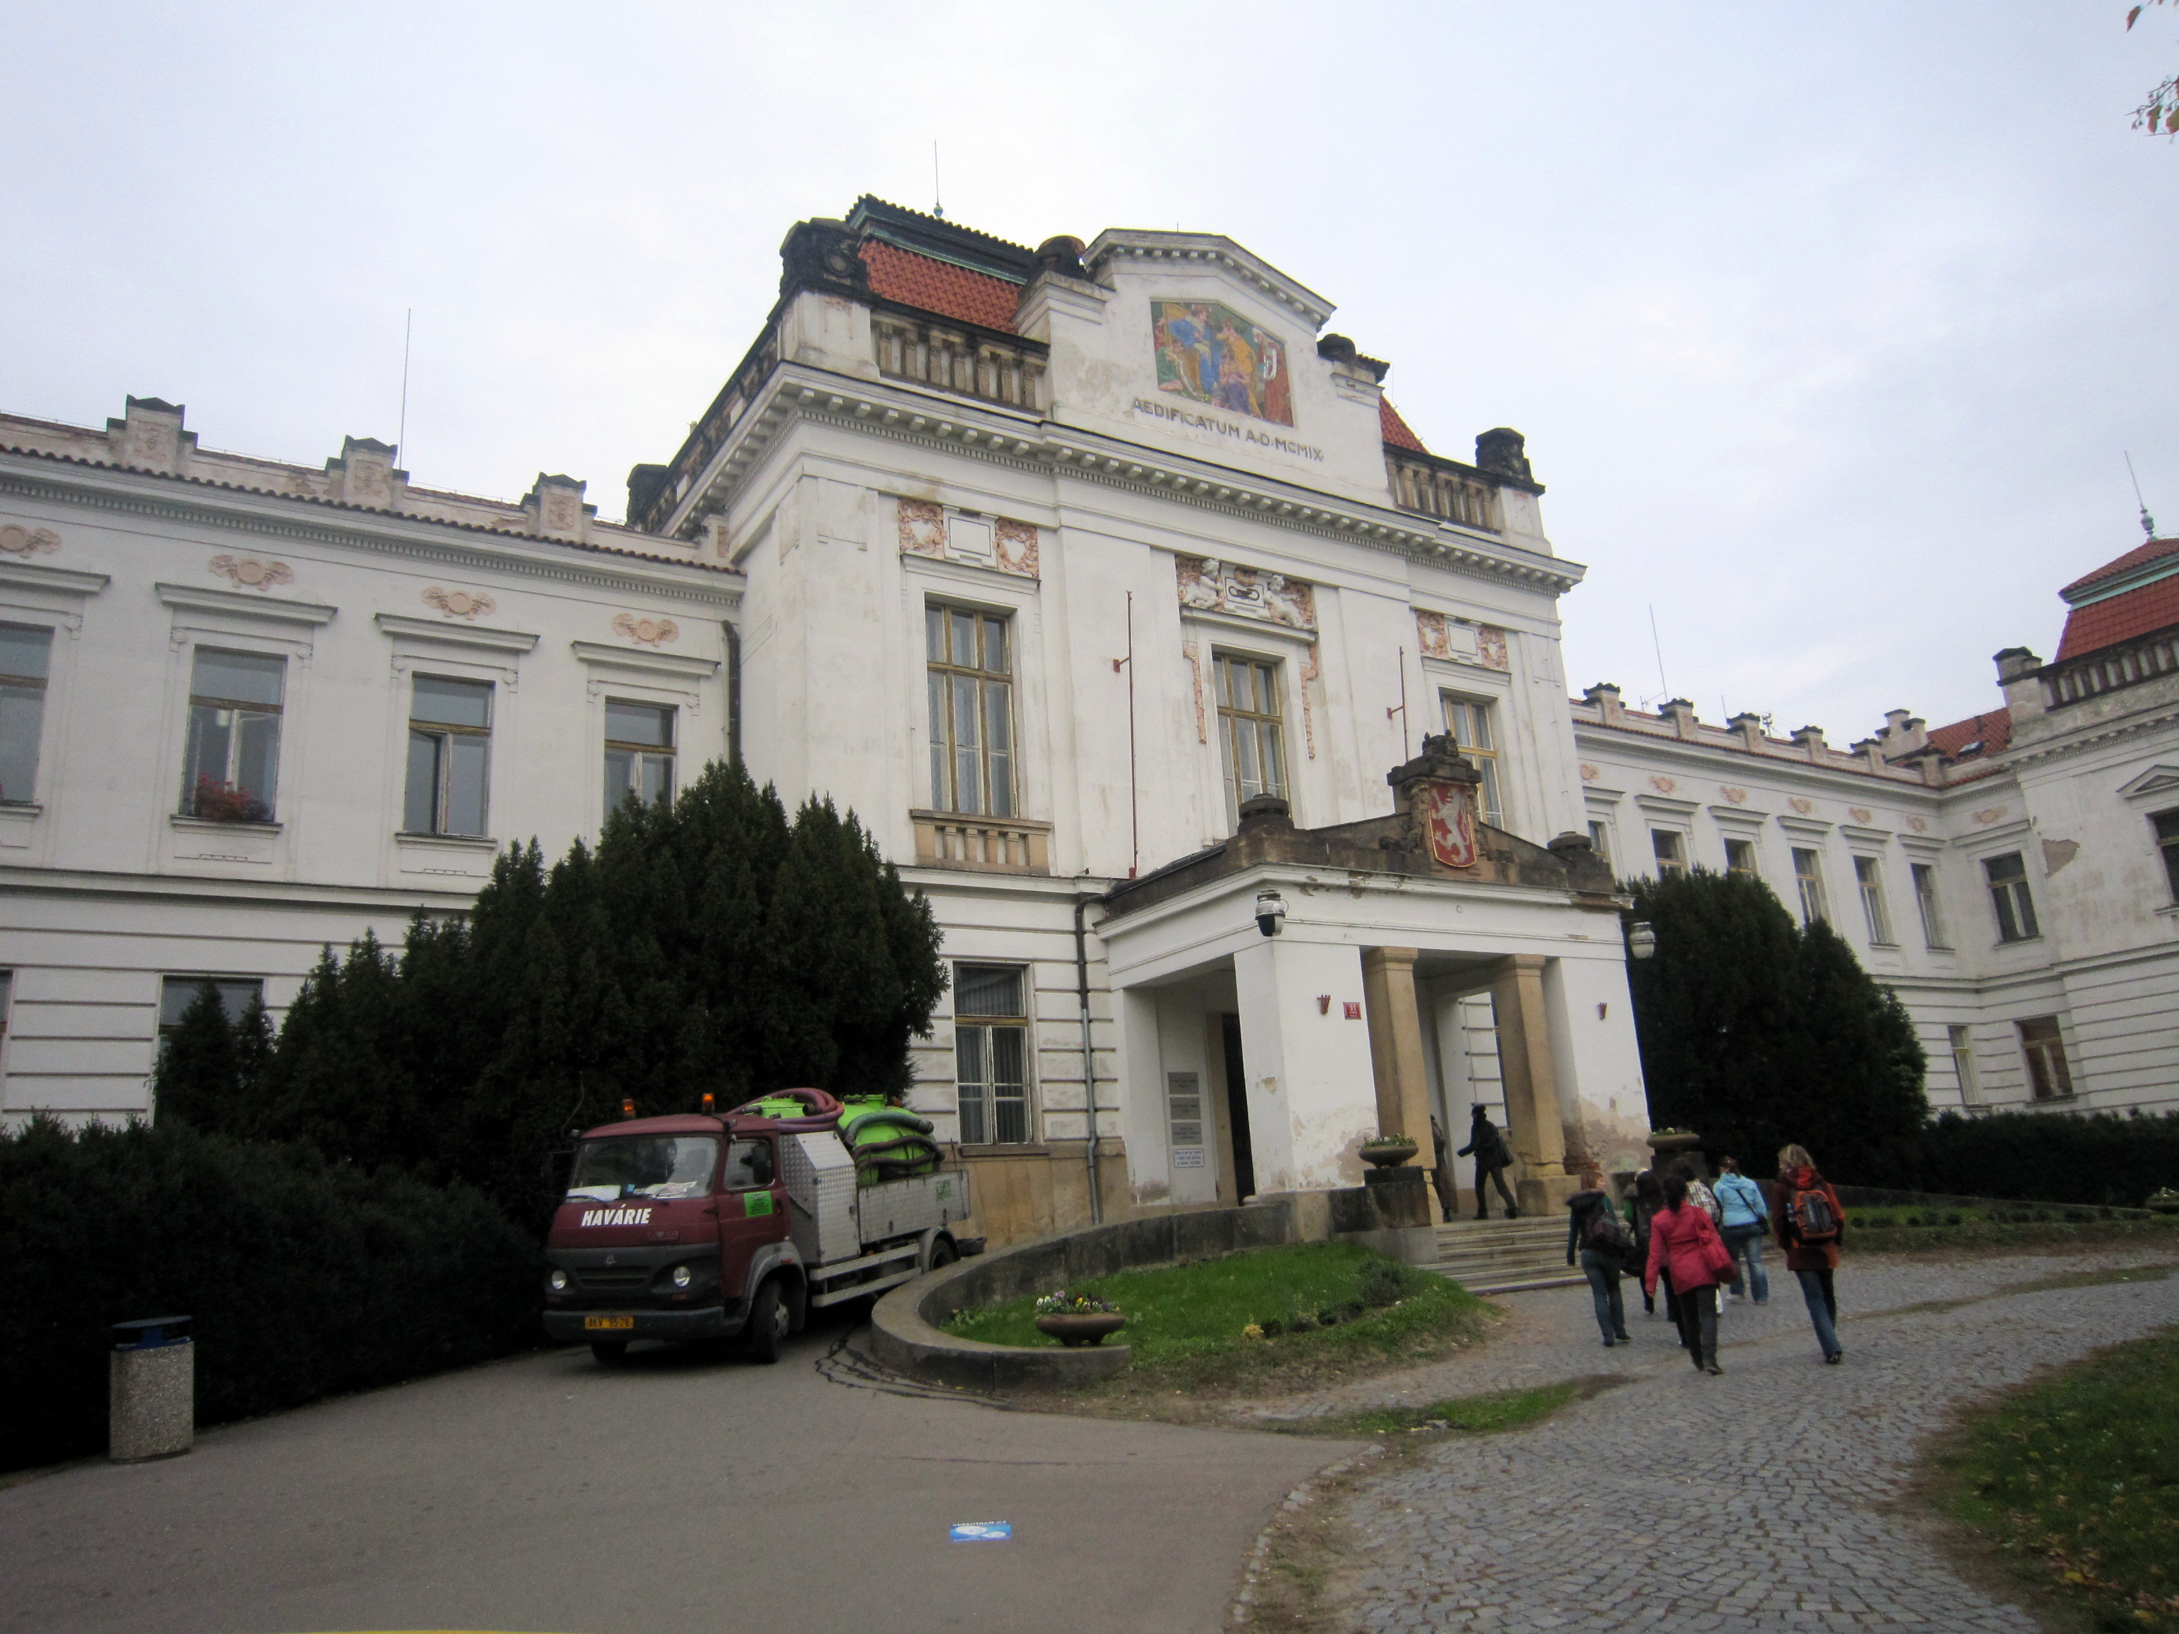
Leading and Directing an Off-Campus Studies Program in Psychology
Ken Abrams
Carleton College
June 3, 2011

Slide 2
Making Connections
Via the Web
  Psych dept website of main university in host country
  Literature review using host country as a search term
On Campus
  Director of Off-Campus Studies
  For interdisciplinary programs, faculty from other depts
Networking within professional organizations
  NAFSA: The Association of International Educators
  IACCP: Int’l Association of Cross-Cultural Psychology
  SCCR: The Society for Cross-Cultural Research

Slide 3
Scouting Trip
Meet with Psychology Faculty
  “Snowball” approach
Meet with Potential Host Organizations
  Student (and faculty) housing
  Excursion transportation and hotels
  Local professors to teach non-psychology courses
Evaluate Potential Excursion Sites

Slide 4
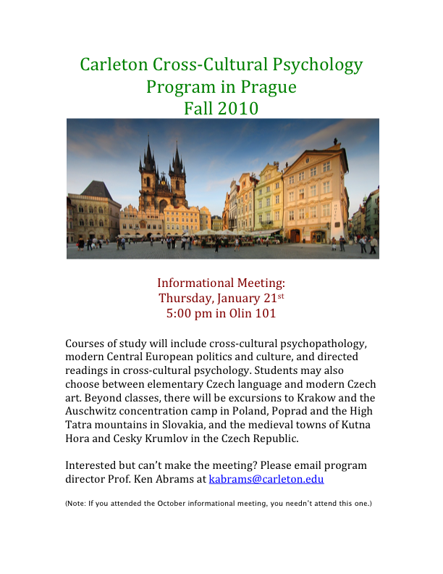
Student Recruitment
Website
Flyers / Brochures
OCS Fairs
Information Meetings
Email
Post-Application: Group Mtg

Slide 5
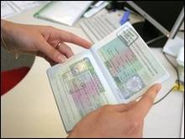
Pre-Departure
Contact Alumni
Visa Issues
Health Insurance
Orientation Meetings
  logistical / practical information
  vocabulary
  map assignments
  goal setting
  student interaction (creating a sense of community)

Slide 6
Directed Readings Course
Assigned Readings
  Crazy Like Us (Watters, 2010)
  Culture and Mental Health (Eshun & Gurung, 2009)
Open-Ended Questions
  How may well-intentioned Western psychologists who overlook cultural factors do more harm than good?
  What additional evidence, if found, would support or contradict Ethan Watters’ arguments?
Week 1 Exam

Slide 7
Cross-Cultural Psychopathology:
Broad Themes
To what extent are mental illnesses such as depression and schizophrenia universal vs. culturally specific?
Do “culture-bound syndromes” exist? How similar must syndromes be to be considered the same?
What are the treatment implications of cultural relativity for psychopathology?

Slide 8
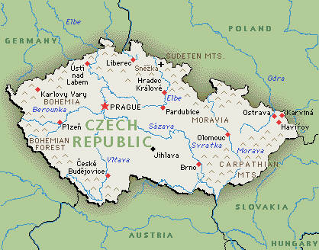
Cross-Cultural Psychopathology:
Country-Specific Themes
The fall of communism and rise of eating disorders
Involuntary commitment as a political tool under communism
The assessment and treatment of sexual offenders
The treatment of individuals with GID

Slide 9
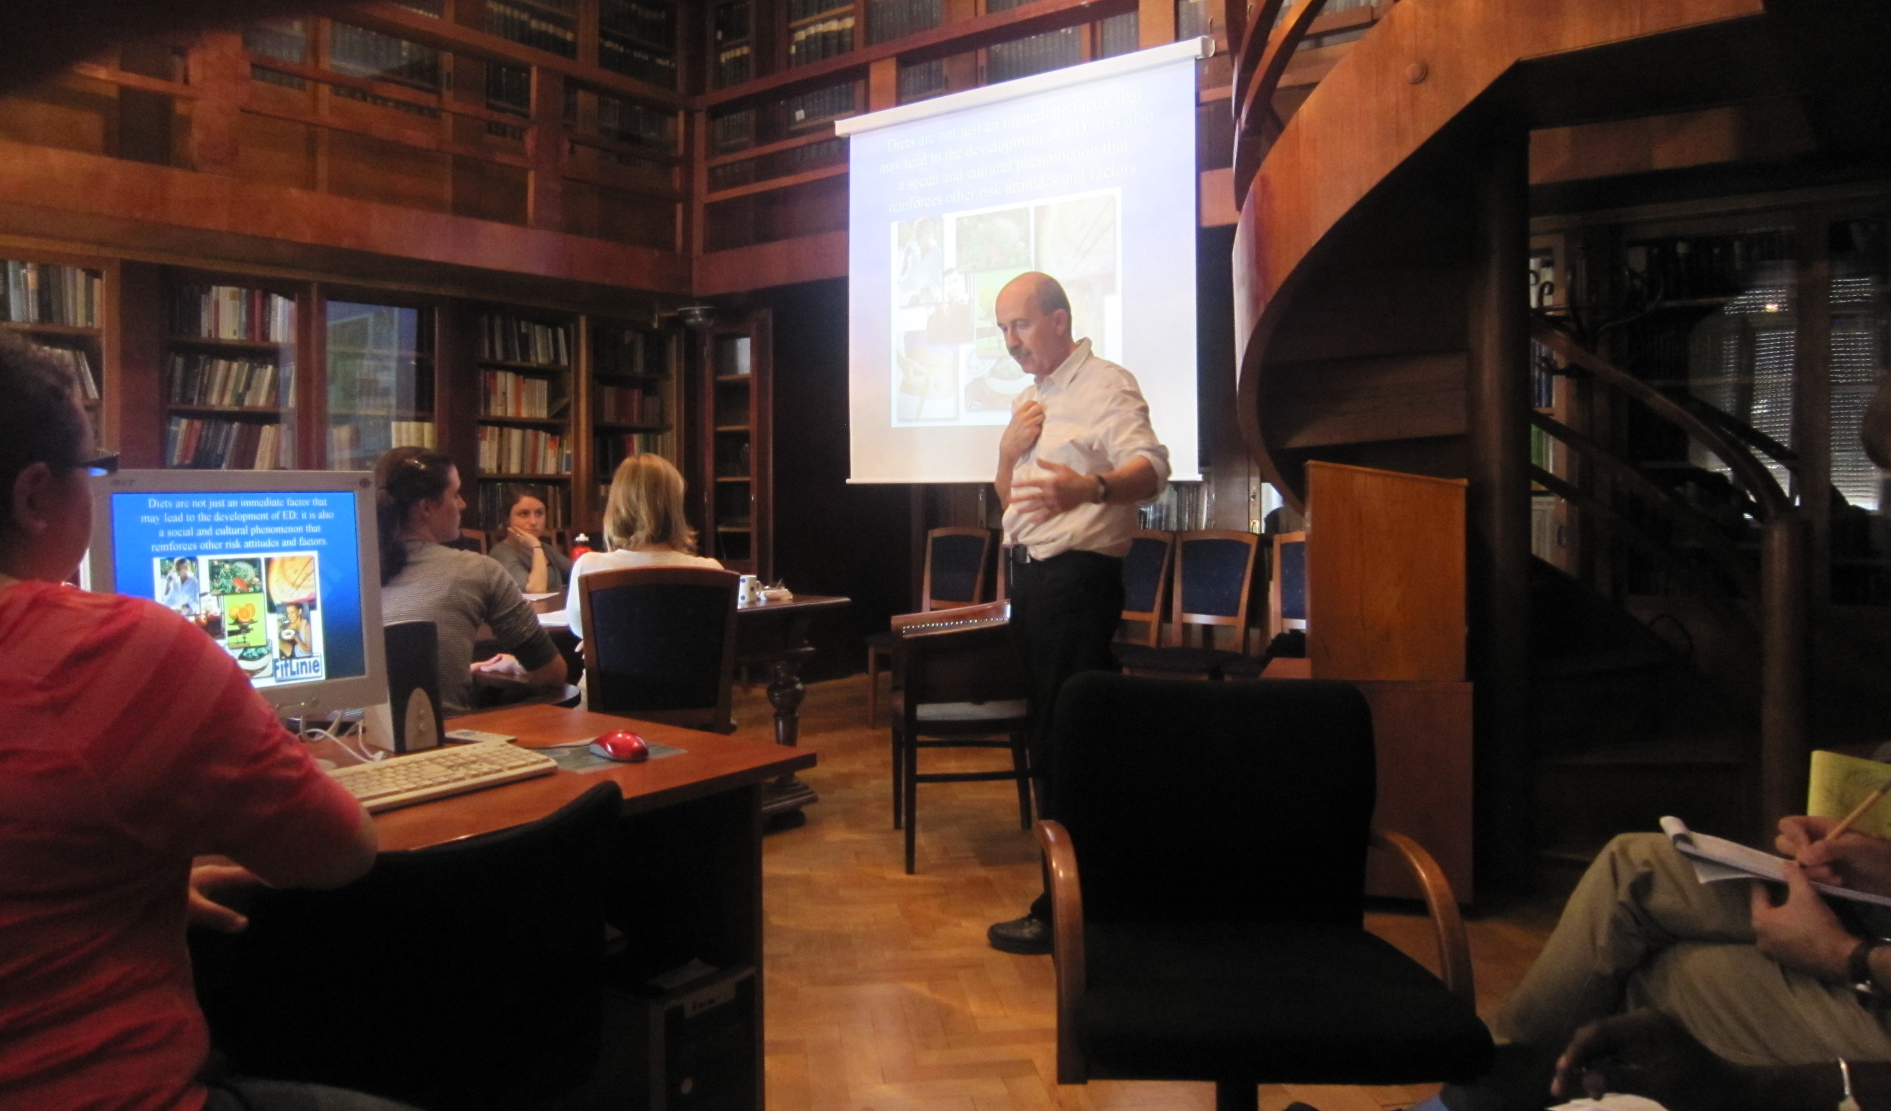
Visits to Psychiatric Clinics
Eating Disorders Unit (patient with anorexia)
Sexual Disorders Unit (patients with GID)
Bohnice Psychiatric Hospital (sexual offenders)
Private Practice (assessment of paraphilias)

Slide 10
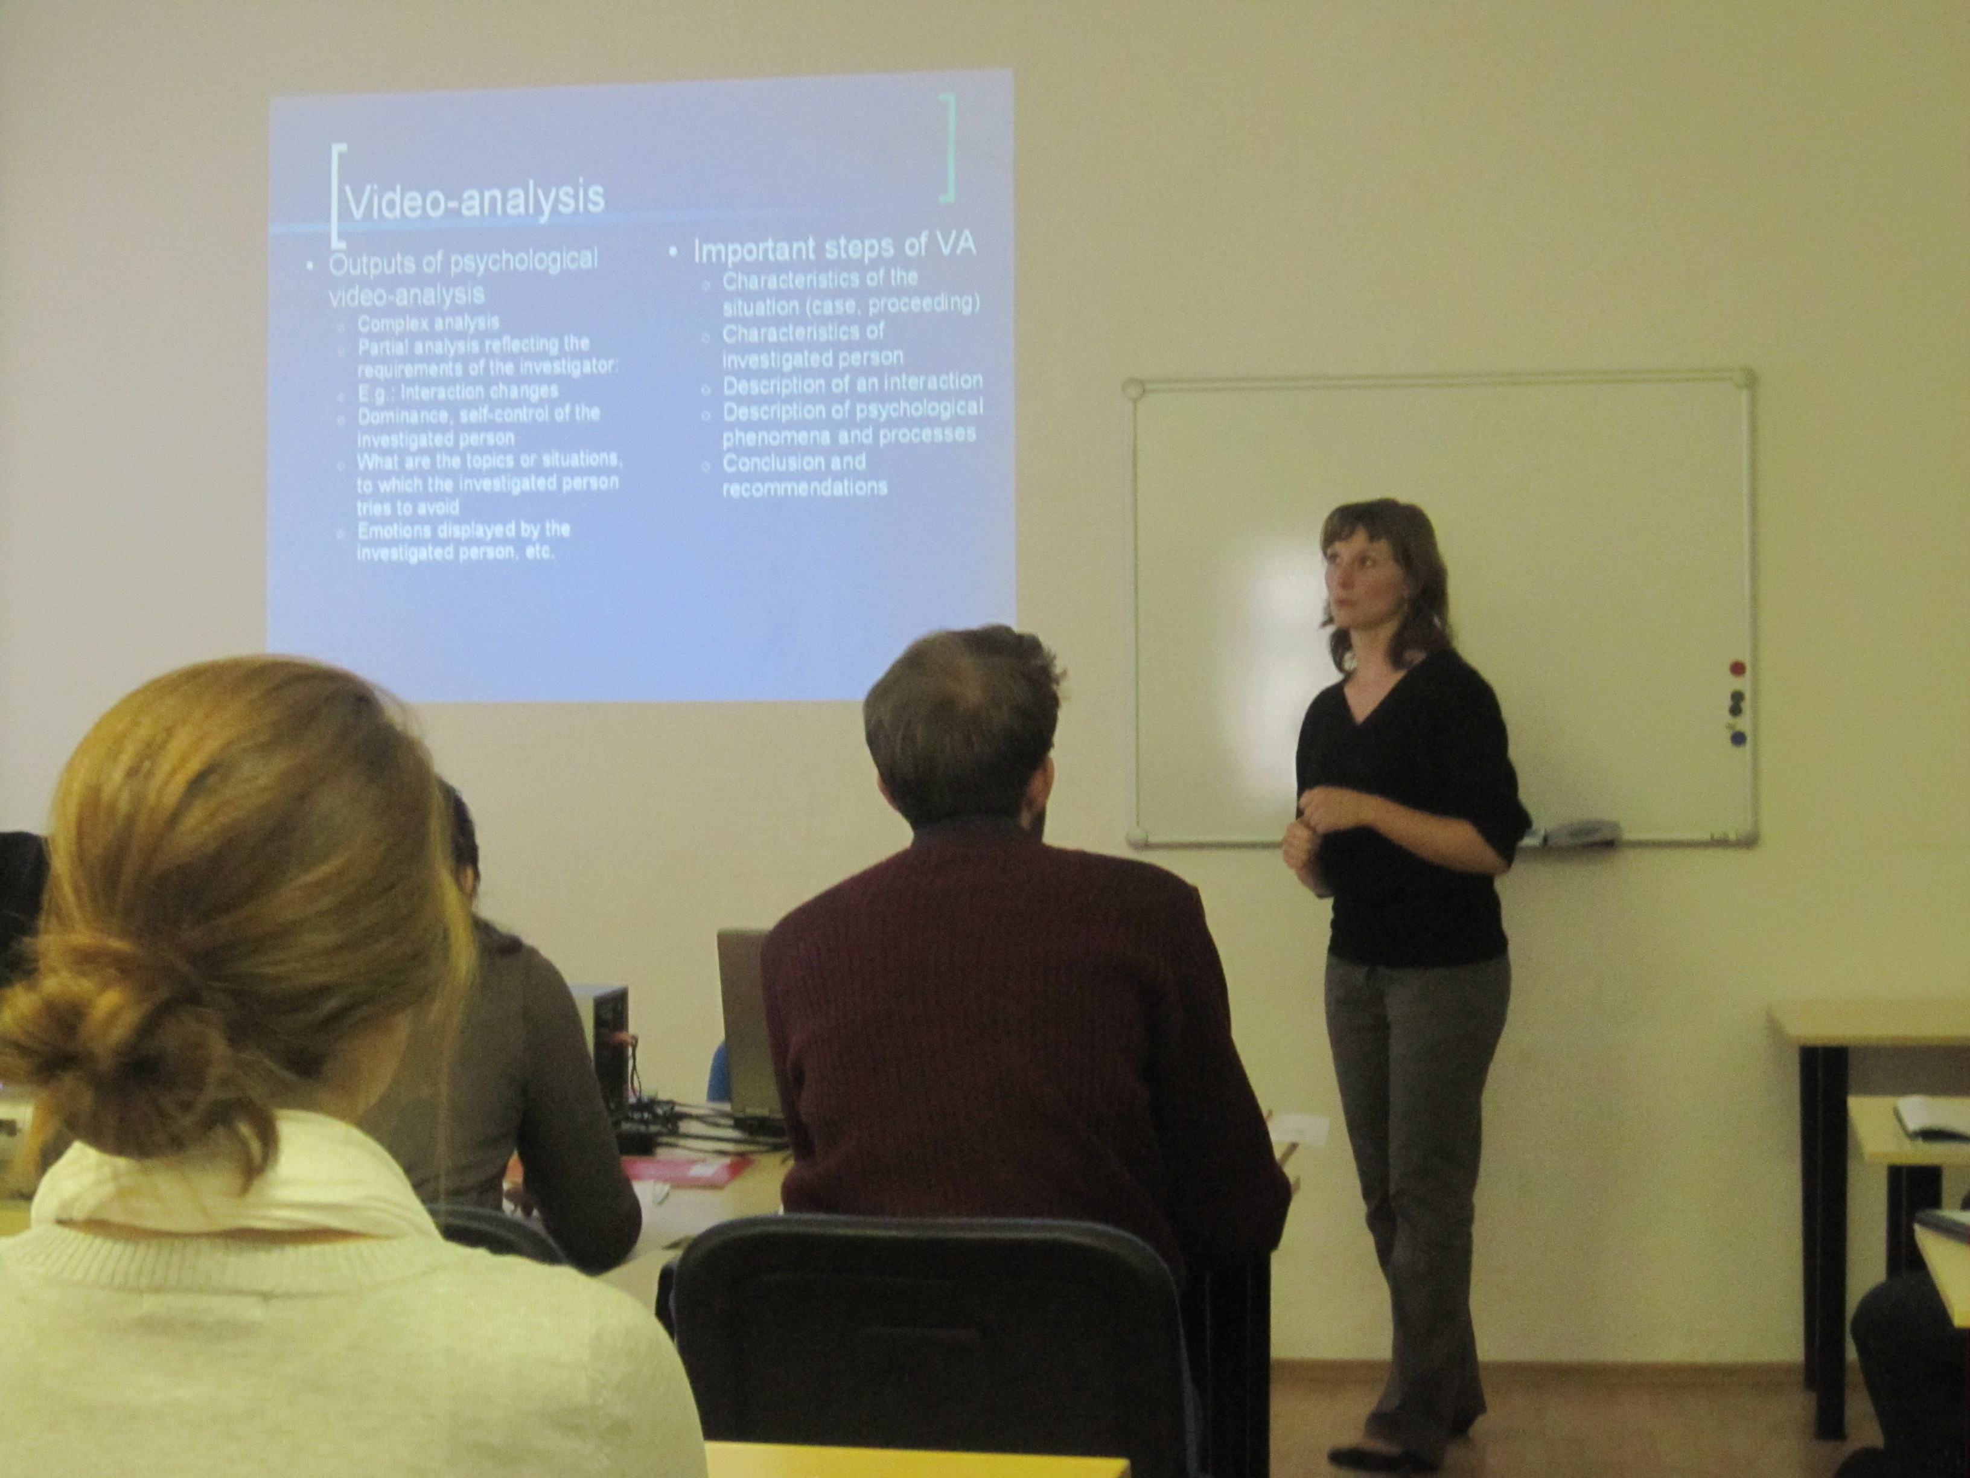
Guest Lectures
Professor of “Sexuology”
Professor of Forensic Psychology

Slide 11

Other Program Components
Non-Psychology Courses
  Central European History
  Modern Art & Architecture
  Czech Language
Extracurricular Activities
  Film nights
  Athletic events
  Castles and museums
Excursions
  Historical towns
  Hiking

Slide 12
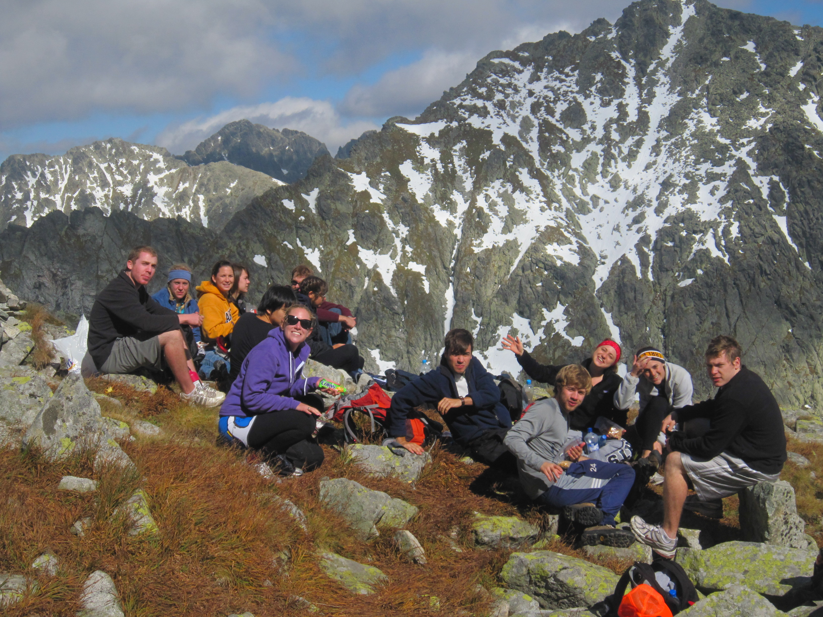
Web Site
Blog For Friends and Parents

Slide 13


Post-Program
Program Assessment
Reunion!

