Slide 1

Culture Shock
as a Foundation for Learning
A European Perspective on Internationalizing Psychology
A European Perspective on internationalizing Psychology Education.

Slide 2
Content of presentation
Offering a European Perspective on our students and their psychological ”somewhere” in order to reflect on optimal ways of internationalizing psychology education.
Psychology as culturally embedded and defined
Crash course on Danish cultural characteristics
Entering a Copenhagen classroom: What are the greatest challenges and benefits of becoming an internationalized student?
To reflect on what are the most important skills for our students to acquire during their psychology studies.
Questions and debate. Would love to hear your uncensored thoughts.

Slide 3
Background
Faculty at the Psychology department at the Danish Institute for Study Abroad, Copenhagen, Denmark (DIS). A program for American undergraduate students primarily from more or most selective US colleges and universities.
A Dane. Born and raised in the odd country. Background in Educational Psychology. Specialized in Positive Psychology and its validity and applicability in 3. world war-torn context; Uganda.
Teaching American undergraduate students (n: around 450) in a Copenhagen classroom
Culture shock as a Foundation for Learning.

Slide 4
Data
Experiences, study tours, papers and surveys with American Psychology undergraduates (n: 400).
Reviews of American Psychology curriculums
Meeting with APA Educational Board for Undergraduate Psychology Education
APA Guidelines and book materials on undergraduate psychology education.
Meetings with various US professors and study abroad counselors
Experiences with teaching Danish psychology students, and Danish psychological traditions.

Slide 5
6 steps when internationalizing Undergraduate Education in psychology
Psychological literacy should build on global and cultural awareness and the psychology curriculum should cultivate intercultural skills.
Connecting theory to application and vice versa: Emphasized hands-on components in courses and awareness of in which context these are situated and the connection between levels of psychology.
Direct link to future careers and job markets in curriculums and courses.
Navigation skills: The building of personal skills percieved as serious academic content.
Prepare for future obstacles – and for going against an anxiety discourse
Going meta: To engage in critical reflection on behalf of psychology as a discipline and on behalf of oneself

Slide 6
Exercise
From the top of your head please list what you believe are the most important skills for your students to acquire during their psychology studies.

Slide 7
Reflections on State of the art
The psychology curriculum of tomorrow according to APA: Psychology and ethics, belief-systems, judgment and decision-making and Neuro-science, Behavioral Economics, Evolutionary Psychology, Physiology of Perception, Discimination Bias, Human Factors Engineering.
Greatest potentials of psychology as a discipline
Greatest downsides to psychology as a discipline
Greatest challenges for our students: According to American employers, according to APA, and according to Danish faculty
Psychology at its worst: Self-sufficient one way communication street.
To listen to the field (Hastrup) and to stop on the road in order to take notes (Finnström)
Notes:
Meta reflections on psychology as a discipline

Slide 8

Definitions of Psychology
When American students define Psychology.
Psychology in a Danish context: A humanistic tradition
Levels of psychology – and how to transition between these
Notes:
Defining psychology in a danish context. Humanistic tradition up till 3 years ago.

Slide 9
Levels of psychology
Defining science
View on man
Defining psychology
Theories
Concepts
Methodology and application
Cultural interpretation
Psychological Practices: Research, clinical psych, Psych Ed.

Slide 10
Psychology as culturally embedded
”There is always a somewhere” (Davies and Harré)
”Concepts carry consequences”.
”Everyone is your teacher”
What is your somewhere? The Authors somewhere? Fellow students´ somewhere? And how does it affect what is perceived, communicated, researched, practiced?

Slide 11
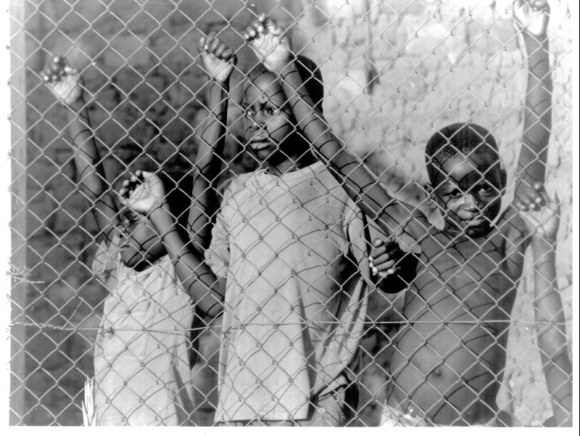
Exemplifying the cultural embeddedness of psychology
Meeting Maria

Slide 12
Exemplifying the cultural embeddedness of psychology
Meeting Ahmed
Strong tendencies in Danish psychological clinical settings:
Reluctancy to diagnose as well as a strong tendency to externalize problems.
Relates to definitions of psychology, view on man, cultural values of living a good life.

Slide 13
A Crash Course on Characteristics of Danish Culture or
Why American students experience culture shock when studying in Denmark
Notes:
Defining the somewhere American students meet and my somewhere as a speaker

Slide 14
Cultural Characteristics of Denmark
One of the wealthiest countries in the world
Known to be the happiest nation in the world.
Most trusting country in the (measured) world
Egalitarianism as a key value in Denmark → The second most equal country in the world (lighed → same as/look alike)
One of the most homogenic cultures in the world
Tribal society
Social welfare system (highest tax in the world)
Most and longest shared meals in Europe
Smalles power-distance → political engagement
Individual definitions of success, evolved around purpose, meaning and fun
Low expectations
Freedoom of speech
Ed Diener, Ronald Inglehart, Roberto Foa, Christopher Peterson, and Christian Welzel 2008
Notes:
Cultural characteristics of <dk

Slide 15
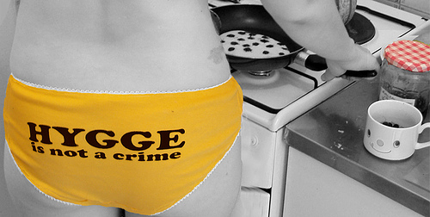
Brought up to pursue living a good life.
Notes:
The concept of hygge – what American students notice the most in DK – Meals take HOURS (we do share more and longer meals in the (measured) world.

Slide 16

Culture shock as a Foundation for Learning

Slide 17
Entry narratives of American students
Dumb Americans
Excluded
Lonely
Confused
Out of Comfort Zone
Liberated (the new me)
Happy

Slide 18
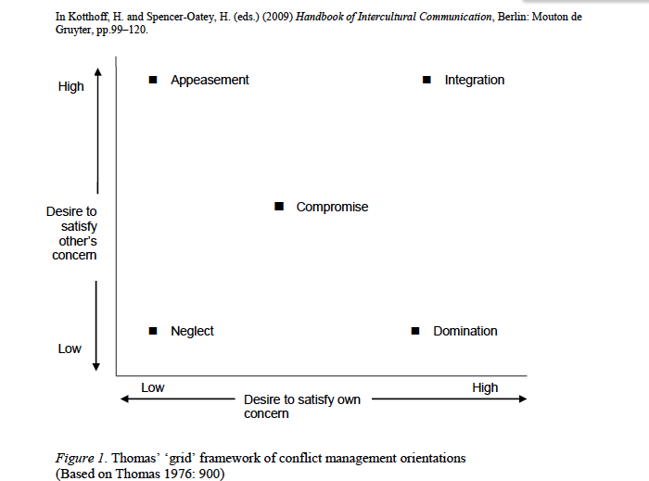
Culture shock as a Foundation for Learning

Slide 19
Outro narratives
Higher reflection levels
New perspectives on Psychology
More resilient
A new defined me
Proud
Feeling brave
Afraid of how it will be to transition back
Longing to go back to belonging

Slide 20
http://www.youtube.com/watch?v=nMgDISIExAg
http://www.youtube.com/watch?v=h8souKoo2Lo&NR=1

Slide 21
Cultivating intercultural skills
Hofstedes mental programs
Individual program
Inherited
/learned
Personality
Collective
Learned
Culture
Universal
Human Nature
Inherited

Slide 22
Personality
Democracy, Freedom, Egalitarialism, Prosperity, Humility, Jantelov, Individualism, Agency, Autonomy, Welfare system, hygge
Human Nature

Slide 23

Cultural Competence (in theory)
An awareness of diversity among human beings
An ability to care for all human beings
Non-judgmental openness for all human beings
Addressing the elephant in the room (or your American equivalent…)
Acknowledging cultural competence as a long term continuous process.
Knowledgeable and acknowledgeable of what is in the middle level of the triangle of others and self.

Slide 24

What Danish Faculty see when teaching American students
Strengths
Challenges
Curriculums
Anxiety discourse vs. Self-preservation focus

Slide 25
Summary: 6 steps when internationalizing Undergraduate Education in psychology
Psychological literacy should build on global and cultural awareness and the psychology curriculum should cultivate intercultural skills.
Connecting theory to application and vice versa: Emphasized hands-on components in courses and the connection between levels of psychology.
Direct link to future careers and job markets in curriculums and courses.
Navigation skills: The building of personal skills percieved as serious academic content.
Prepare for future obstacles – and for going against an anxiety discourse
Going meta: To engage in critical reflection on behalf of psychology as a discipline and on behalf of oneself

Slide 26

Going meta
Notes:
The interrelatedness of view on man, view on science, psychological theories, psychological concepts , methodologies and how conceps carry consequences for professionals as well as clients in the field of psychology

Slide 27
Going meta
2. Order Cybernetic Learning/Expansive Learning (Bateson and Engeström)
What is psychology? And what are the pros and cons of the discipline?
Concepts carry consequences: How do views on the human being, definitions of science, schools of psychology, theories, concepts, methodologies and cultural context influence professionals as well as clients within the field of psychology?
Zooming in and zooming out (Hofstede). Demonstrating how different levels of psychology relate and influence each other.

Slide 28
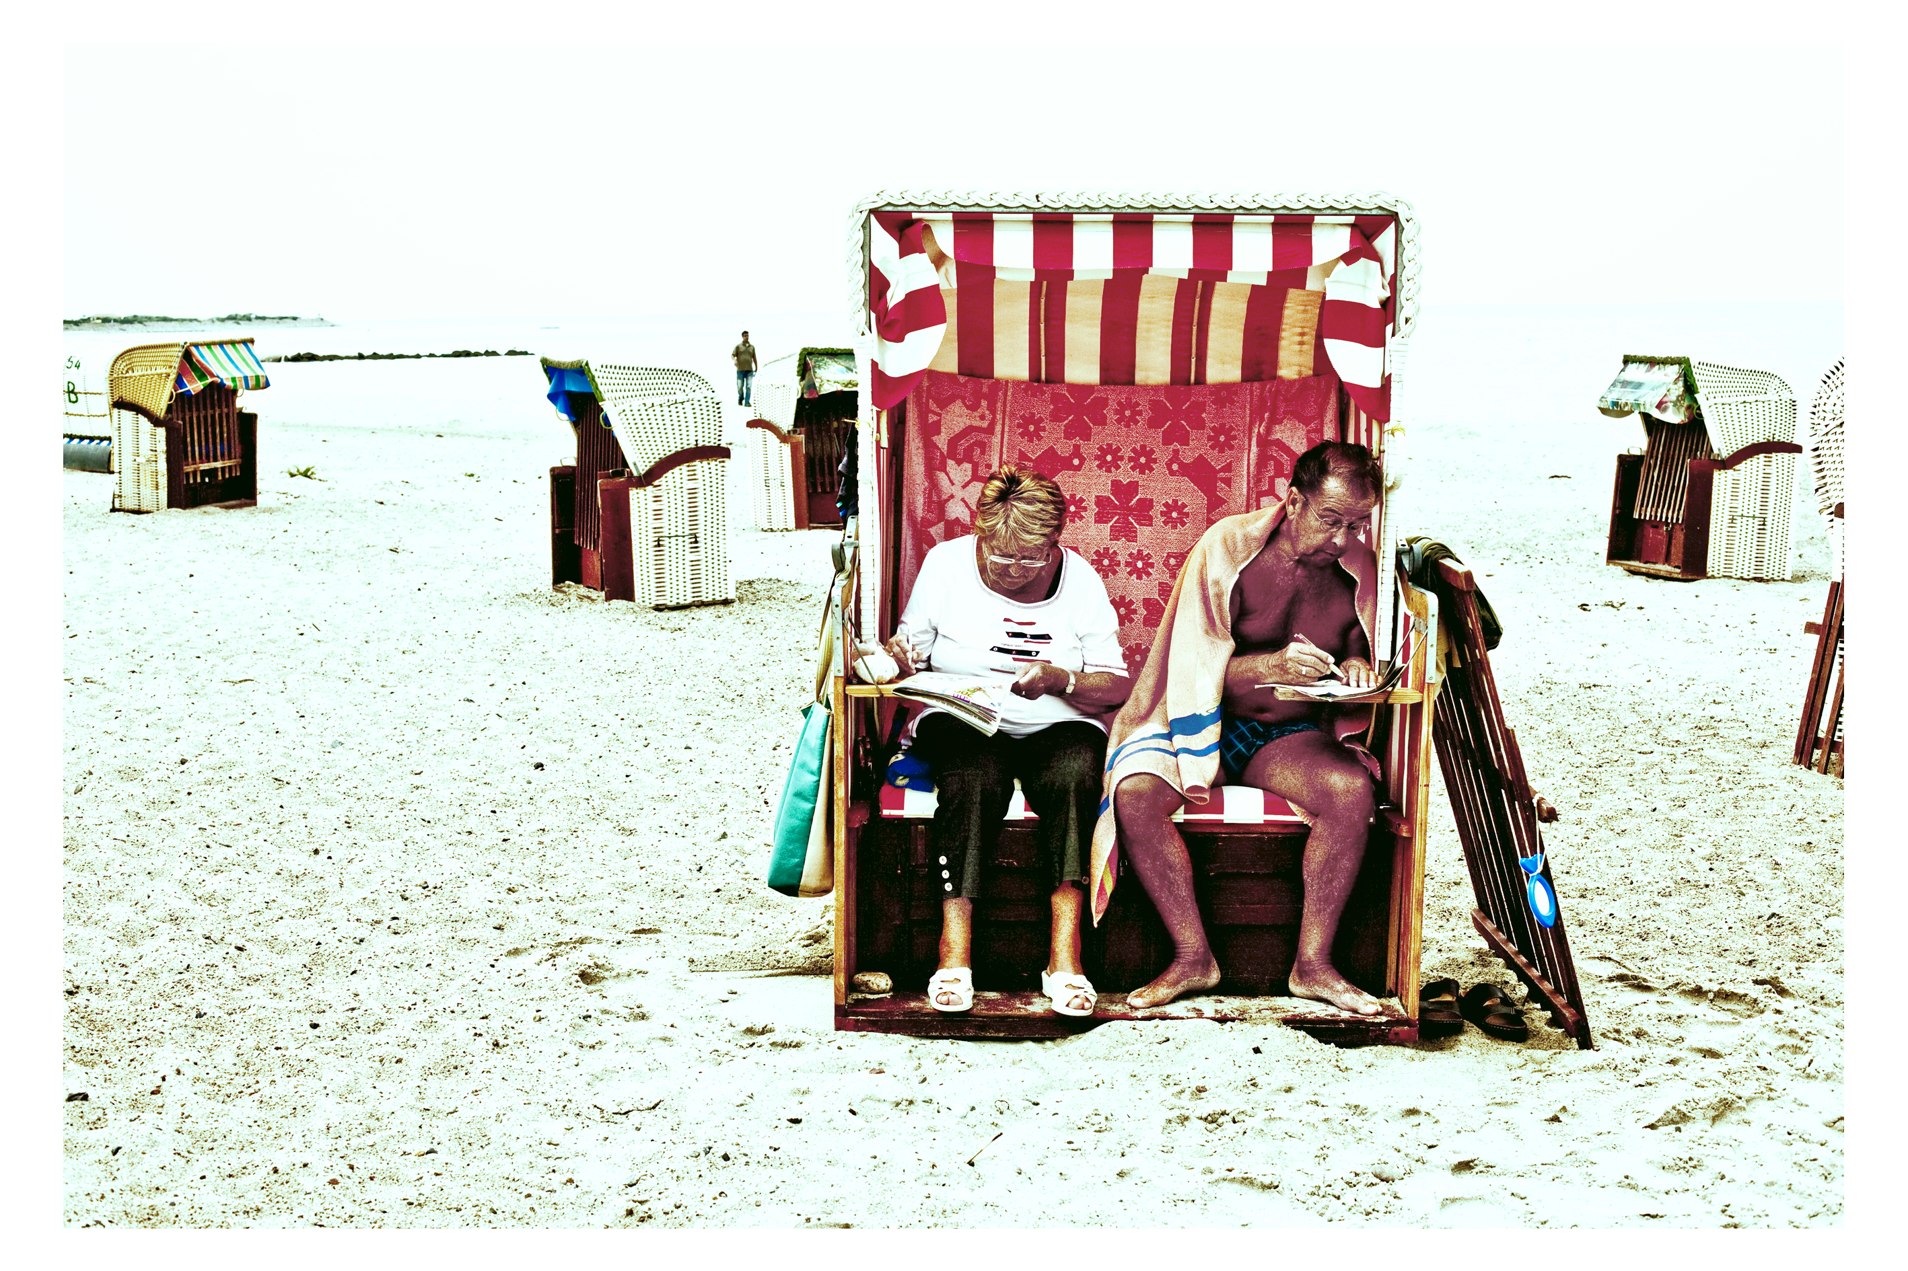
There is always a somewhere

Slide 29

Notes:
What did you notice first?

Slide 30
Prepare for future obstacles –
and for going against an anxiety discourse
Notes:
What did you notice first?

Slide 31
Course activities
Entry narratives
Pros and cons of the Psychology studied
Reviewing research articles
Choosing theme of project based on intrinsic motivation, create clinical intervention plan, carry out interventions, perform workshop demonstrating and evaluating process and product.
What on Earth should I do with my Future workshop
Challenging previous material learned in course
Study tours
Evaluating pros and cons of own work
Personal impact of course, most important learning sentences, how to adapt concepts and practices when back, reverse culture shock debriefing
Pursuing ”Optimal frustration” (Kohut).

Slide 32
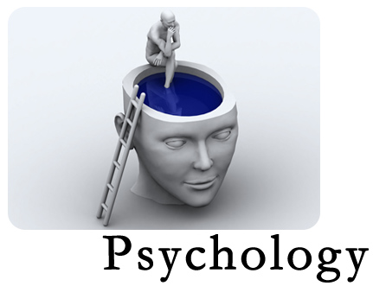
Questions, comments, debate?

Slide 33
Bateson, G. 1973: Steps to an Ecology of Mind. Chicago University Press.
Biswas-Diener, Vittersø & Diener 2009: The Danish Effect: Beginning to Explain high Well-being in Denmark. Social Indicators Research. Vol. 96, n. 2, p. 229-246. Springer.
Davies, B. & Harré, R. 1990: Positioning and the discursive production of selves. (Journal for the Theory of Social Behaviour, 20(1)): 43-63
Dreier, O. 2003: Subjectivity and Social Practice. Health Humanity and Culture. Department of Philosophy, Aarhus University
Dunn, D. S., J.S. Halonen, Smith, R. A. (Ed.) 2008: Teaching Critical Thinking in Psychology: A handbook of Best Practices. Wiley-Blackwell.
Engeström, Y. 1987: Learning by Expanding. Jyväskyla.
Finnström, S. 2003: Living with bad surroundings. War and Existential Uncertainty in Acholi Land. Uppsala University, Uppsala studies in Cultural Anthropology no. 35.
Furedi, F. 2007: Culture of Fear – Revisited. New York, London. Continuu
Juul, J. 2002: Dit kompetente Barn. Schönberg. Denmark.
Halpern, D. 2010 (ed.): Undergraduate Education in Psychology: A blueprint for the Future of the Discipline. APA, Washington DC, US.
Harnisch, H. 2010: Positive Psychology in Contexts of Chronic Crisis. European Conference on Positive Psychology, Copenhagen.
Hastrup, K. (Ed.) 2003: Ind i Verden. Hans Reitzels Forlag. København. Denmark.
Hofstede 2004: Cultures and Organizations: Software of the Mind. New York: McGraw-Hill
Seligman &Peterson 2004: Character Strengths and Virtues. Oxford.
Seligman, M. 1996. The Optimistic Child. Harper Perrenial. US.
Svendsen, T. G. & Svendsen, G. L. H. 2006: Social Kapital. En introduktion. København: Hans Reitzels Forlag.
Stern, D. 1985: The Interpersonal World of the Infant. Basic Books.
Thomas, K. W. And Schmidt, W. 1976 A survey of managerial interests with respect to conflict. Academy of Management Journal 19: 315–31
van Meurs & Spencer-Oatey 2010: Multidisciplinary Perspectives on Intercultural Conflict: The Bermuda Triangle of Conflict, Culture and Communication.
Wagner, J., Broström, S. (Ed.) 1996: Early Childhood Education in Five Nordic Countries. Academia.

Slide 34
Thank you
helle.harnisch@gmail.com
www.dis.dk

Slide 35
The Competent Child
Rousseau 1762: ”Èmile” Egalitarianism and natural development of the human being
A reaction to ”Tabula Rasa” and behaviorism
Daniel Stern ”The Interpersonal world of the infant” 1991. Theories and practice – Psychodynamics.
Jesper Juul: Det kompetente barn
Pros and Cons of the spreading of the concept ”The Competent Child”: Negotiating childhood
Children and family time today: New families
Notes:
Stern – born 1935, US, The interpersonal world of the infant” 1991) – social relational competent child. GOING BACK TO AHMED’S CASE

Slide 36
Important concepts in
Danish childcare
Important Concepts in US child care according to US students
Egalitarianism (Wagner)
Emancipation (Wagner)
En god barndom (Wagner, Brostøm, Gitz-Johansen)
Autonomy (Cultural value)
Friendship (Danish pedagogy, cultural value)
The Competent Child (Stern, Seligman, Jesper Juul, Gitz-Johansen)
Trust (cultural value)
Democracy
Empathy/fairness (pedagogical practice)
Lighed (Same as) (lighed - look like)
Competition for excellence
Control
A good childhood
Protection
Friendship (Encouraged through play).
The skilled child
The fear culture
Democracy
Rights
Diversity

Slide 37
Important concepts in
Danish childcare
Important concepts in US child care
Egalitarianism/scared of difference
Emancipation/Laissez faire
En god barndom
Autonomy/neglect
Friendship
Fairnes /conflict avoidant
The Competent Child
Trust / naivetivity
Democracy
Same as / Xenophobia
Competition / pressure /ambition
Control / structure
A good childhood
Protection / nurture
Friendship
Rights /selfishness
The skilled child /adult values?
The fear culture / protection
Democracy
Diversity

Slide 38
Factors that correlate with Well-being -
and the good life
Economy - Amount of resources
Equality
Fairness in distribution/level of corruption
Social support/Social relations (macro/micro)
Influence on life circumstances – freedom of choice
Collectivistic vs. Individualistic societies
Trust
Power distance in societies (Hofstede)
Cultural norms and definitions of success
Sense of purpose and belonging
Ed Diener, Ronald Inglehart, Roberto Foa, Christopher Peterson, and Christian Welzel 2008
Notes:
Cultural characteristics of <dk

