Slide 1
Race and the Teaching of Economics
Cecilia Conrad
profcece@gmail.com
Notes:
Introduce myself.

Slide 2
Today’s Plan
Reasons to talk about Racial and Ethnic Inequality in Economic Principles
Race & Ethnicity and the Teaching of Core Economic Concepts and Data Literacy
Tips for Inclusive Pedagogy

Slide 3
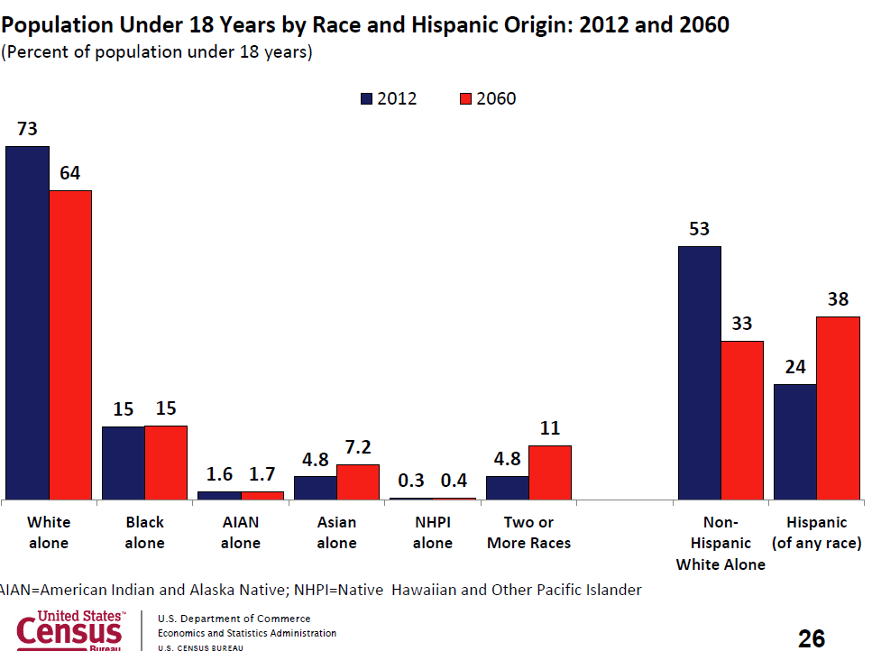
Population Projections
Source: Presentation by Jennifer Ortman, U.S. Census Bureau to Committee on Equal Opportunity in Science & Engineering, National Science Foundation, February 25, 2013.

Slide 4
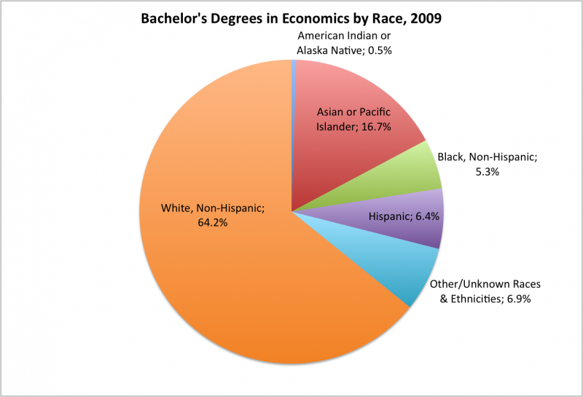
ECONOMICS MAJORS
http://wikis.swarthmore.edu/div_econ/index.php/Participation_data

Slide 5

Blacks & Hispanics Under-represented in Economics Relative to STEM fields
Economics
STEM Fields
http://wikis.swarthmore.edu/div_econ/index.php/Participation_data

Slide 6
Develop and sharpen economic reasoning skills
Distinguish between simplifying assumptions and those that are essential to an economic model.
Compare the assumptions and predictions of competing economic theories;
Use economic theory to formulate a hypothesis to explain differences in economic outcomes
Critique a statistical analysis of racial disparities in economic outcomes.
Notes:
Excerpt from syllabus for my course Race and the US Economy: Many introductory economics courses purport you At the end of this semester, you should be better able to

Slide 7
Model a rational discourse about race, ethnicity and economic disparity.
Emphasize evidence-based analyses of race and ethnicity.
Make distinctions between speculative hypotheses and conclusions based on a careful analysis of quantitative and qualitative data.
“At the end of the semester, you should be better able to 1) Avoid assessments based on stereotypes; 2) Support a position with references to empirical evidence; 3) Express disagreement by challenging the logical consistency or the evidentiary basis of an opponent’s statement.”

Slide 8
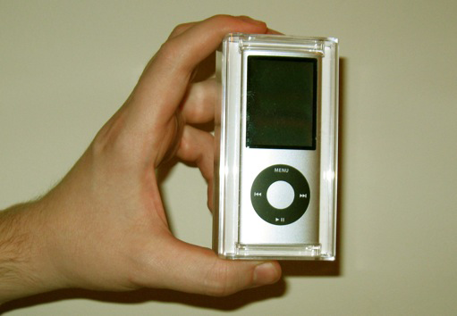
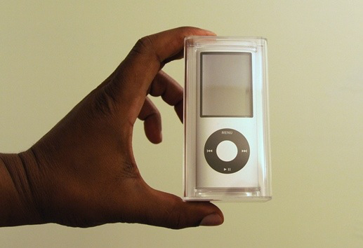
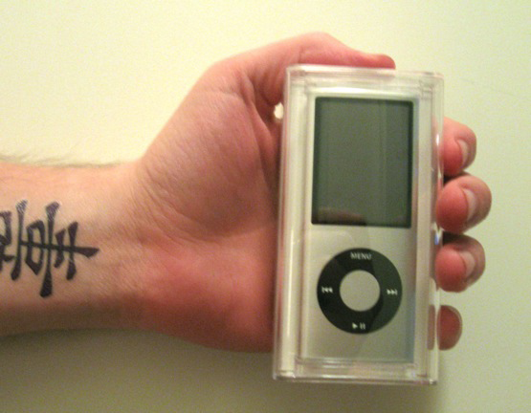
What Price for an iPod?
A
B
C

Slide 9
Competitive Market for Used iPods
Assume used iPods are identical and of known quality.
Internet based sales, payment through Pay Pal, delivery included
Use Supply and Demand graphs to illustrate equilibrium price
What factors will affect demand? What factors will affect supply?
In this model, will the prices of A, B and C be identical?

Slide 10


Experiment by Doleac & Stern http://www.voxeu.org/article/race-discrimination-and-ipods-experimental-evidence-online-markets
Online advertisement of iPods, payment through Pay Pal, iPod shipped to seller offering highest price.
Year-long experiment, 300 markets, 1200 advertisements
Each ad contained a photo of the iPod held by a black hand, white hand, or a white hand with a wrist tattoo.
How does this experiment compare with the competitive market model?

Slide 11
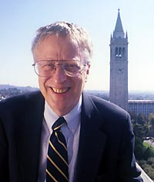
Imperfect Information
Quality is not known; All iPods may not be identical.
Buyers have imperfect information
The “Lemons” Problem
What will be the effect on price and number sold?
How might buyers assess the quality of individual iPods?

Slide 12
Will Number of Offers and Price Be Identical for A, B & C?
Black sellers received 13% fewer responses and 17% fewer offers than white sellers.
The average offer received by black sellers is 2%-4% lower
Wrist with tattoo experience similar to that of black sellers

Slide 13
Possible Explanations for Differences in Price
Buyer’s have “tastes for discrimination” (Becker)
Buyer’s engage in statistical discrimination and rely on stereotypes.
Stereotypes can be self-confirming. (Loury)

Slide 14
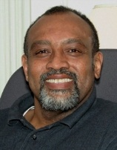
Logic of Self-Confirming Stereotypes
Rational statistical inference in the presence of limited information.
Feedback effects on the behavior of individuals
An equilibrium in which mutually confirming beliefs and behaviors emerge out of this interaction
Loury, An Anatomy of Racial Inequality, 2002

Slide 15
An Illustration
Valuation of a Good iPods -2500; lemons-500
Consumers believe that 50% of iPods sold by Purple People are lemons. 0% of iPods sold by Non Purples are lemons. In reality,20% of iPods are Lemons independent of the seller’s color.
Consumers offer $1500 for Purple People’s iPods and $2500 for NonPurple People’s iPods.
Purple People with good iPods will not offer them for sale - self-confirming stereotype.

Slide 16
Racial & Ethnic Wage Differences
Show a graphic/table comparing the median earnings of year round, full time workers by race & ethnicity – www.census.gov.
Use neoclassical model to lead discussion on why wages might vary across jobs and individuals. (Marginal productivity theory)
Show a graphic/table comparing median earnings of year round, full-time workers by race & ethnicity by educational attainment. Discuss why racial gap is smaller.
Discuss Becker’s tastes for discrimination model & statistical discrimination as possible explanations.
Notes:
Worker’s output depends on effort and external factors (luck). Employer can’t directly observe effort, but believes purples are low-effort employees.
Threshold for number of mistakes before dismissal for purples will be lower than for other employees.
Loury argues that purples will respond by expending less effort.
Under what circumstances is this true? How do we fix it?

Slide 17
Racial Differences in Economic Well-Being – Spreadsheet Exercise
See http://serc.carleton.edu/econ/spreadsheets/index.html
Discuss alternative measures of the economic well-being of a population sub-group.
Student Assignment:
  Choose an indicator available from www.census.gov or from www.bls.gov .
  Download the data for at least two racial/ethnic groups and for at least five years into a spreadsheet.
  Create a message and choose the best chart to illustrate the message.

Slide 18
Inclusive Pedagogy
Stereotype Threat affects academic performance, but can be mitigated.
In qualitative interviews, college students report experiences of micro-aggression in the classroom from fellow students and faculty.
Special effort required to offset tendency of students of color in white institutions to go it alone.
Inquiry based learning, research experiences, “service” learning have been shown to increase engagement.

Slide 19
Make the Invisible Visible
Examine syllabus, textbook, and course content for implicit bias and for opportunities to discuss the diversity of economic experiences.
Integrate biographies of a diverse group of economists into lectures/class materials/videos
Acknowledge that “colorblindness” and “gender blindness” is embedded in orthodox economic analysis and that there are alternative models.
Be aware of implicit bias – which students receive eye-contact, with whom do you engage in small talk, etc.
Notes:
Students of color often speak of feeling invisible in the classroom. The sources of the invisibility include an ideology of “color blindness” on the part of the instructor or fellow students which tends to negate the racial and ethnic experiences of the person of color; the appearance that a professor has a closer personal relationship with white students; and the absence of curriculum content related to race.

