Slide 1
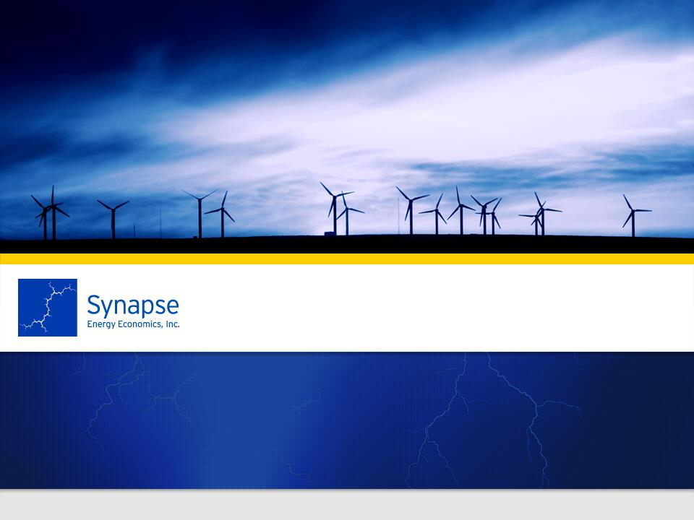
Frank Ackerman
April 26, 2013
Explaining Climate Economics:
What do we know about unknown risks?
Cutting Edge Webinars
Economics at Community Colleges

Slide 2
“The greatest market failure the world has seen”

Slide 3

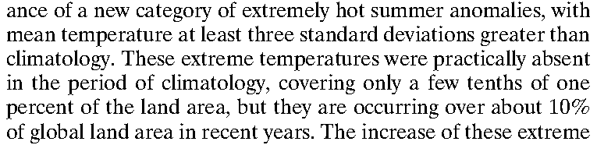
“Perception of climate change”
James Hansen, Makiko Sato, and Reto Ruedy (PNAS, 2012)
[1951-80 means]
[1951-80]

Slide 4
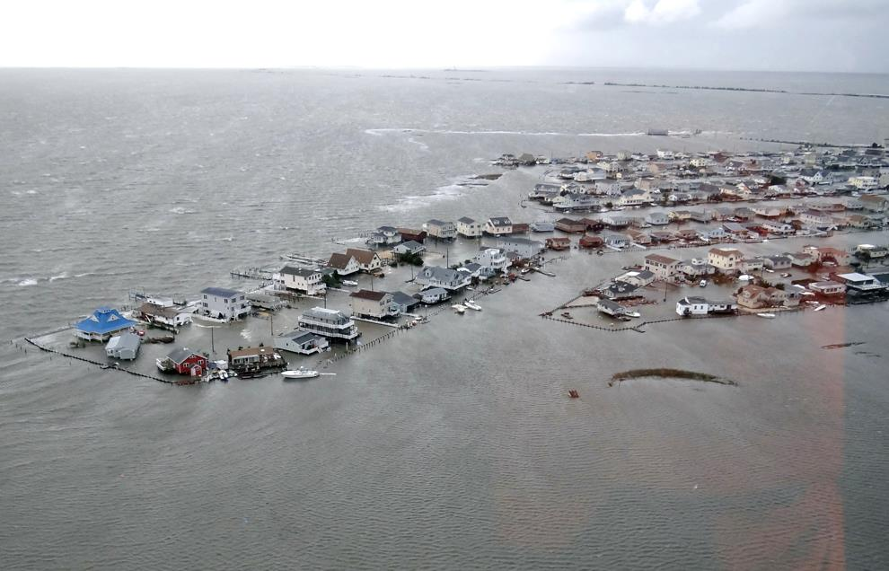
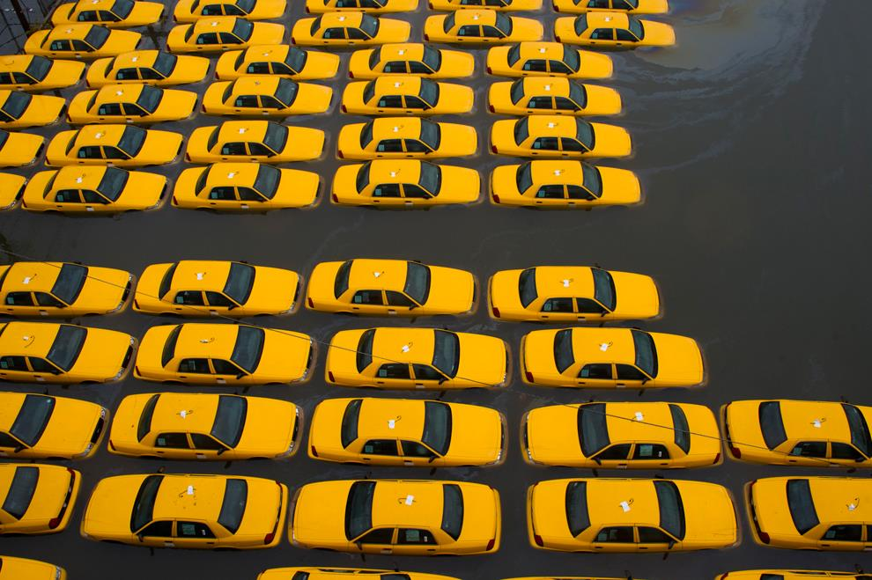
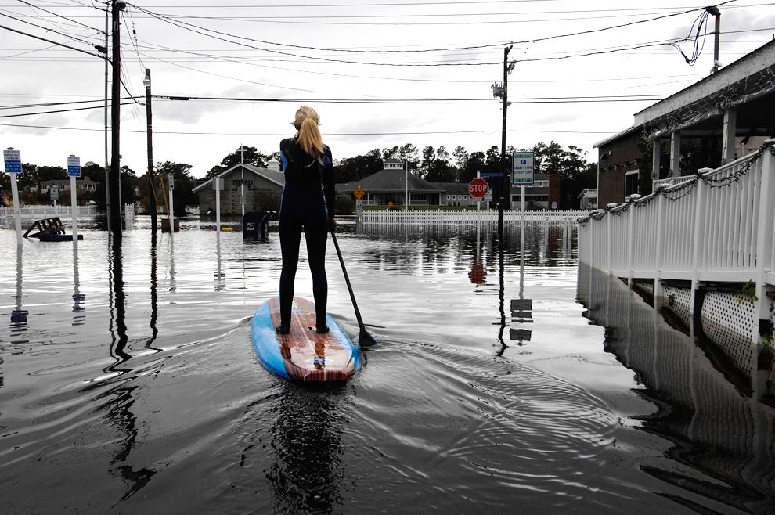
Hurricanes, moving north

Slide 5
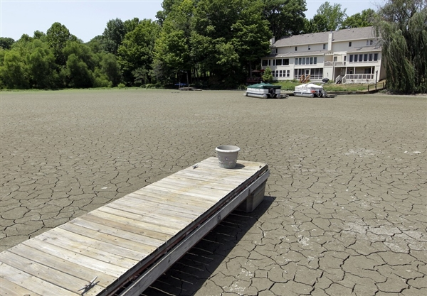
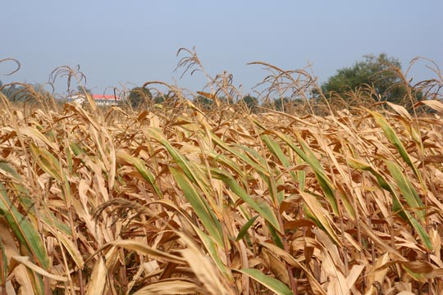
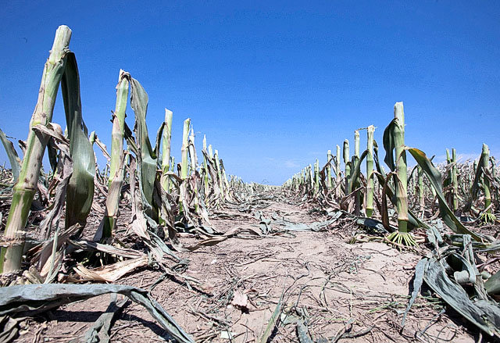
Record-breaking drought

Slide 6
Dimensions of climate impacts
Fairly soon, and fairly certain
  Heat waves, drought, storms, some sea-level rise
  Agricultural and coastal property losses
  Bad, but not enough to cause a global crisis?
Far future
  Worst impacts will be 100+ years from now
  Outcomes uncertain due to time span
  Is discounting meaningful beyond one lifetime?
Extreme risks
  We know that we don’t know the exact tipping points
  “Black swans,” fat-tailed probabilities
  More research may not resolve uncertainties

Slide 7
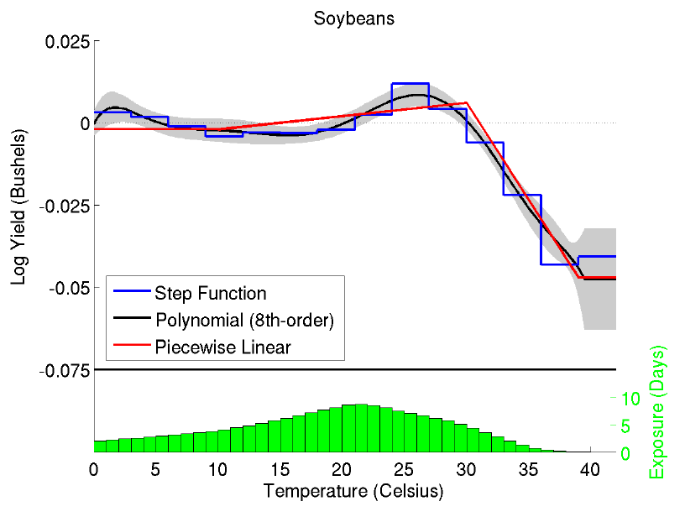
Optimal temperatures: old vs new views
Older research assumed a quadratic relationship between crop yields and temperature
  (Illustrative shape, not real data for any actual crop)
Newer research : asymmetric, yields collapse at higher temperatures
  (Schlenker & Roberts 2009)

Slide 8
The U.S. “social cost of carbon”
APPENDIX 15A. SOCIAL COST OF CARBON FOR REGULATORY IMPACT ANALYSIS UNDER EXECUTIVE ORDER 12866
Interagency Working Group on Social Cost of Carbon,
United States Government
With participation by
Council of Economic Advisers
Council on Environmental Quality
Department of Agriculture
Department of Commerce
Department of Energy
Department of Transportation
Environmental Protection Agency
National Economic Council
Office of Energy and Climate Change
Office of Management and Budget
Office of Science and Technology Policy
Department of the Treasury
(No office, no address, no website, no publicity, no named authors)
Their answer: $21/ton CO₂

Slide 9
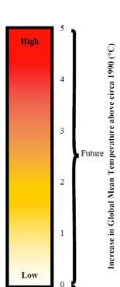
Mapping science to economics: 1
Scientific assessment of damages
Economic assessment of damages
This mapping changes the structure of information
$21/ton CO₂

Slide 10

Mapping science to economics: 2
Scientific assessment of damages
Economic assessment of damages
Disastrously high SCC
This mapping preserves the structure of information
Higher SCC
Low SCC ($21?)

Slide 11
Our re-analysis of SCC
Based on DICE model, from task force analysis of SCC
Explore effects of four variations
  Median vs. 95th percentile climate sensitivity (3.0 vs. 7.1)
      Climate sensitivity: long-run temperature increase from doubling CO₂
  Discount rate: 3.0% vs. 1.5%
      3% is conventional, 1.5% is close to the Stern Review value
  Low-temperature damages:
    DICE default (low) vs. Hanemann re-estimate at 2.5ºC
  High-temperature damages:
    DICE default (low) vs. Weitzman estimate (disaster at 12ºC)
Result: 2 x 2 x 2 x 2 = 16 variants on SCC

Slide 12
Why is climate sensitivity uncertain?
Many positive feedbacks are involved in warming
  Warming melts ice, lowers Earth’s surface albedo, so more solar energy is absorbed, causing more warming
  Warming accelerates release of CO₂ from land, ocean
Let total positive feedback strength = f < 1
  Initial impact of 1 → first-round feedback of f → second-round feedback of f² , etc.
Cumulative effect = 1 + f + f² + f³ + … = 1/(1-f)
  As f →1, 1/(1-f) gets very large (approaches infinity)
Small errors in measuring f cause large errors in 1/(1-f)
  We can only measure f; but the goal is to estimate 1/(1-f)
    Explanation due to Roe and Baker (2007)

Slide 13
Discounting the future
Present value t years from now = future value / (1 + r)^{t}
  r = discount rate, a crucial number for climate economics
A high discount rate makes it hard to “see” costs we impose on future generations
  What is it worth now to prevent a $1,000 loss in 100-200 years?
Present value of $1,000 in 2113
  At 1.5%: $226
  At 3.0%: $52
Present value of $1,000 in 2213
  At 1.5%: $51
  At 3.0%: $3

Slide 14
The world will not look like this in 2100!

Slide 15
Four damage functions
Weitzman:
50% loss at 6º, 99% loss at 12º
Hanemann at 2.5º
Nordhaus at 2.5º

Slide 16
Alternate SCC values, 2010

Slide 17
Alternate SCC values, 2050
Marginal cost of maximum feasible abatement scenarios

Slide 18
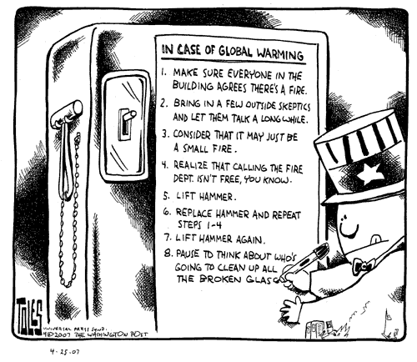
Republican climate policy

Slide 19
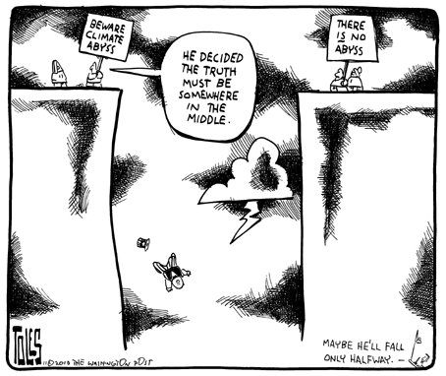
Democratic climate policy

Slide 20

What will you wear to the apocalypse?

Slide 21
This is not happening to your house

Slide 22
Why buy insurance?
The average U.S. house has a fire every 350 years
  0.3% probability per year of a residential fire
  Almost all homeowners have fire insurance
Annual probability of death is below 1% until age 61
  Probability of death is under 0.2% until 40
  Most young parents have life insurance
Why not cancel your insurance?
  Spend the premium on something you’ll really enjoy
  Your standard of living goes up unless you have a fire (or die)
How likely is catastrophic climate change?
  Unlikely, but less unlikely every year as the world warms
  Should we buy insurance for the planet?

Slide 23
frankackerman12@gmail.com http://frankackerman.com
Synapse Energy Economics
Cambridge, MA

