Slide 1


Using GIS with Real-time Water Quality Assessment to Guide Scientific Inquiry and Learning in a Community College Environmental Studies Program
Matthew Schwartz
University of West Florida
Allison Beauregard
Northwest Florida State College and
Mattie Kelly Environmental Institute

Slide 2
Project Goals
Target STEM education through inquiry-based learning
Showcase laboratory methods and techniques in environmental science
Introduce GIS to NWFSC science students
Assess and target needs for environmental technician training
Develop novel technique to interpolate multiple data streams for real-time visualization

Slide 3
Aquatic Environmental Science
(OCE 1013C) at NWFSC
Course goals and objectives:
  Learn the defining characteristics of freshwater, saltwater and estuarine habitats, and the relationships between biotic and abiotic components of aquatic ecosystems
  Perform field sampling and laboratory methods
  Interpret and present scientific data
  Gain a better understanding of the scientific method and the process of science

Slide 4
A Class Divided
Control group (“traditional” field-based course)
  Takes single field trip
  Performs in-lab analysis
  Sees results at the end of semester
Experimental group (intensive field-based course)
  Takes multiple field trips
  Analyses performed in field in real time
  Sees results at the end of each field day

Slide 5
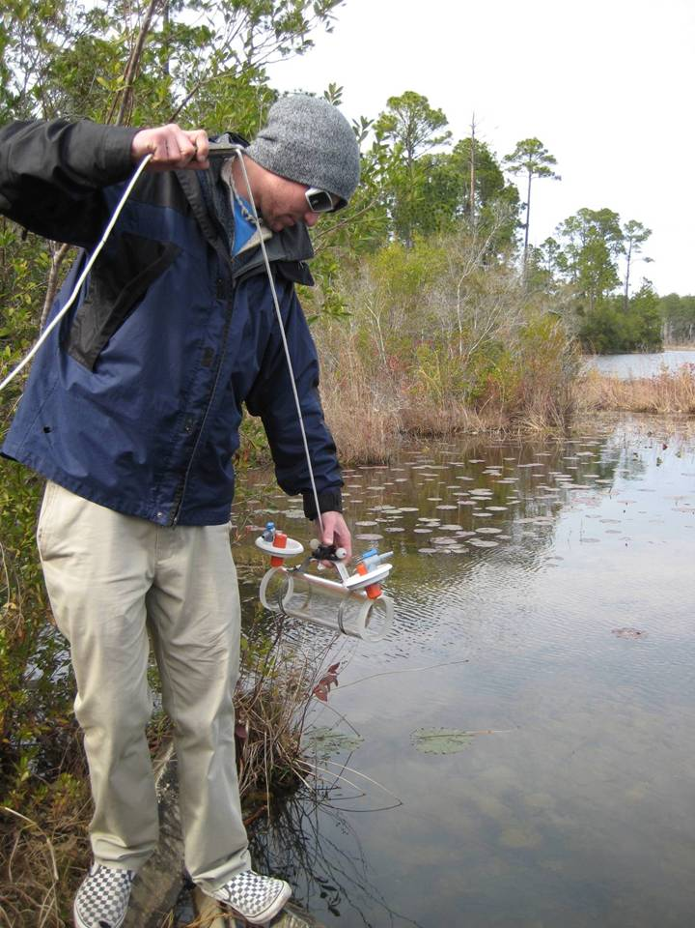
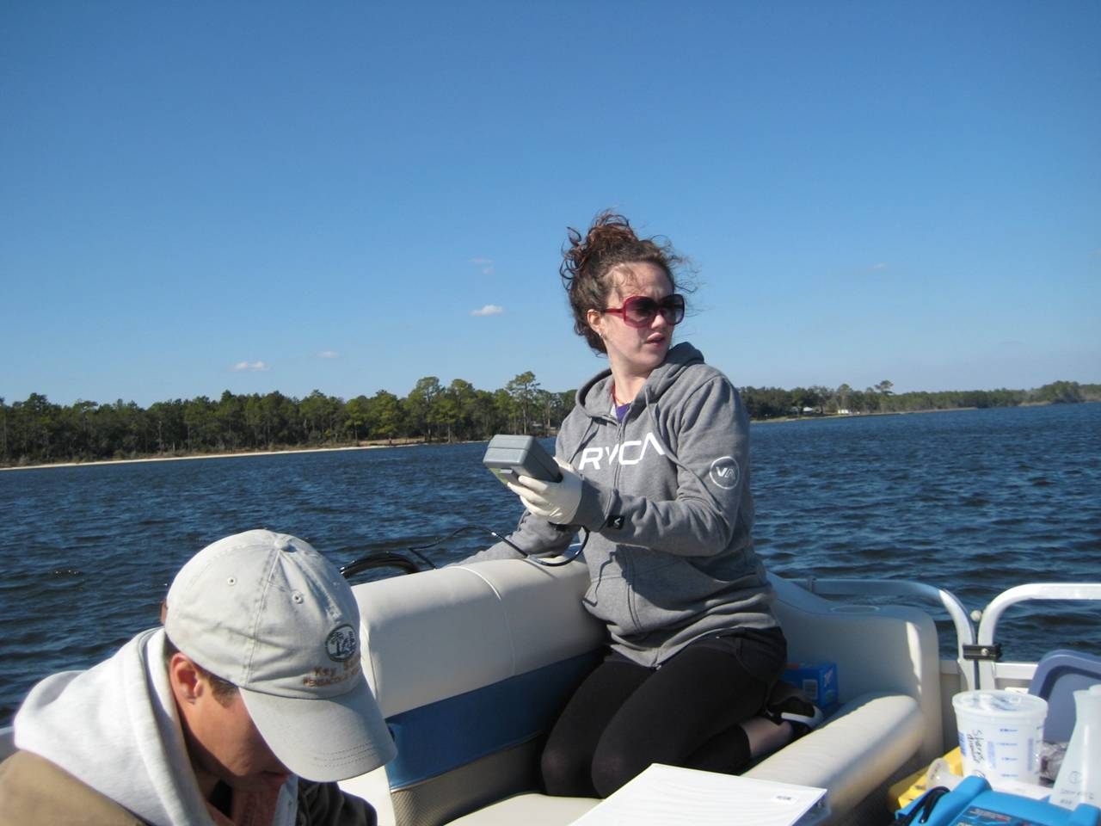
Technology Students Use
Sampling
  Van Dorn sampling bottle
  YSI 85 field meter
  GPS
    Handheld or integrated

Slide 6
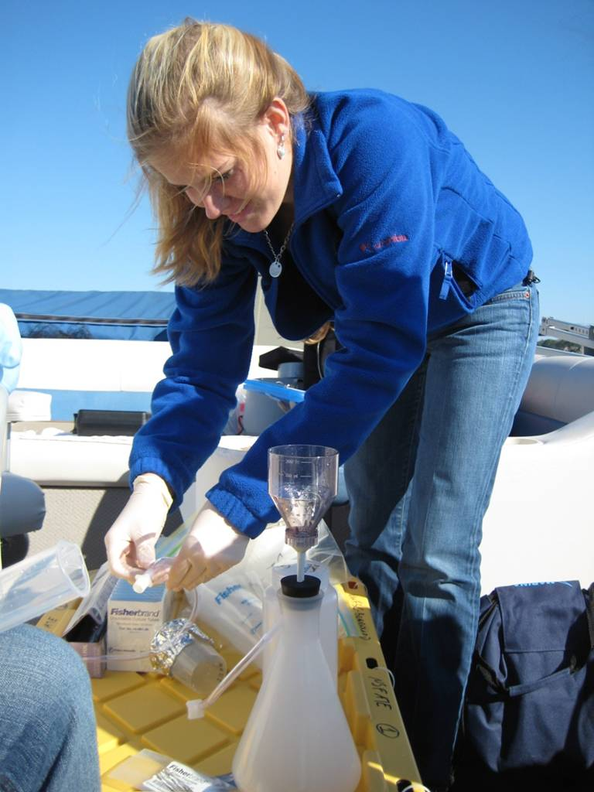
Technology Students Use
Sampling
  Van Dorn sampling bottle
  YSI 85 field meter
  GPS
    Handheld or integrated
Sample processing
  Vacuum filtration rigs
    GF/F filters

Slide 7
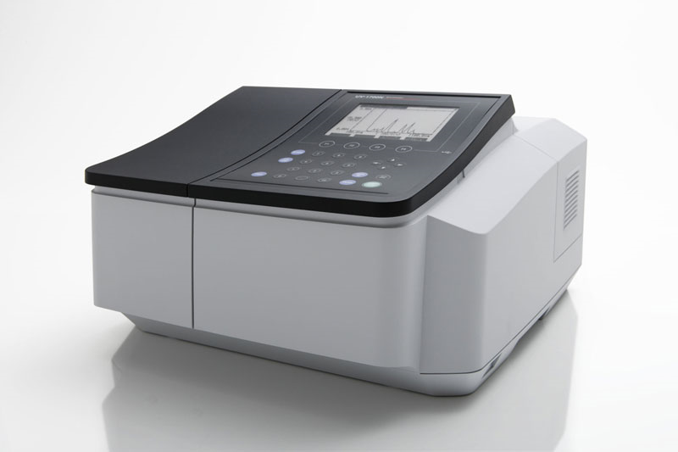
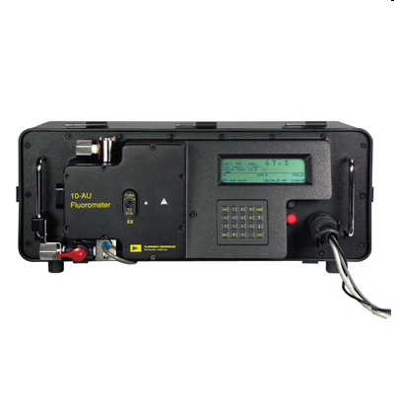
Technology Students Use
Sampling
  Van Dorn sampling bottle
  YSI 85 field meter
  GPS
    Handheld or integrated
Sample processing
  Vacuum filtration rigs
    GF/F filters
Analytical (control)
  Spectrophotometer
  Fluorometer
  Pipettors and other miscellany

Slide 8
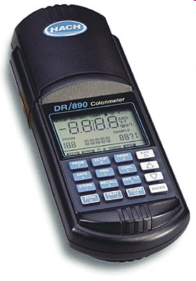
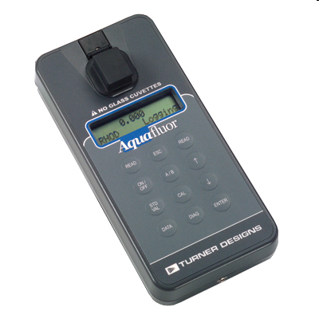
Technology Students Use
Sampling
  Van Dorn sampling bottle
  YSI 85 field meter
  GPS
    Handheld or integrated
Processing
  Vacuum filtration rigs
    GF/F filters
Analytical (experimental)
  Colorimeter
  Portable fluorometer
  Pipettors and other miscellany

Slide 9
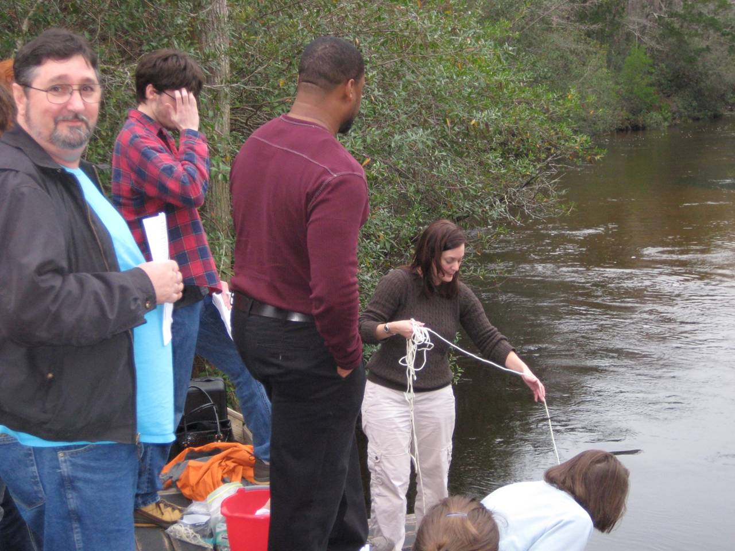
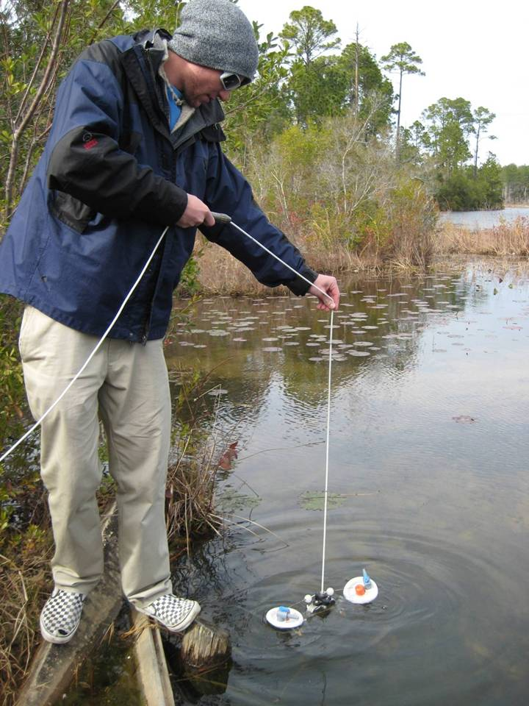
Preparing Students for Field Work
Instructors-led demonstration
  Sampling

Slide 10
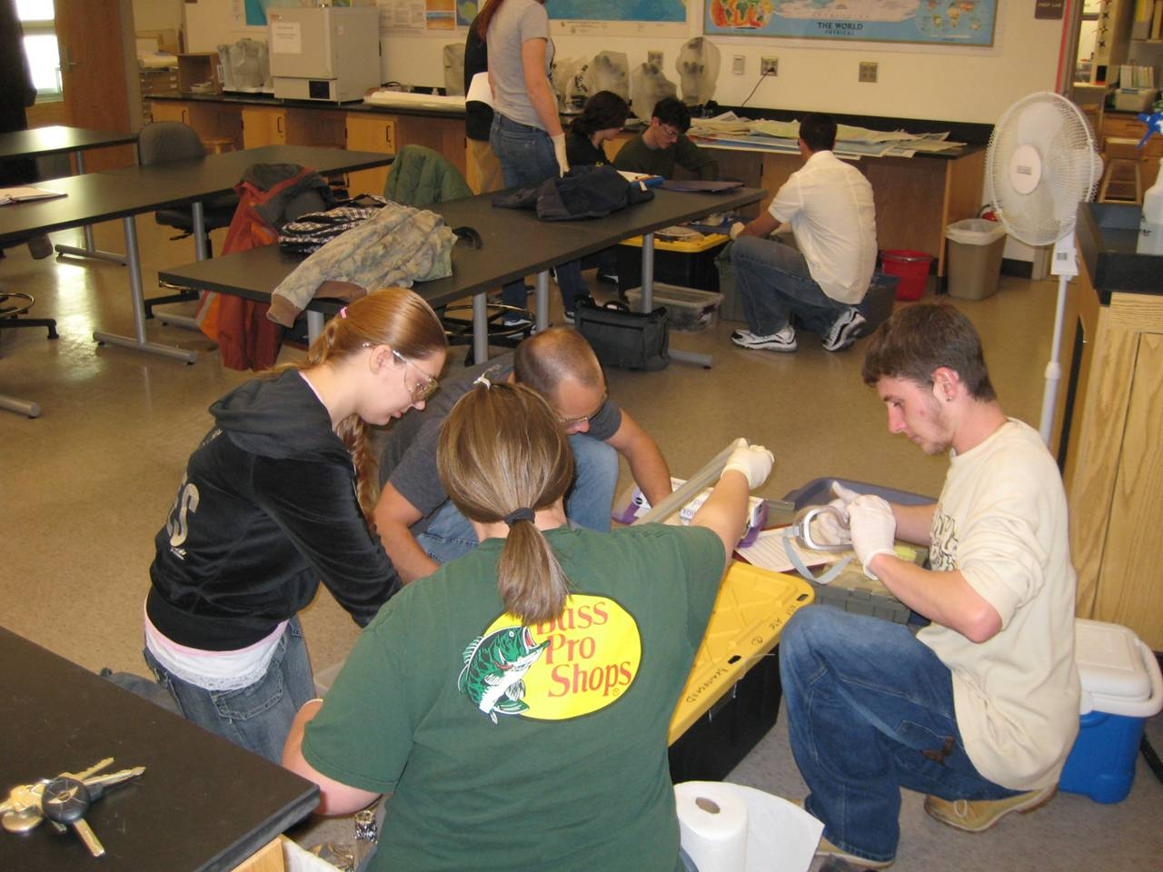
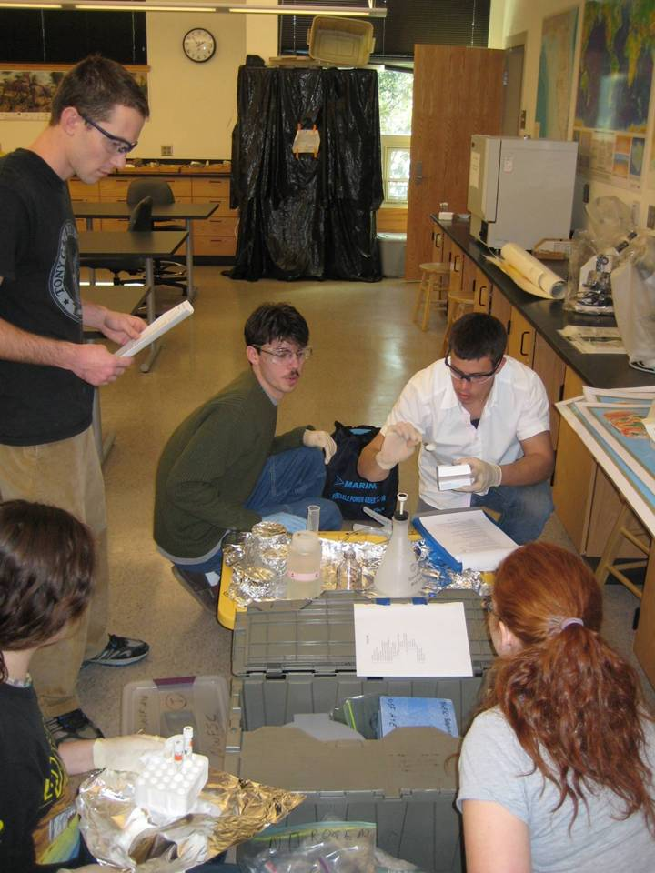
Preparing Students for Field Work
Instructors-led demonstration
  Sampling
In-class practice
  Sampling + Processing
  Sampling + Processing + Analysis 1 (nutrients)
  Sampling + Processing + Analysis 1 (nutrients) + Analysis 2 (chlorophyll a)

Slide 11
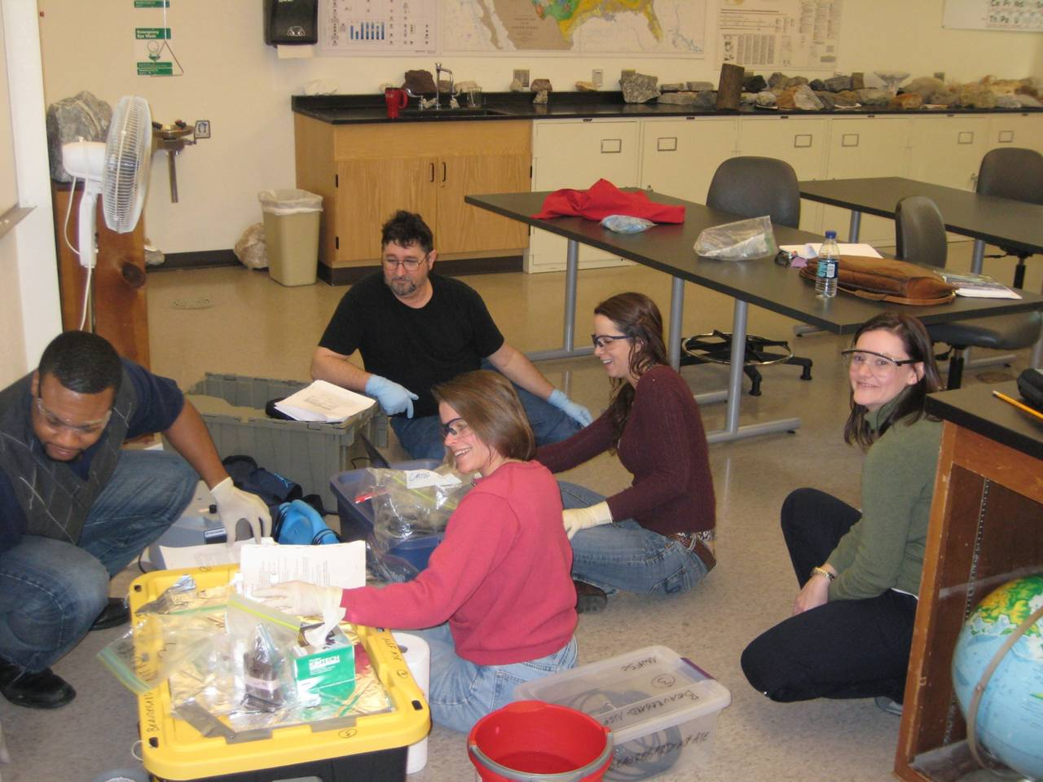
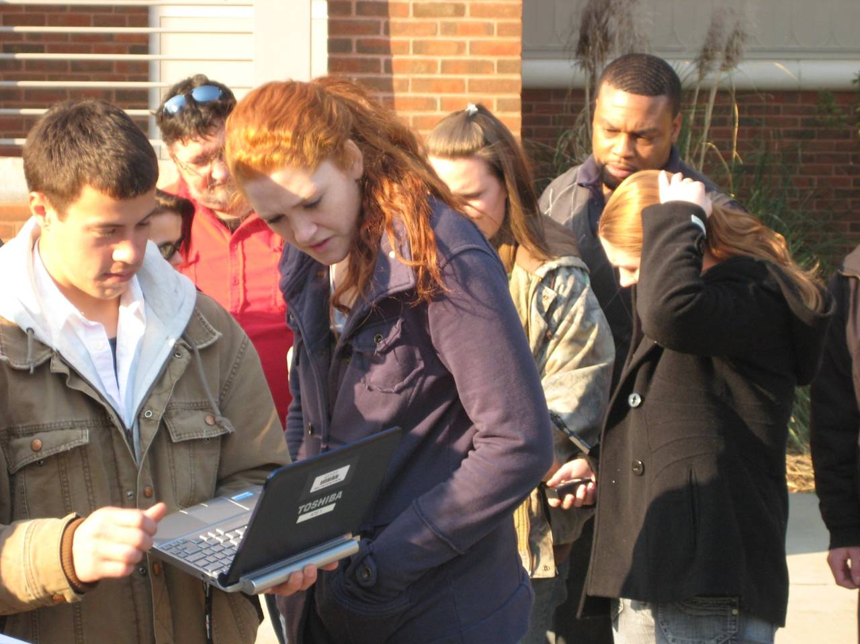
In-class Practice
Improve student comfort-level and skill set with technology
Develop group rapport
Facilitate comfort with working conditions
  Boat size, wind, sharing space and equipment

Slide 12
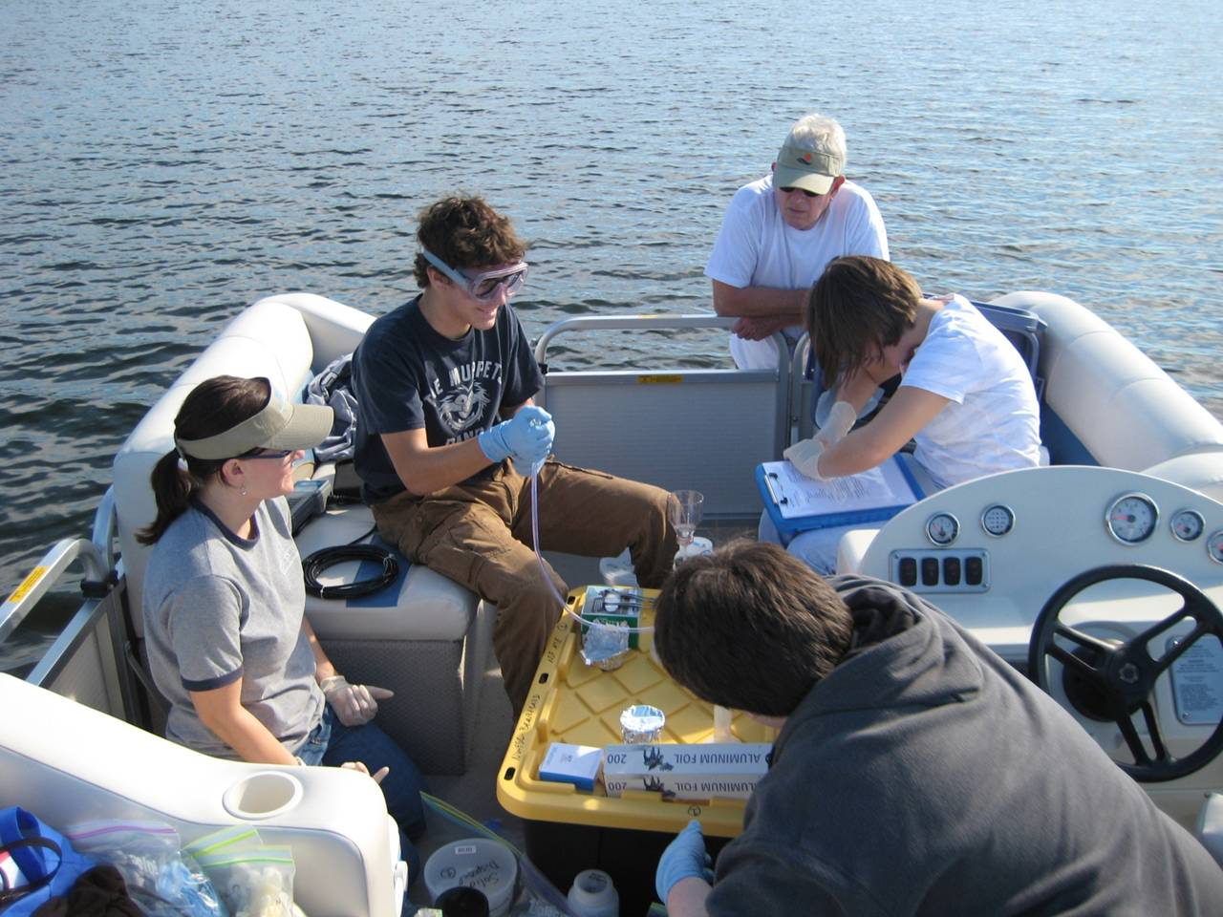
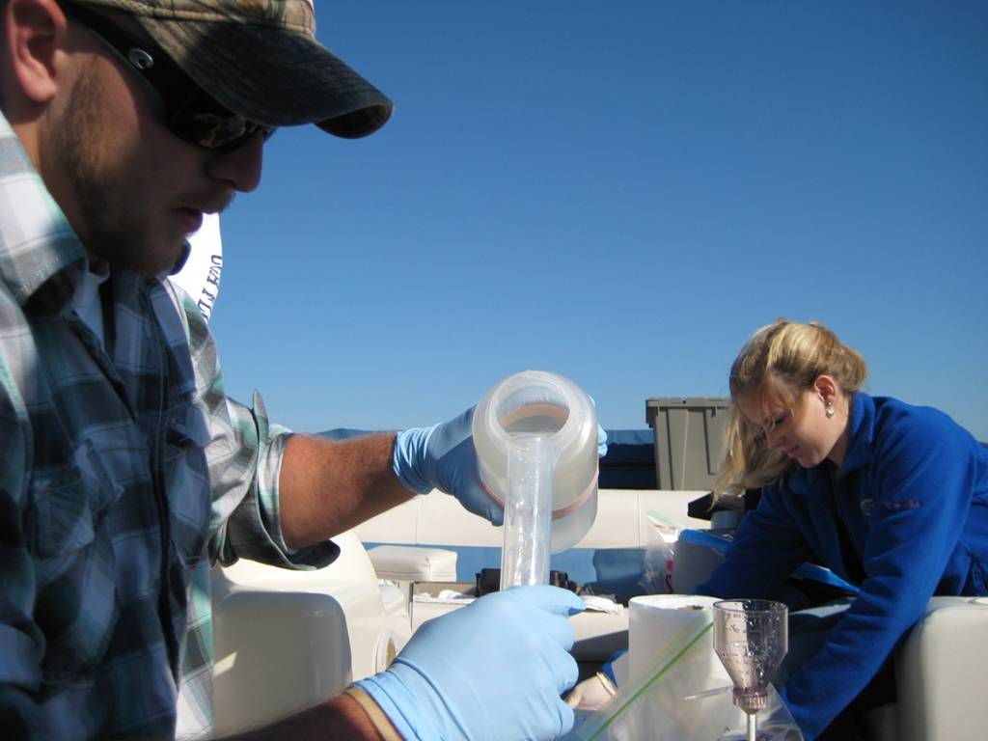
Preparing Students for Field Work
Instructors-led demonstration
In-class practice
  Sampling + Processing
  Sampling + Processing + Analysis 1 (nutrients)
  Sampling + Processing + Analysis 1 (nutrients) + Analysis 2 (chlorophyll a)
Field trips (3)
  Each group rotates through three instructors

Slide 13
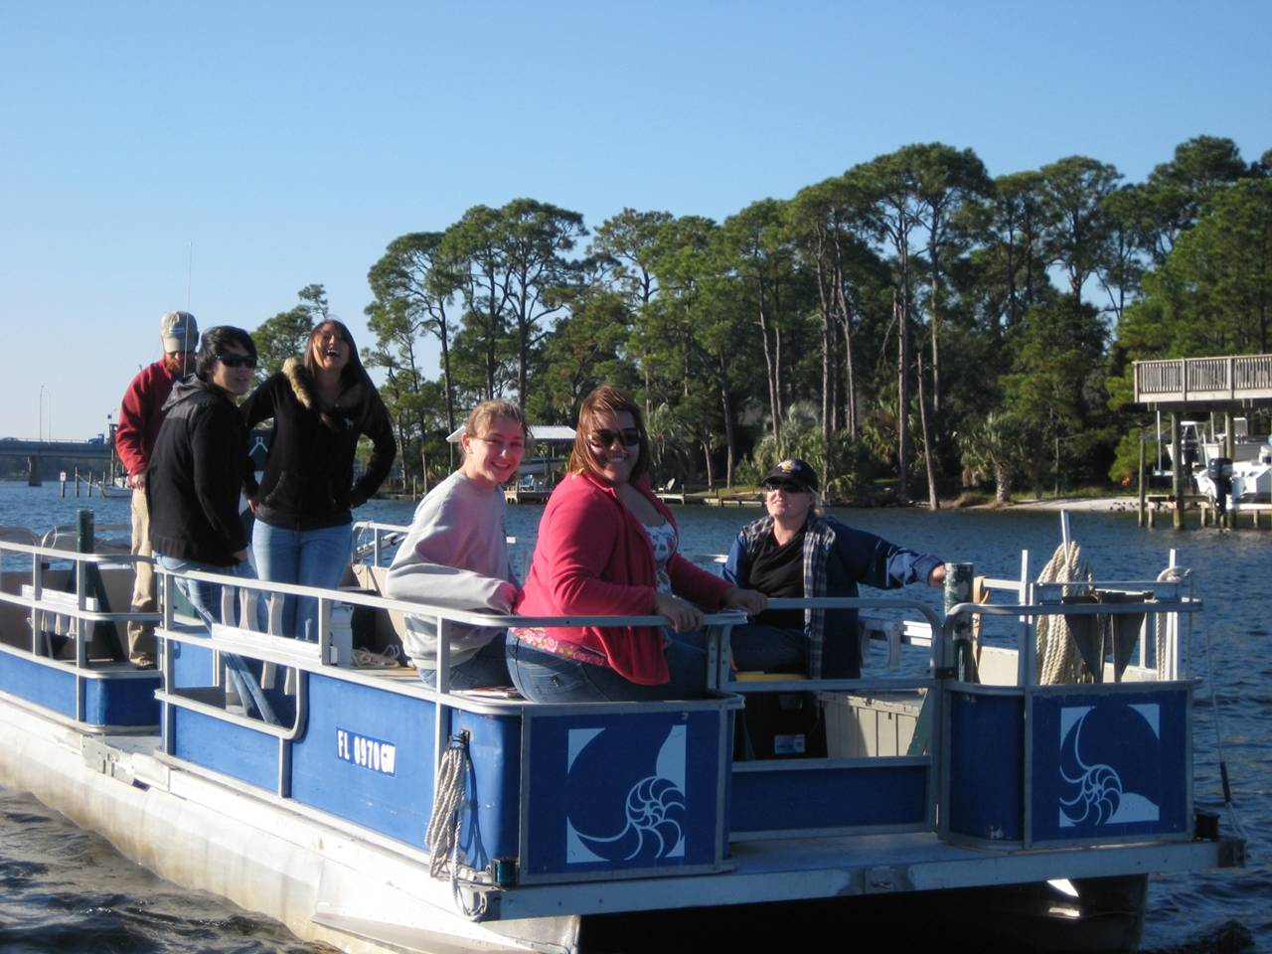
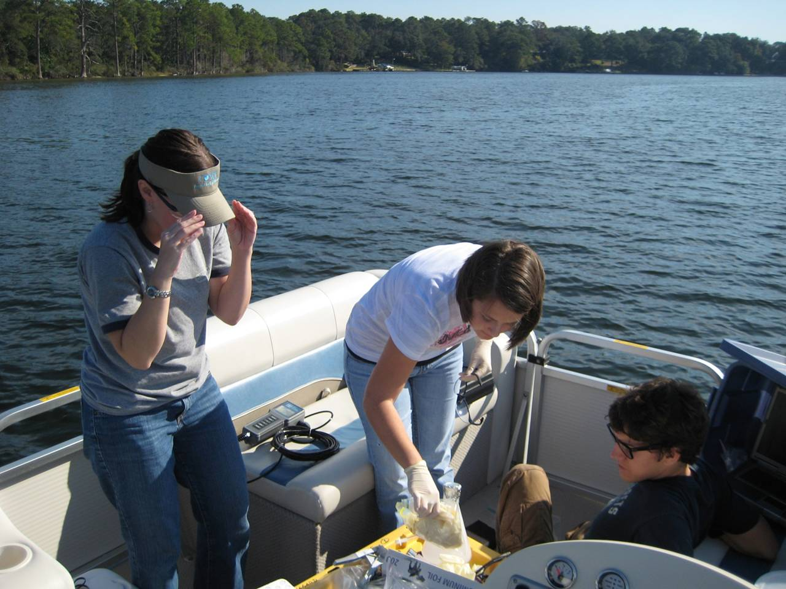
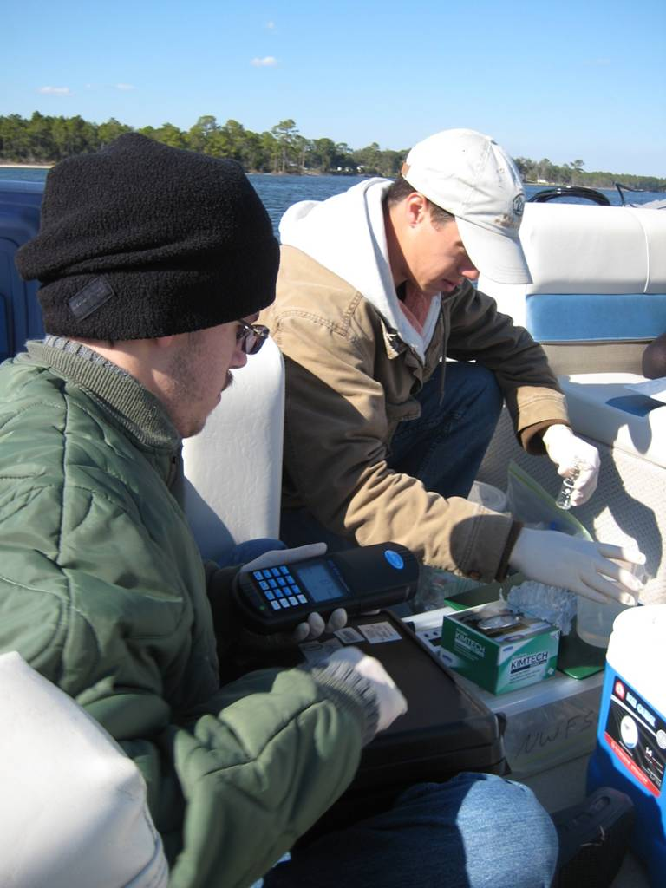
Field Trips (3)

Slide 14
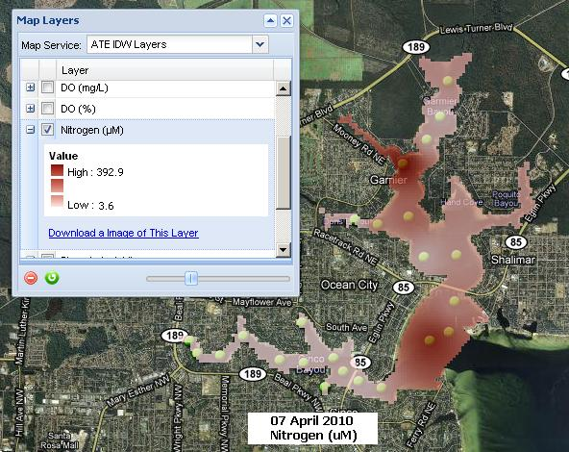
GIS and Data Visualization
Field data collection (three student groups)
  Temperature, salinity, dissolved oxygen (mg/L and %)
  Nitrate, phosphate
  Chlorophyll a
Data transfer to GIS webserver (each group)
Compilation of all student data
Interpolation of compiled data
  Each field parameter, plus calculated parameter (N/P)
Download maps (8) with interpolated data
“Floating classroom”
  In-field assessment by students and instructors

Slide 15
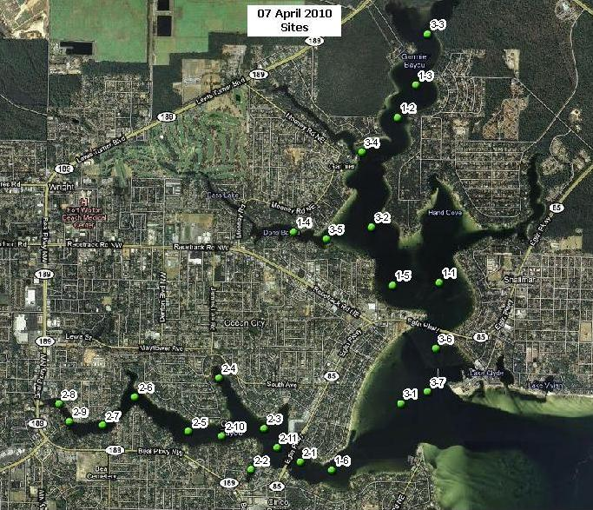
GIS Maps
Three separate groups simultaneously collect field data

Slide 16
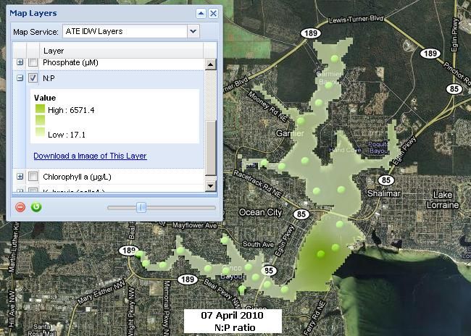
GIS Maps
Incorporate and assimilate student data from each of three different teams

Slide 17
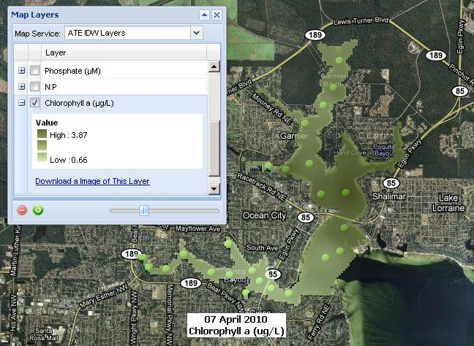
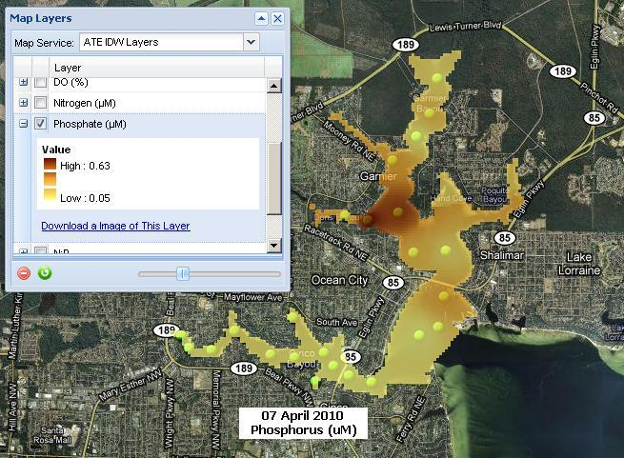
GIS Maps
Facilitates real-time, in-field assessment of class data by class

Slide 18
GIS Maps
Facilitates real-time, in-field assessment of class data by class

Slide 19
Year-one Products
New Aquatic Environmental Science course (OCE1013C) developed and offered
In-class student presentations evaluating data
GIS webserver mapping program developed, implemented, and optimized
Trained two PIs and one graduate student for continuing efforts
Impact assessment was inconclusive due to low sample size

Slide 20
Year-two Products
In-class student presentations evaluating data
Student booth at May 2010 Choctawhatchee Estuary Family Festival
June 2010 Teacher Workshop
Impact assessment revealed
  Significant increases in cognition, positive changes in technology acceptance levels, and increases in self-efficacy levels of the Experimental Group
  No significant changes in cognition, affect, technology acceptance, or career interest level of the Control Group

Slide 21
Acknowledgments
Fritz Langerfeld, UWF
NSF Advanced Technological Education
  DUE-0902898 (Beauregard)
  DUE-0902897 (Schwartz)
UWF Marine Services
Mattie M. Kelly Environmental Institute at NWFSC
GIS programmers:
  George Raber, University of Southern Mississippi
  Stuart Hamilton, College of William and Mary
All participating students
Notes:
21

Slide 22
Challenges and solutions
Two weeks between lab meetings
Homework assignments and quizzes

Slide 23
Quizzes & Homework
Week 1
  Provided personal copies of procedures
  Quizzed on basic details of specific steps
Week 2
  Provided labeled photos of all equipment
  Quizzed on names and uses
Week 3
  Assigned to create an abridged version of procedures
Weeks 4 & 5
  Quizzed on purpose and importance of various tasks and procedures

Slide 24
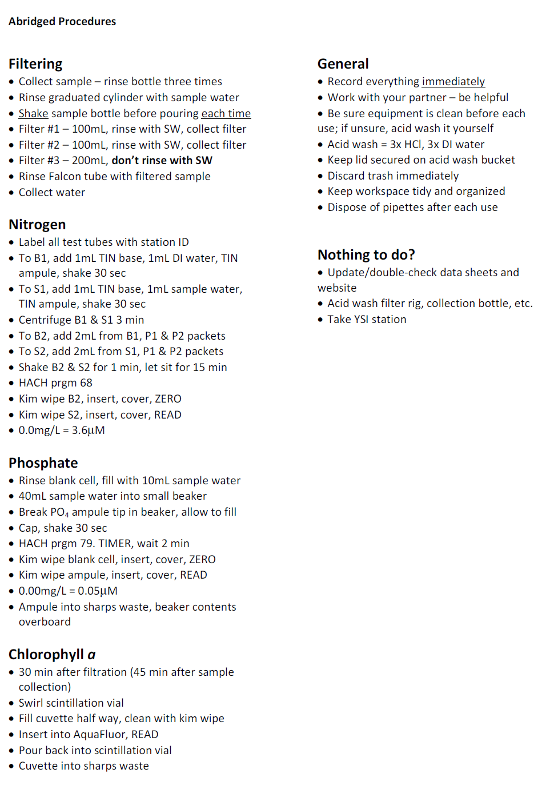
Abridged procedures
Nine-page document into one page
Remind students of the important steps

Slide 25
Challenges and solutions
Two weeks between lab meetings
Homework assignments and quizzes
Disorganization
Toolboxes, buckets
Active learning at end of day
Floating classroom

Slide 26
Group dynamics
Work in pairs
Switch tasks
(Ideally) 5th student acts as chief scientist

