Slide 1

Research Experiences in Community College
Science Programs
Allison Beauregard
Northwest Florida State College

Slide 2
Goals of Research Program
Challenge top students without losing general education students
Maintain my own connection to current research

Slide 3
Roadblocks to Research
Heavy teaching load
Scarce departmental funds
Lack of institutional support and assistance with grant writing and administration

Slide 4
Example Partnerships:
International research institution
Regional 4-year university

Slide 5
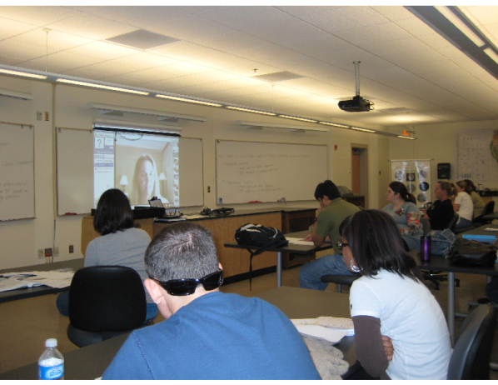
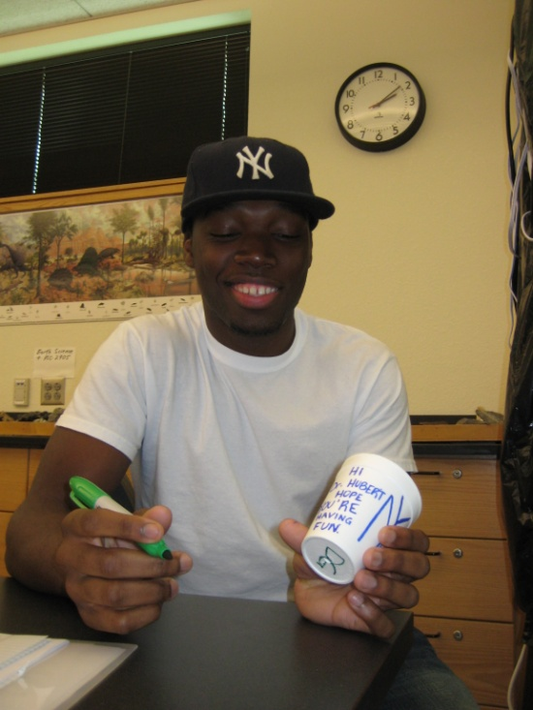
1. Marine Biological Laboratory
Funded under NSF – Biological Oceanography (broader impacts)
Incorporates cutting-edge hydrothermal vent science into NWFSC curriculum
  Researcher-student contact
  Vent curriculum
  Internship program

Slide 6
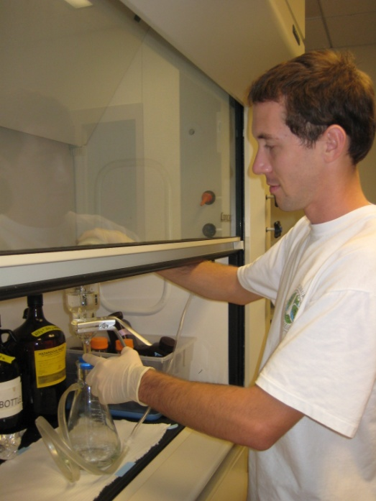
1. Marine Biological Laboratory
“Learning more, in-depth, about the ins and outs of a specific class of microbes and the amazing things they can do, and the tools that scientists use to learn and discover more about them, has really changed my perspective ...”

Slide 7
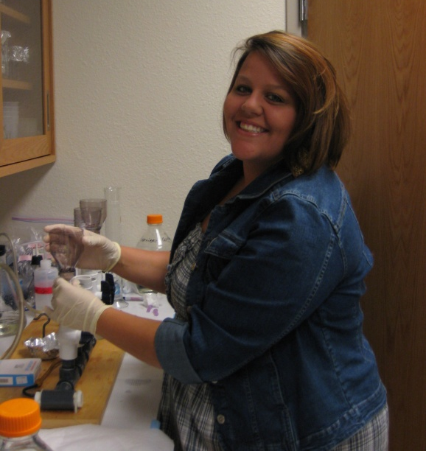
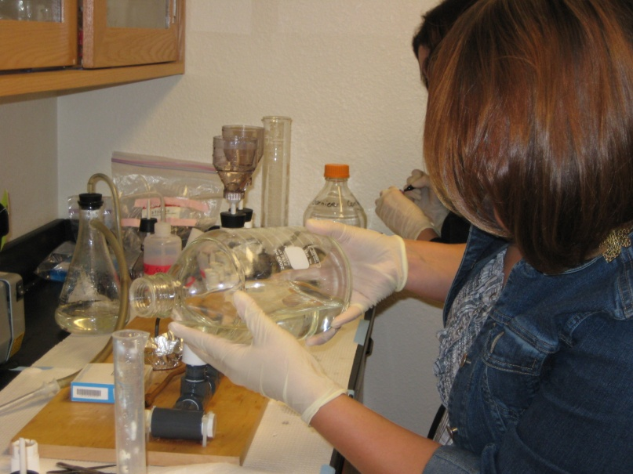
1. Marine Biological Laboratory
“My favorite part of the internship was being able to extract and run DNA on the gel by myself. I loved that the post-docs trusted us with the equipment… That really built my confidence ...”

Slide 8
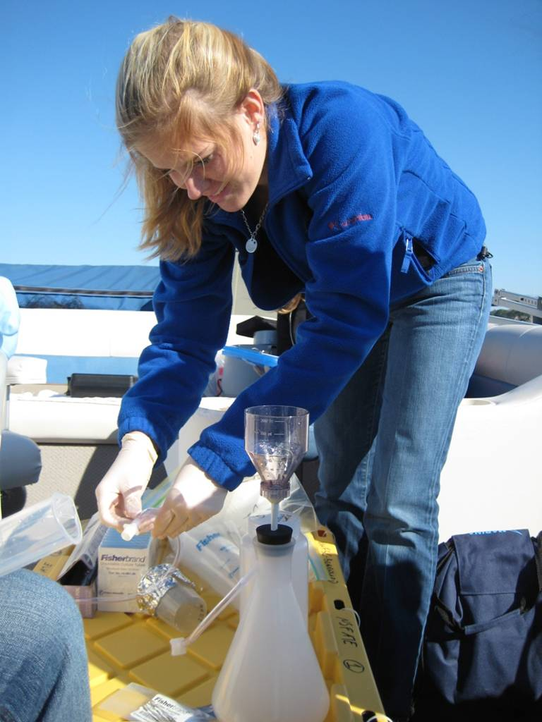
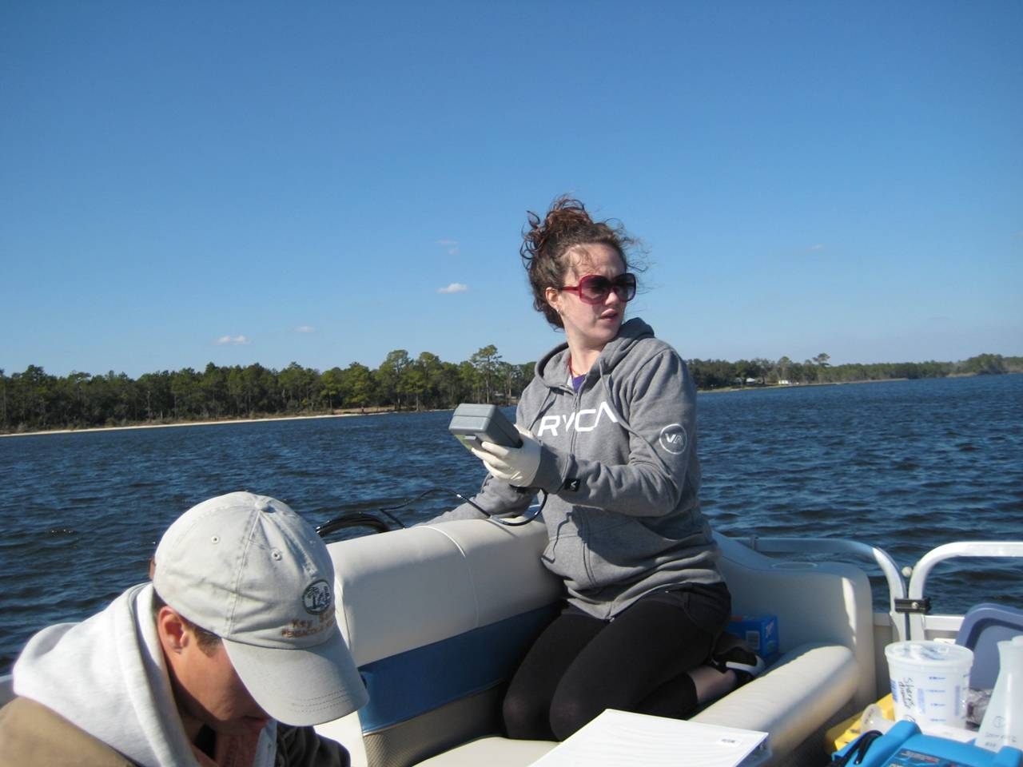
2. University of West Florida
Funded under NSF – ATE program
Developed new field/technology -based course at NWFSC (community college)
Co-taught by faculty from NWFSC & UWF & graduate student from UWF
Notes:
Partnership with a regional 4-year university partner
Tiered mentoring –
graduate student – less intimidating/easy to talk with and ask questions – see grad students as “real” people – maybe I could do that
Build relationship with faculty members at UWF and can ask questions about their program, classes, etc.
The UWF people get to interact with our students – see first hand what our students need, motivations, abilities, etc. And can identify specific students to recruit into their program

Slide 9
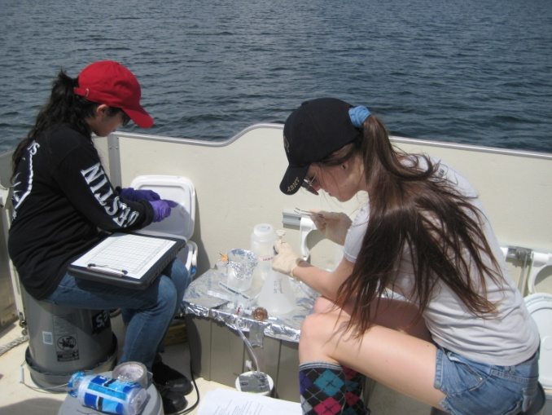
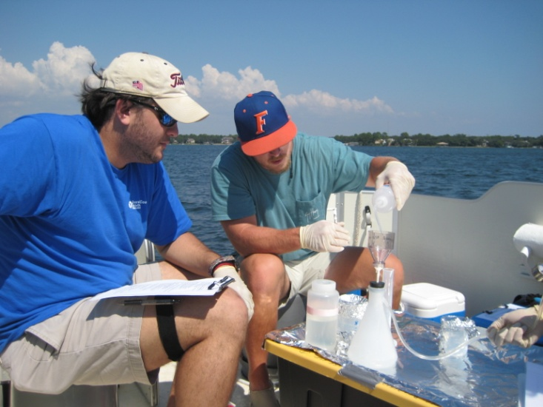
2. University of West Florida
“This is the first class I have ever had where we have had hands on technology; I thought it was great, it was a really cool way to learn.”
“… I'm in the water, I live on the water, and now I know what is in the water and why it matters to EVERYTHING- whoa! You may have taught me more than I've learned in any other class ever...”

Slide 10
Community College
Benefits of Collaborations:
Engages students at all levels (general ed to majors)
“Flexes” my research muscles
Builds relationships with other institutions/faculty
Boosts reputation of community college
Strengthens proposals
Access to boats, equipment, data
Access to grant resources (IRB, budgeting, Fast Lane, etc.)

Slide 11
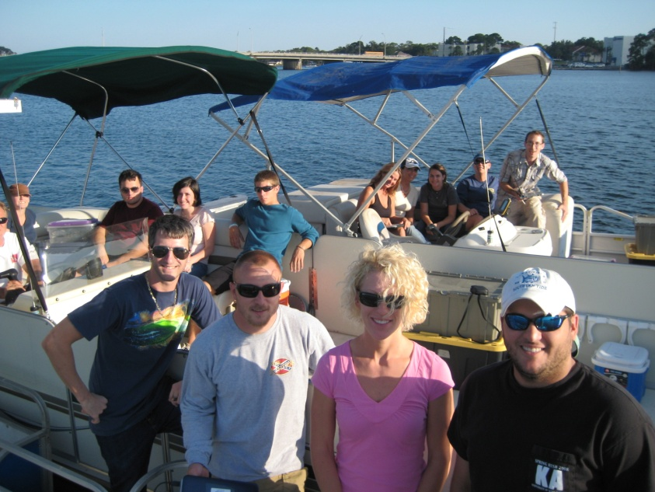
University & Research Partners
Benefits of Collaborations:
New equipment
Student recruitment
Access to community college funding sources!
Meaningful broader impacts strengthens proposals
Great PR

Slide 12
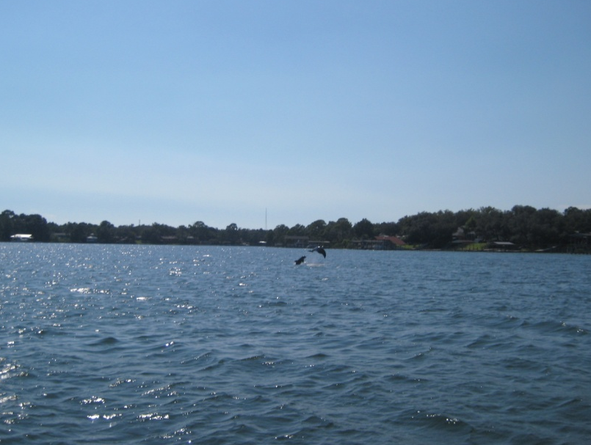
Acknowledgements
Dr. Matthew Schwartz, University of West Florida
Dr. Julie Huber, Marine Biological Laboratory
NSF Advanced Technological Education
  DUE-0902898 (Beauregard)
  DUE-0902897 (Schwartz)
NSF Biological Oceanography
  OCE-0929167

