Slide 1
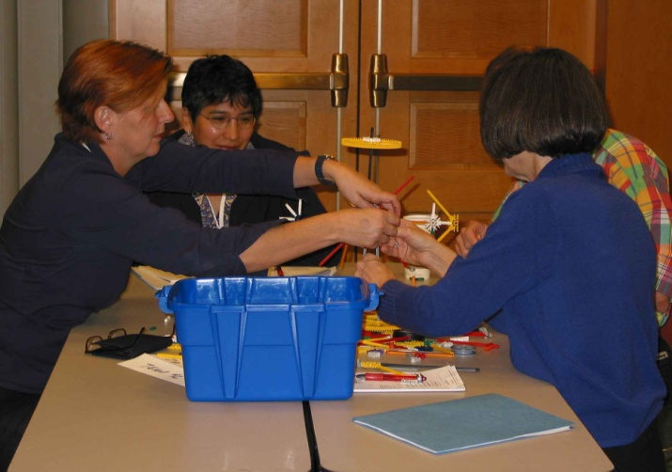

NSF Programs That Support Research in the Two-Year College Classroom
l V. Celeste Carter, National Science Foundation l Jeffrey Ryan, University of South Florida l Jill Singer, SUNY-Buffalo State l
Abstract
The National Science Foundation recognizes the significant role provided by two-year institutions in providing high quality STEM courses to large numbers of students. For some students the STEM courses completed while attending a two-year institution represent the only STEM courses a student may take; for others the courses serve as the foundation to continue on into a STEM major at a four-year institution; and some students complete STEM courses that lead directly into the workforce. Several programs in the Division of Undergraduate Research, including the Advanced Technological Education (ATE) program, STEM Talent Expansion Program (STEP), and the Transforming Undergraduate Education in STEM (TUES) program, support the inclusion of student research experiences at two-year institutions. Information about these programs and examples of successful funded projects will be provided. Resources for faculty considering applying for support will be shared with special attention to a faculty development program designed to help faculty learn about funding opportunities and prepare proposals for submission to the TUES and ATE programs.
Making a Case for Undergraduate Research
Transforming Undergraduate Education in STEM (TUES)
Undergraduate research builds student skills and competencies
ATE is a workforce program that supports the needs of industries
  Craft the proposal to inform the reviewers regarding skills and competencies recognized and valued by industry
Suggestion: Take advantage of NSF Award Search to read abstracts of funded projects that involve undergraduate research
Supports educational innovation at the undergraduate level in all disciplines
May and January deadlines each year, for small* and larger projects
Type 1: Exploratory Projects*
  Up to $200,000 ($250,000 when 4-year & 2-year schools collaborate)
  Type 2: Expansion Projects
  Up to $600,000; 2 to 4 years; build on smaller-scale proven ideas. Diverse users at several institutions, or work at one institution aimed at systemic change.
  Type 3: Large-Scale Projects
  Up to $5,000,000 over 5 years; combine proven results and mature products. Involve several diverse institutions
  * Recommended to test new ideas and approaches, pilot new strategies and curricula. Primary impact is on your own campus, but addressing important problems in the discipline, with proactive dissemination/faculty development.
ATE and Undergraduate Research
Advanced Technological Education (ATE)
DUE-0603119. PI: Nancy Hensel, Council on Undergraduate Research
www.cur.org
This project is exploring the current status of undergraduate research, identifying potential partners, developing resources, and creating a plan for establishing new partnerships that promote undergraduate research in community college technician education programs.
ATE solicitation (11-692):
  www.nsf.gov
  Formal Proposals: October 2012 (tentative)
Projects: up to $900,000 for 3-yrs
  Small, new to ATE: $200,000 for 3-yrs
Supported Activities
Hot Topics in Geosciences
Climate Change
Energy and Resources
Cyberlearning
Visualizations
Geospatial Tools &Technologies
Creating New Learning Materials and Teaching Strategies
Developing Faculty Expertise
Implementing Educational
Innovations
Assessing Learning and Evaluating Innovations
Research on Undergraduate STEM Teaching and Learning
The TUES Program and Undergraduate
Research at Two-Year Colleges
1123181: David Bahr, Washington State University
Collaborative Proposal: EURO: Enhancing Undergraduate Research Opportunities
This project is developing a collaborative approach to increasing early undergraduate participation in significant research activities through courses and programs designed to teach general research skills. By focusing on "research oriented" or "research skills" experiences, more students can be economically included early in their undergraduate studies.
TUES Can Support Undergraduate Research
Projects which focus on:
  Program Development, Implementation and Improvement
  Professional Development for Educators
  Curriculum and Educational Materials Development
  Teacher Preparation
  Small Grants for Institutions New to the ATE Program
  Business and Entrepreneurial skills for students in technician education programs
  Undergraduate Research (in the context of gaining skills needed in the workplace)
  Mentoring students: recruitment, retention, completion
  Veterans in STEM Technician Education
Acquisition of research quality equipment and its integration into undergraduate courses, including independent research
Construction of lab courses and exercises that integrate advanced equipment, prepare students for research, and draw on faculty research expertise
Incorporation of inquiry-based projects into laboratory courses
Partnerships with local research and informal education institutions
Service learning can provide relevant problems while addressing the needs of the local community
1118679 James Hewlett, Finger Lakes Community College
The Community College Undergraduate Research Initiative
This project is a national consortium of community colleges, four-year schools, government agencies, and private organizations dedicated to the development, implementation, and assessment of a sustainable model for integrating an undergraduate research (UR) experience into community college biology curriculum. In partnership with the Council on Undergraduate Research (CUR), CCURI has developed a fully-integrated model for integrating undergraduate research at a community college.
Resources to
Transform
Undergraduate
GEOscience
EDucation
Resources to Transform Undergraduate Geoscience Education is providing digital resources and faculty workshops aimed at building capacity within the geosciences community to increase both the quantity and quality of grant proposals submitted to the NSF TUES* program and other NSF educational programs. The project is delivering proposal writing workshops at sectional and regional geoscience conferences and workshops held at Buffalo State (June 2012) and University of South Florida (June 2013) aimed at earth, oceans, atmospheric, environmental, and geospatial science faculty from research and comprehensive universities and two- and four-year colleges. All geoscience faculty are encouraged to participate and faculty with limited or no previous NSF education funding will be given priority at the two summer workshops.
Information Session
American Geophysical Union Fall Meeting
December 6, 2011, 12:30 - 1:30 p.m.
Moscone North, Room 124
Light lunch provided.
RTUGeoEd supported by DUE-1134954; DUE-1134963

