Slide 1
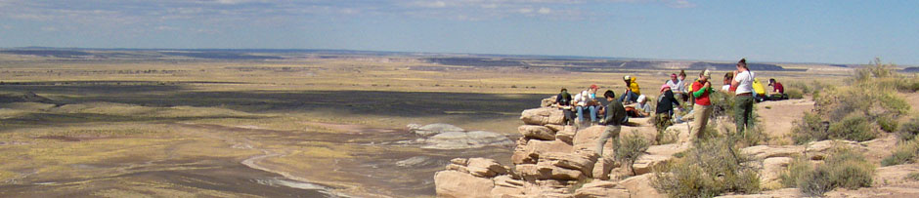
The Role of 2YC’s in Broadening
Participation in the Geosciences:
Some Data and Some Questions
Heather Macdonald, College of William and Mary
Bob Filson, Green River Community College

Slide 2
What does “broadening participation in the geosciences” mean to you?

Slide 3
Some Numbers from the American Association of Community Colleges
1173 colleges
  ~12 million students, 6.8-8 million taking courses for credit
  60% part time, 40% full time
  56% women, 44% men
  40% minorities
  42% first generation to attend college
CC students constitute the following % of undergrads
  43% undergraduates
  53% Hispanic, 52% Native American, 45% Black, 45% Asian/Pacific Islander
http://www.aacc.nche.edu/AboutCC/Documents/factsheet2010.pdf

Slide 4
Student Demographic Data from Participant Colleges
Institution Geoscience Courses

Slide 5
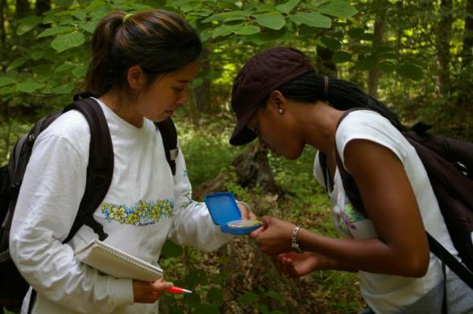
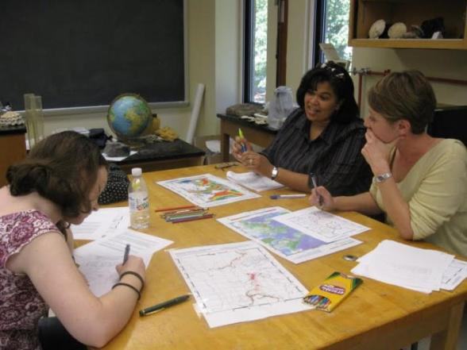
Examples of Programs and Strategies to Enhance Diversity in the Geosciences
Contributed by Callan Bentley
What are we doing?
What could we be doing?
What information and resources are needed?
Peter Berquist

