Slide 1
A National Perspective on Geosciences at Community Colleges
Leila M. Gonzales
American Geological Institute

Slide 2
Community Colleges at a Glance
750,164 Associate’s degrees conferred in 2008
  2,268 geoscience and geoscience-related AA/AS degrees
Higher pool of diversity than in 4-yr institutions (esp. Hispanic students)
Transfer potential
  ~67% of students intend to obtain a bachelor’s degree. (Special Analysis 2008, Condition of Education, NCES)

Slide 3
Enrollment Trends at 4-year Institutions

Slide 4
Degree Trends at 4-year Institutions

Slide 5
Minority Representation at 4-year Institutions

Slide 6
Minority Representation at 4-year Institutions

Slide 7
Minority Representation at 4-year Institutions

Slide 8
Degree Gender Parity at 4-year Institutions

Slide 9
Community College Trends
233 of 1685 community colleges have degree programs in the geosciences or related physical sciences.
  145 offer “general” geoscience programs.
    Physical Science, Environmental Science, Natural Science
  76 offer “core” geoscience programs.
    Geology/Earth Science, Atmospheric Science, Hydrology, Oceanography,
    CA = 44, TX = 12
Community college adaptability to changing workforce requirements
  New programs in renewable energy, sustainable development, etc.

Slide 10
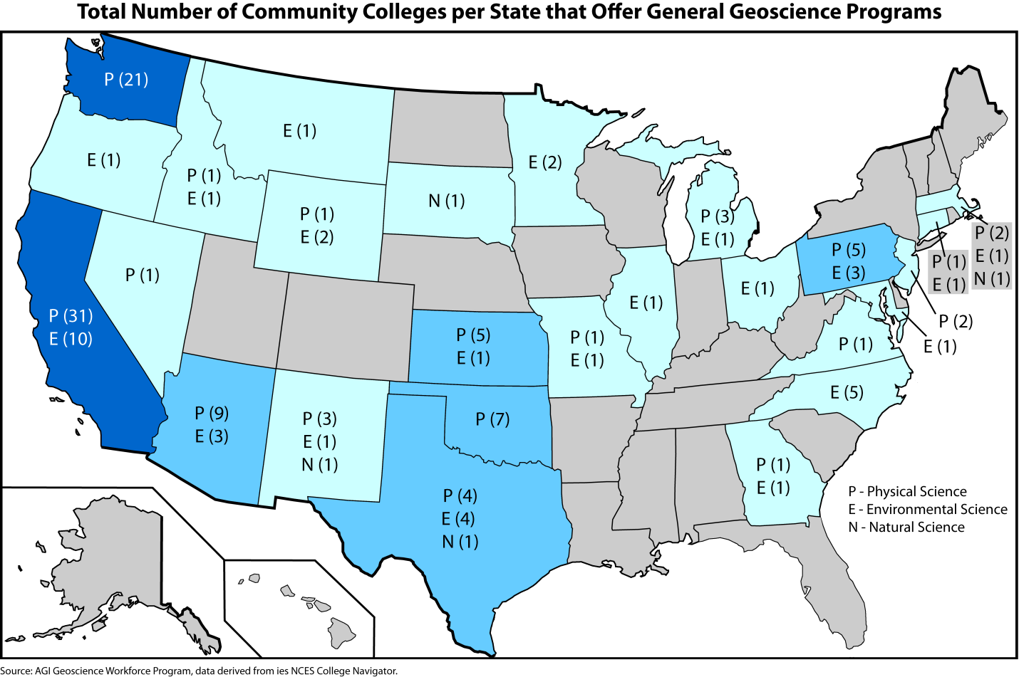

Slide 11
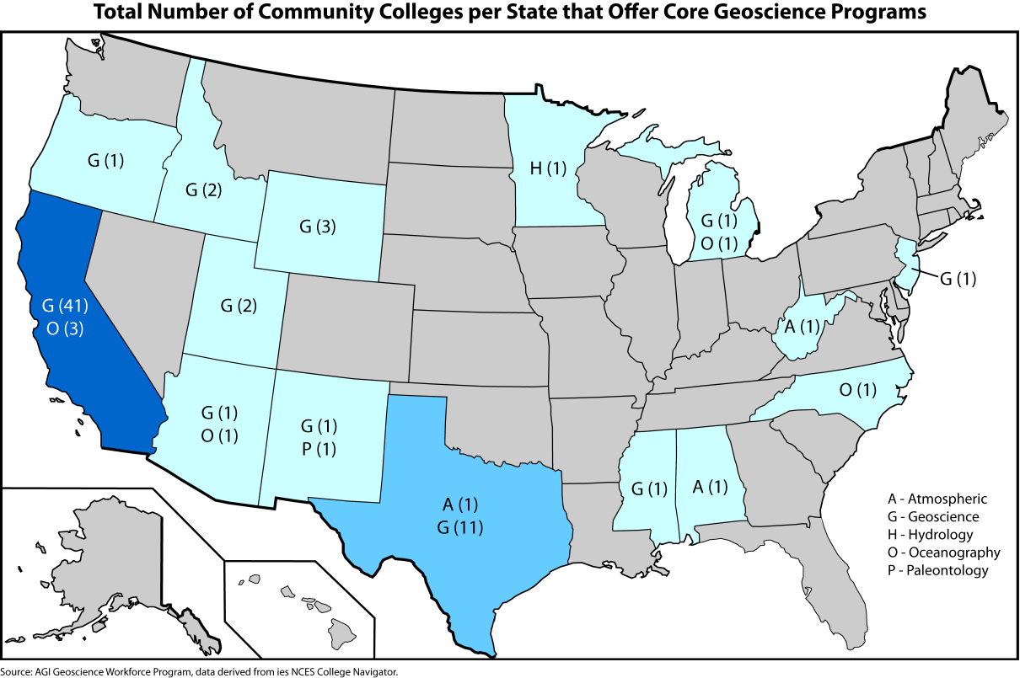

Slide 12
Participation of Under-represented Minorities

Slide 13
Gender Parity in College Enrollments

Slide 14
Degrees Conferred

Slide 15
Minority Participation

Slide 16
Gender Parity

Slide 17
Faculty Information

Slide 18
Faculty Information

Slide 19
Where do we go from here?
Update DGD with information from H. Macdonald
  NCES, DGD information merge.
Information on faculty diversity

