Slide 1
History of the Two-Year College
Physics Faculty in the AAPT
Warren Hein
Executive Officer
American Association of Physics Teachers

Slide 2
AAPT’s Mission
AAPT was founded in 1930 to enhance the understanding and appreciation of physics through teaching.
Four critical issues that guide AAPT’s future activities:
  Increased support for the teaching and learning of physics.
  Increase the diversity and numbers of physics teachers and students
  Improve the pedagogical skills and physics content knowledge of teachers at all levels.
  Increase our understanding of physics learning and of ways to improve teaching effectiveness.

Slide 3
Governance
AAPT Executive Board
  Eleven Elected Members
    President, President-Elect, Vice-President, Past President
    Secretary, Treasurer
    Chair and Vice-Chair of the Section Representatives
    Three members-at-large representing four-year colleges and universities, two-year colleges, and pre-college constituencies
  Three Ex-officio members
    Editor of American Journal of Physics, Editor of The Physics Teacher, the Executive Officer

Slide 4
Council
Section Representatives
  AAPT currently has 51 sections
    45 sections in the United States roughly aligned with state boundaries
    4 sections in Canada-Alberta, British Columbia, Ontario and Quebec
    Mexico
    Puerto Rico
Executive Board
Meets annually at the AAPT Winter Meeting

Slide 5
18 Area Committees
Apparatus
Educational Technologies
Graduate Education in Physics
History and Philosophy of Physics
Interests of Senior Physicists
International Education
Laboratories
Minorities in Physics
Physics in High Schools
Physics in Pre-High School Education
Physics in Two-Year Colleges
Physics in Undergraduate Education
Professional Concerns
Research in Physics Education
Science Education for the Public
Space Science and Astronomy Education
Teacher Preparation
Women in Physics

Slide 6
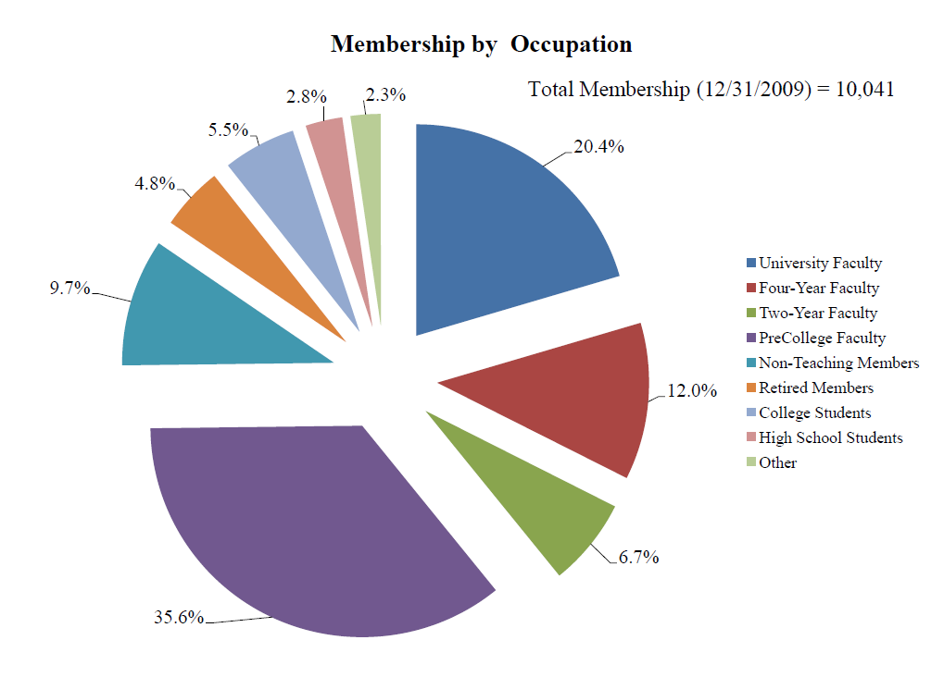
6.7%TYC Physics Faculty

Slide 7
AAPT TYC Physics
Federally Funded Commission of College Physics (1968)
  Panel on Physics in Two-Year Colleges Sponsored Meetings and Workshops
Committee on Physics in Two-Year Colleges Established (1970)
First TYC Representative elected to AAPT Executive Board (??)
National Conference of TYC Physics Faculty (November 1989) Critical issues identified:
  There is a feeling of isolation experienced by many TYC physics faculty;
  There is a need to network with other TYC faculty;
  There is a need to remain current in pedagogical approaches to teaching physics;
  There is a need to know how many students take physics at two-year colleges; and
  There is a need to know what encompasses a physics program at TYC (and how to keep it current).

Slide 8
AAPT TYC Physics
The AAPT Two-Year College in the 21st Century (TYC21) Project funded by the NSF ATE program (Mary Beth Monroe, Southwest Texas Junior College, and Marv Nelson, Green River Community College, co-principal investigators)(1994-2000) resulted in a plan of action to address the critical issues:
  Provide professional development for TYC faculty at AAPT national meetings, AAPT section meetings, and at meetings in the 15 regions established by the TYC21 project;
  Seek external funding for professional development to be led by members of the TYC physics community; and
  AIP Statistical Research Center survey of TYC physics programs funded primarily by NSF ATE (Physics in the Two-Year Colleges and Directory of Two-Year College Physics Programs & Staff: 1996-1997).
  Project Report : A Model of Reform - Two-Year Colleges in the Twenty-First Century: Breaking down Barriers http://www.physicsworkshops.org/TYC_Information.html

Slide 9
AAPT TYC Physics
Two-Year College Workshop Project (1991-2005) (Curtis Hieggelke, Joliet Junior College, and Tom O’Kuma, Lee College)
  Three Day Intensive Workshops at TYC Sites around the Country emphasizing current curriculum and technology and their implementation into the physics classroom
  61 workshops, hosted by 23 different TYC, 52 different workshop leaders, 1,304 participants from 46 different states, Puerto Rico, and Marshall Islands, 336 different TYCs, and 92 different high schools (http://tycphysics.org)
PEPTYC Project (1991-2004) (Robert Beck Clark, Texas A&M University, and Tom O’Kuma, Lee College)
  One or two year programs with 2 week intensive May Institutes (“Physics Boot Camps”) and 2 academic year follow-ups at Texas Section AAPT meetings
  Modern physics topics and pedagogical curriculum topics
  7 programs, 148 TYC faculty representing 128 TYCs, 35 states and Puerto Rico

Slide 10
AAPT TYC Physics
ATE Program for Physics Faculty Project (2006-2010) (Tom O’Kuma, Lee College, and Dwain Desbien, Estrella Mountain Community College)
  Three Day Intensive Workshops and Conferences at TYC Sites around the country emphasizing current curriculum and technology and their implementation into the physics classroom and sustainability at their institutions
  15 workshops, 8 different TYC sites and 1 university, 307 participants from 36 states, Puerto Rico and American Samoa, 158 TYCs. 137 high schools, and 12 university participants (http://www.physicsworkshops.org)

Slide 11
AAPT TYC Physics
SPIN-UP/TYC project (2002-2005) (Monroe, O’Kuma, and Hein) included a follow-up survey of the 1998 Physics in the Two-Year Colleges survey by the AIP Statistical Research Center. The project found that successful two-year college physics programs had the following common features:
  A dedicated physics faculty;
  A real and sincere interest in students;
  A collegial relationship with other faculty, in particular STEM faculty; and
  A good working relationship with the administration.
Strategic Programs for Innovations in Undergraduate Physics at Two-Year Colleges: Best Practices of Physics Programs (AAPT, College Park, MD, 2005) is available online at: http://www.aapt.org/Programs/projects/spinup/spinup-tyc.cfm

Slide 12
AAPT TYC Physics
New Faculty Experience for TYC Physics Faculty(2010-2012) (Scott Schultz, Delta College, Todd Leif, Cloud County Community College, and Hein) funded by NSF DUE to introduce new TYC faculty to the results of Physics Education Research and interactive engagement methods to improve their teaching and the learning of students.
Tandem Meeting of TYC Physics Faculty prior to the AAPT Summer Meeting in Portland, OR, on July 16-17, 2010
TYC Breakfasts at every AAPT meeting

Slide 13
AAPT
Strengthening Physics Education
Supporting Physics Educators
www.aapt.org
whein@aapt.org

