Slide 1
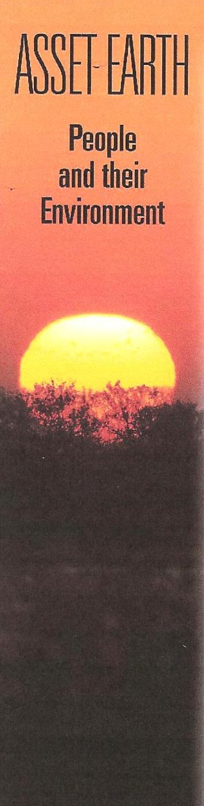

“Asset Earth” as a method of building community at Waubonsee Community College
David H Voorhees
Sugar Grove, IL

Slide 2
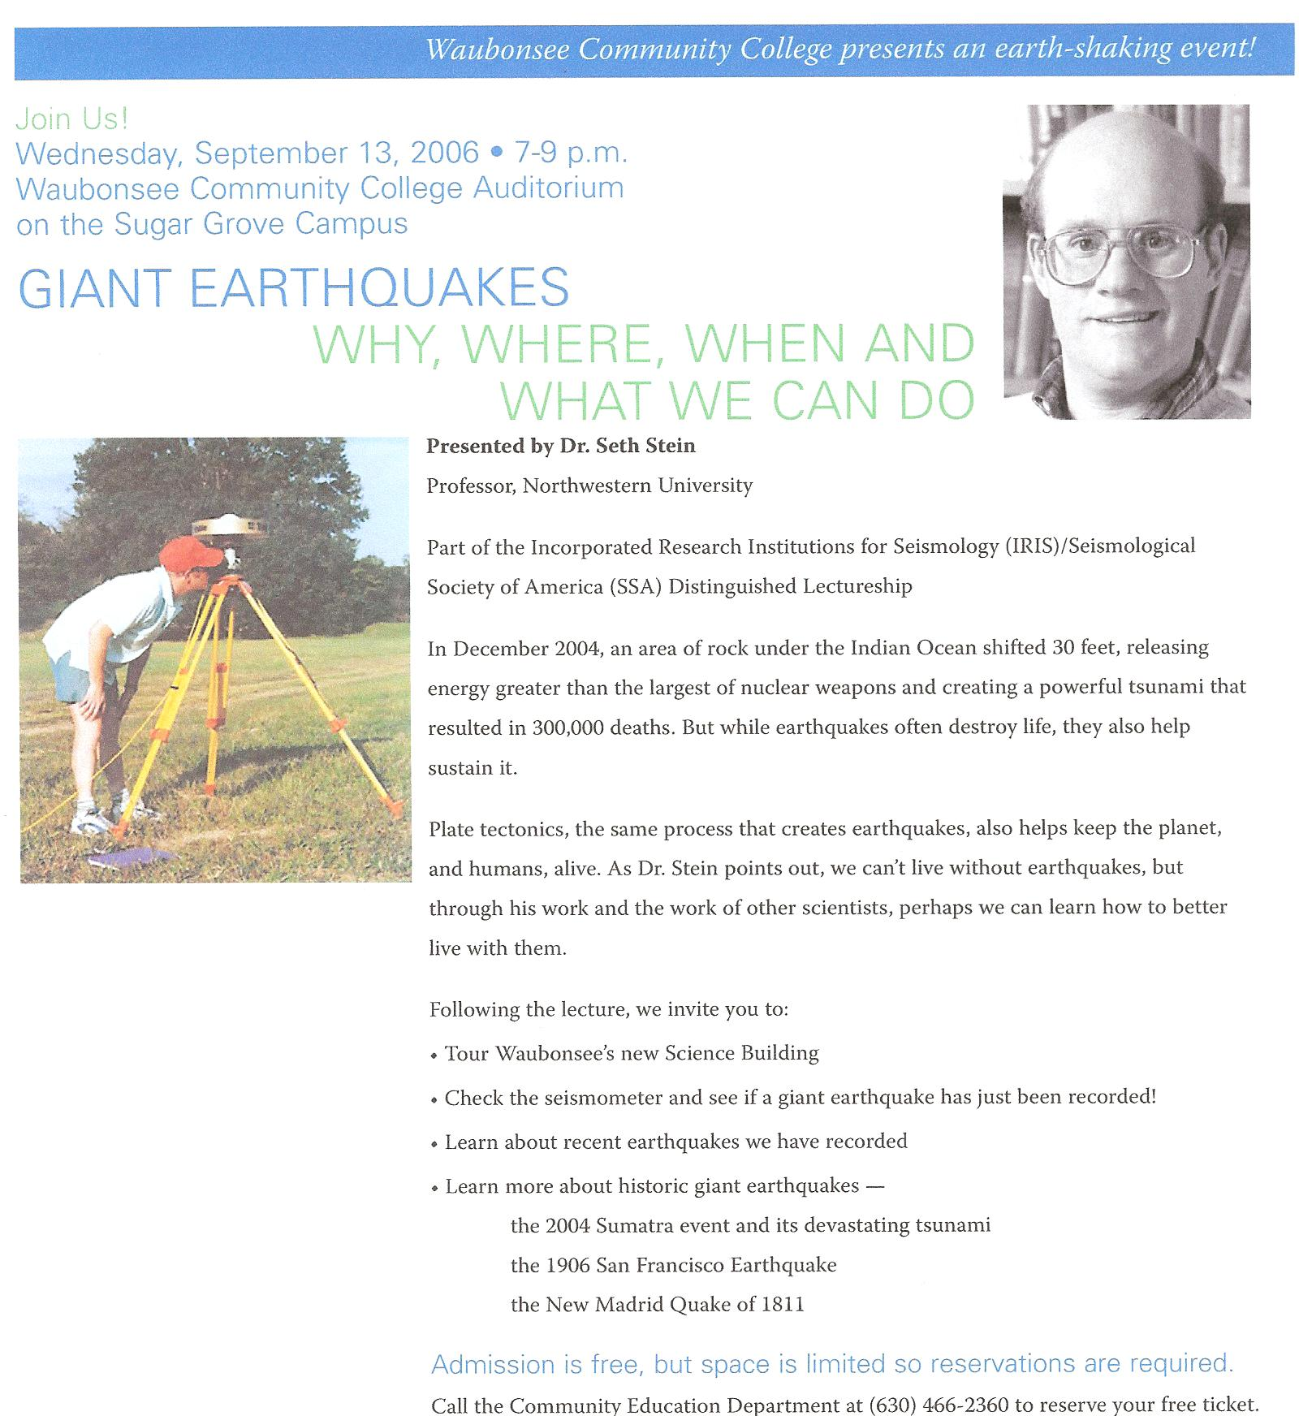
Asset Earth
Model is colloquium
General audience
WCC
  Students
  Staff
  Faculty
  community
Notes:
Audience is
Non-scientific
Non-specialist

Slide 3
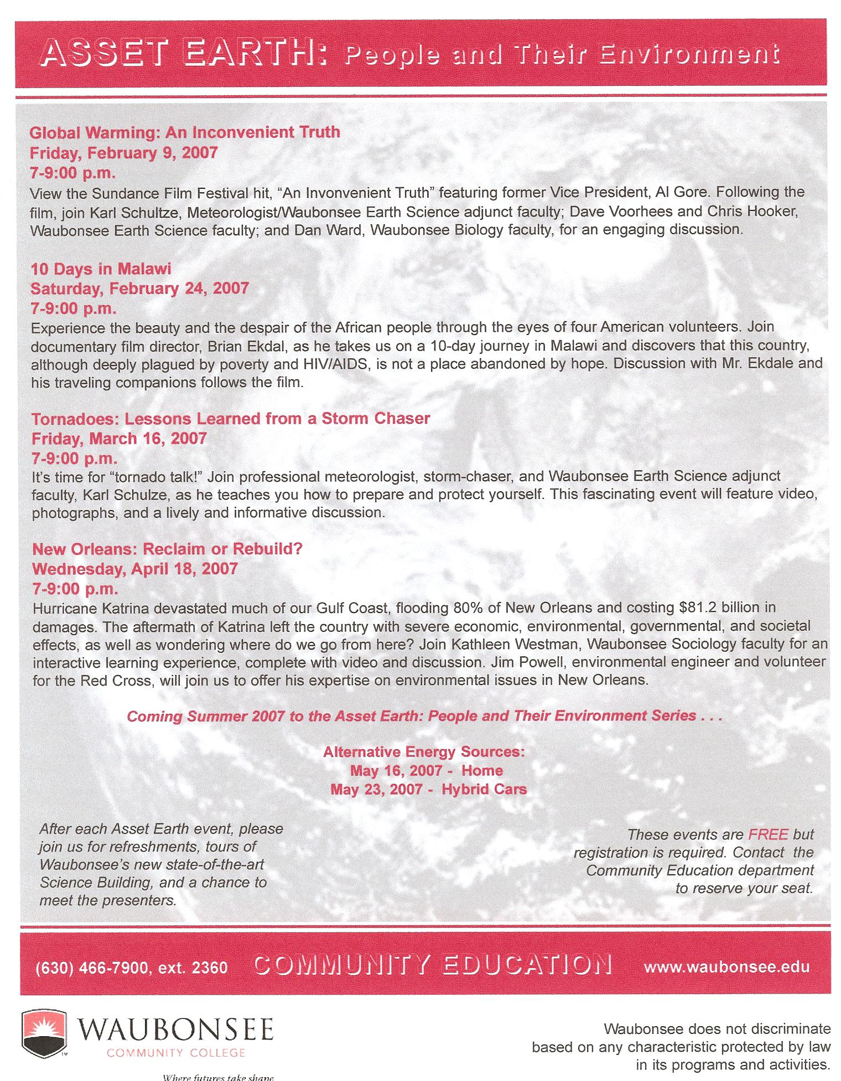
Goal
Scientific literacy
Current topics in science
  Diverse topics
Cross-discipline
Notes:
The title ‘Asset Earth’ allows us to present topics over a broad range of topics, from earth science & geology to bio and meteorology & economics
Improve scientific literacy
“Asset Earth” title developed/coined by Comm Ed Dept

Slide 4
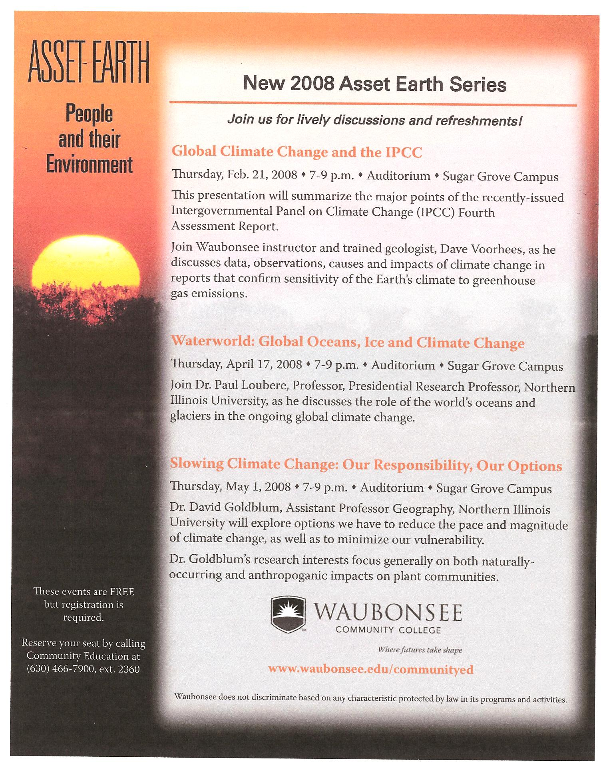
Typical event
Free
Thursday evening
  80 to 120
1 hour presentation
‘meet-and-greet’
  Book signing?
giveaways
Notes:
Refreshments
1st had ‘seismic eruption cookies’
Informal dinner with speaker before

Slide 5
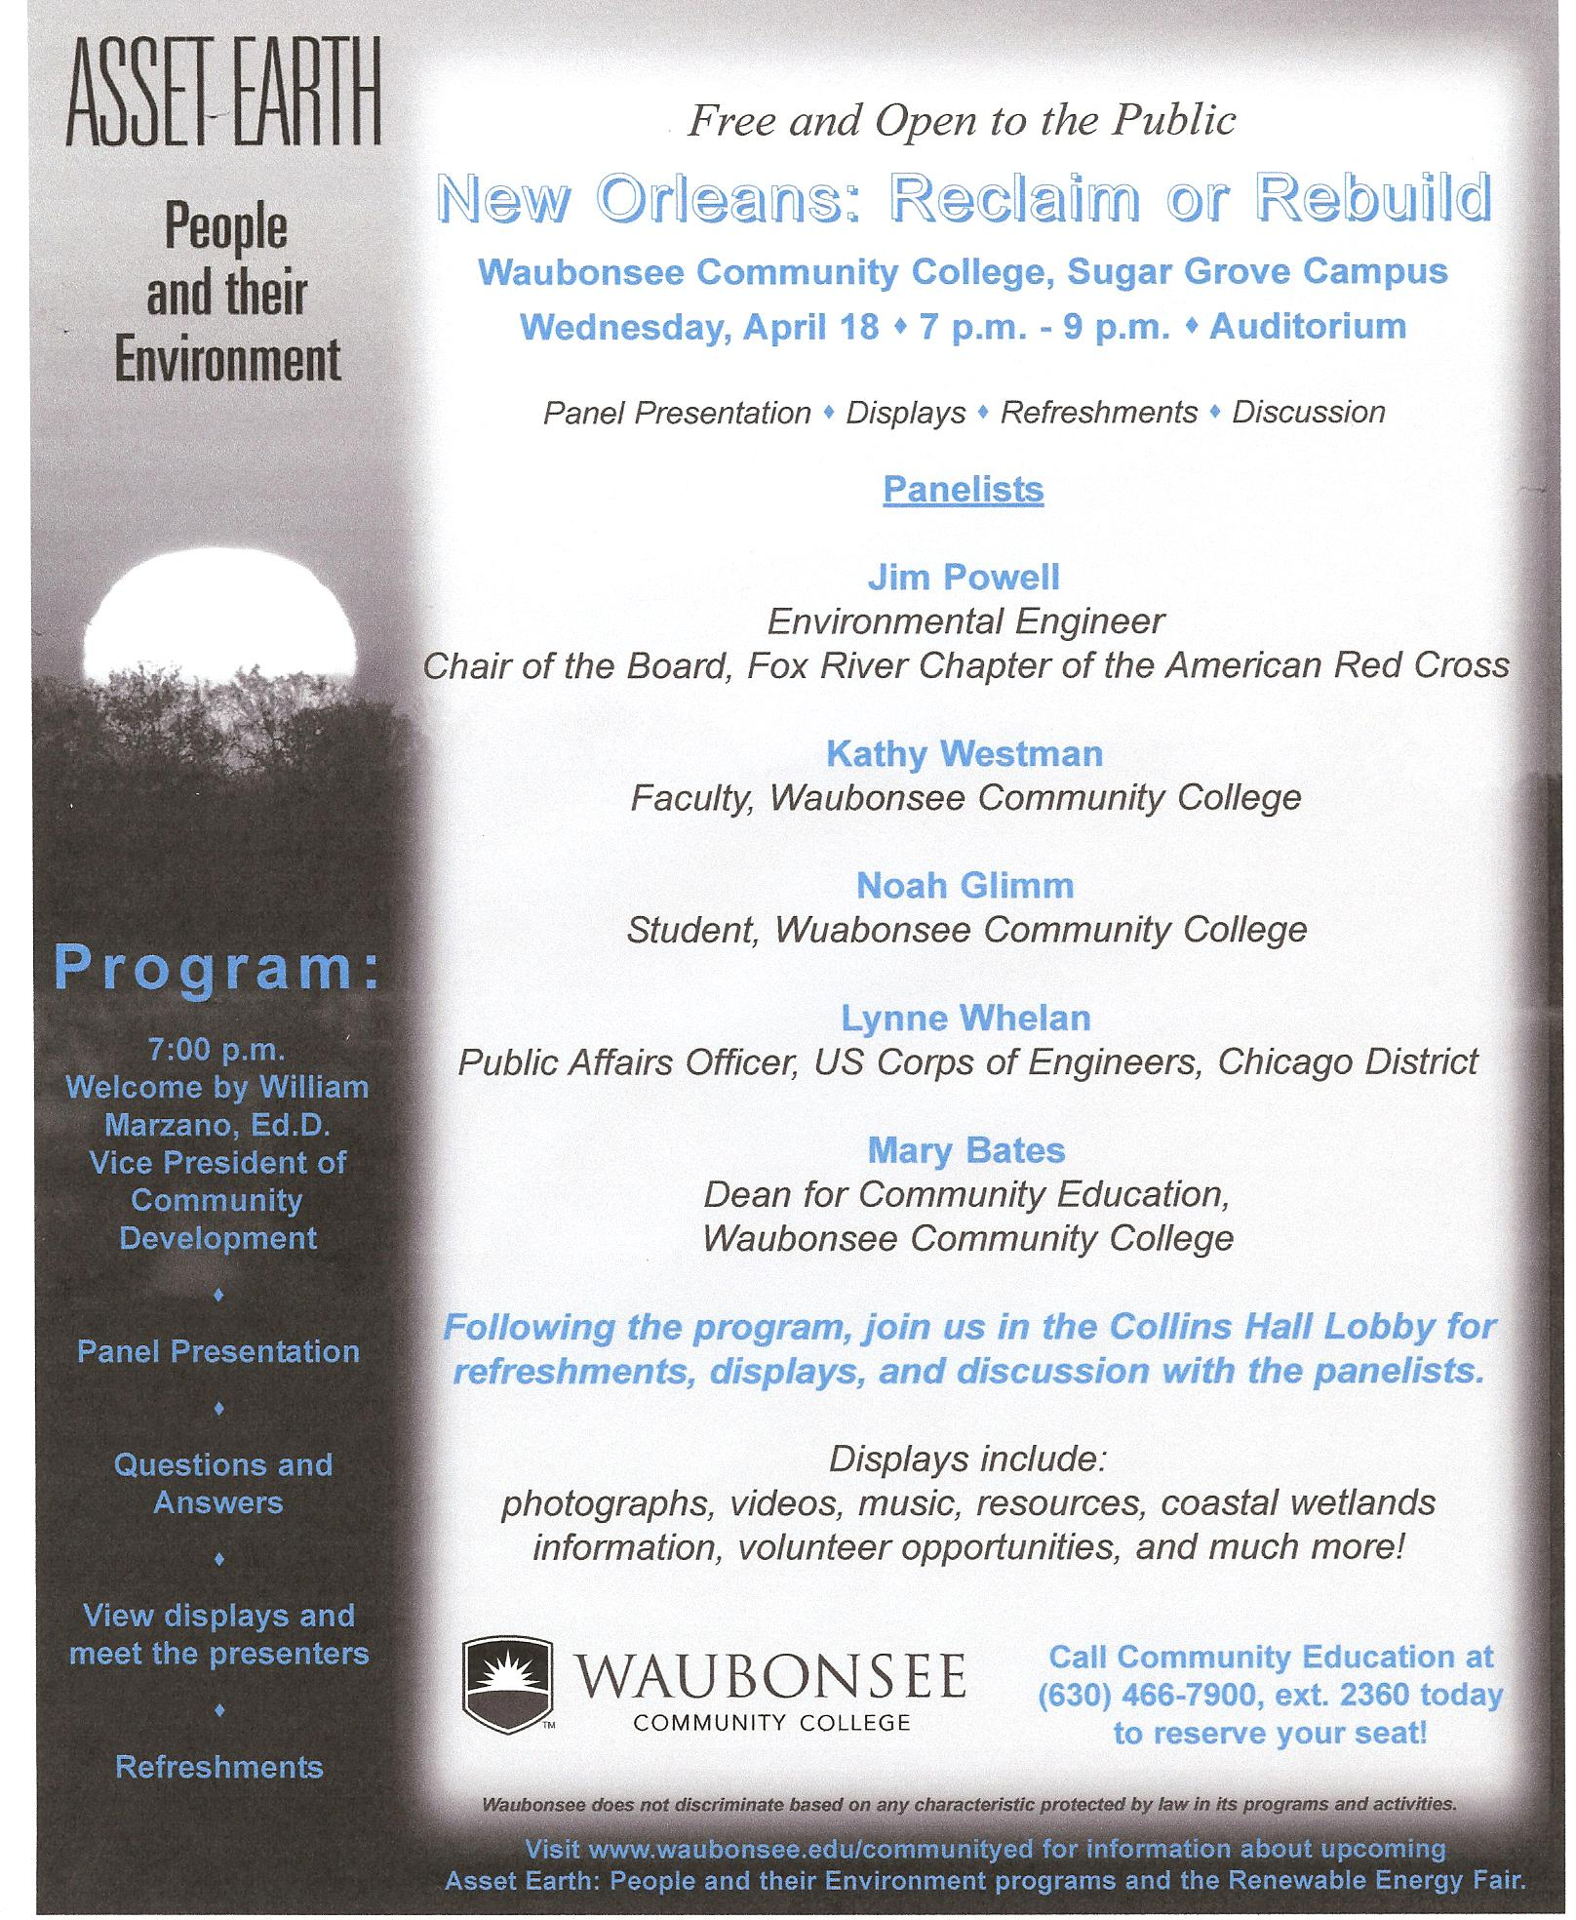
Key to success
Links with
  Community Education
    mailings
  Marketing & Communication
    Press releases
    WCC website
Speaker selection
  WCC faculty
    (red titles)
  Outside WCC
Notes:
Selection of speaker critical, have to be a presentation that is not laden with jargon & facts/graphs. Also, presentation (note not a lecture) is to be entertaining as possible.
Comm Ed
advertisements in program catalogue(s)
flyers in slides
M&C
when possible
electronic bill board on road
radio announcements
PSA
Speaker needs to focus on typical non-specialist audience

Slide 6
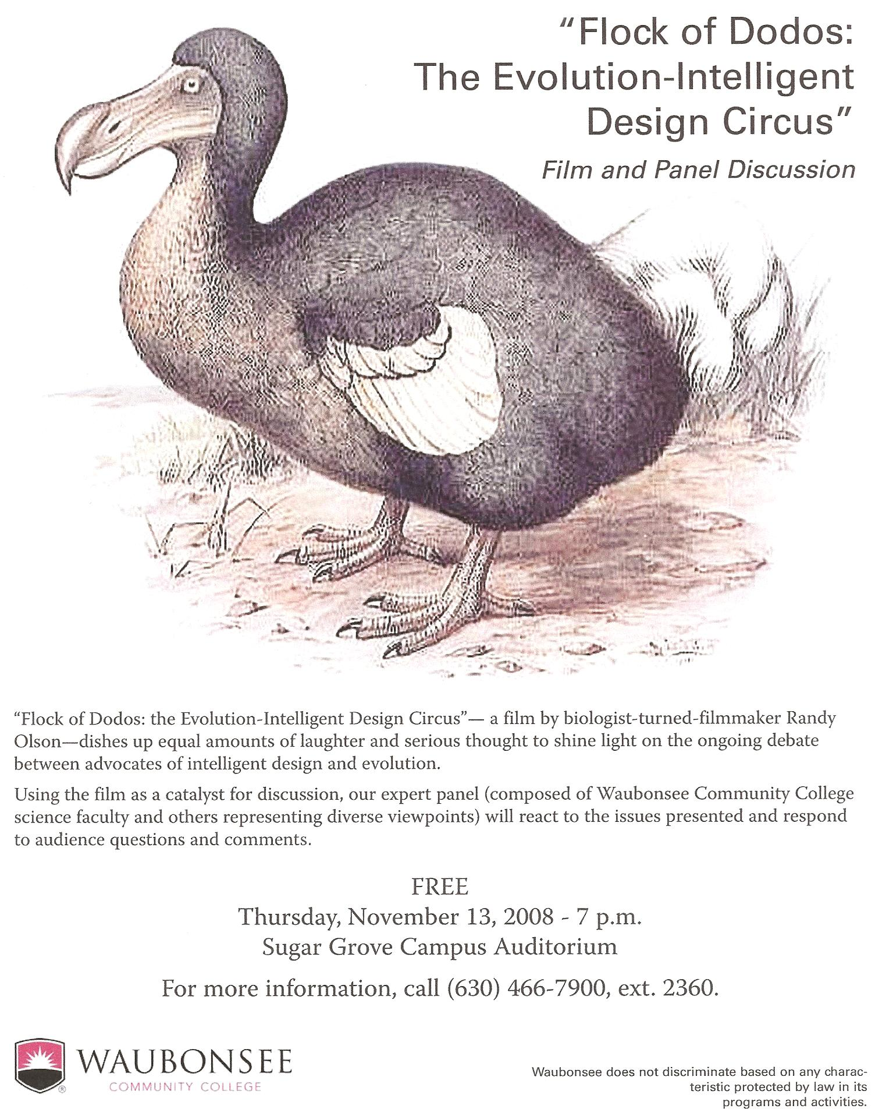
Other advertisements
Letters
  HS & Jr HS
  Local groups
  4y & 2 y schools
Newsletters
  NCGSA
  NAGT
Notes:
In addition to traditional campus-flyers and posters (as shown in these slides)
Appropriate professional organizations

Slide 7


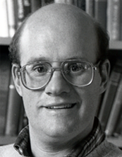
First event – Fall 2006
Giant Earthquakes: Why, Where, When and What We Can Do
Dr. Seth Stein
  Northwestern Univ
IRIS Distinguished Lectureship Series
The Incorporated Research Institutions for Seismology
Seismological Society of America
Notes:
Booked as an EA of IRIS, also provides AS1 seismometer & seismologic expertise
Coincided with grand opening of Science building
Sent letters in previous spring & in fall
Pre-presentation dinner in Sci building with Stein, administrators & faculty (started tradition)
Distinguished lecturers picked by IRIS that are dynamic & used to speaking to public
talks well thought out & designed so all from newbie to specialist benefits
IRIS provides poster give-ways
Based on reviews, clear there was a distinct interest and hunger for these types of presentations
made clear that this should the beginning of something…

Slide 8
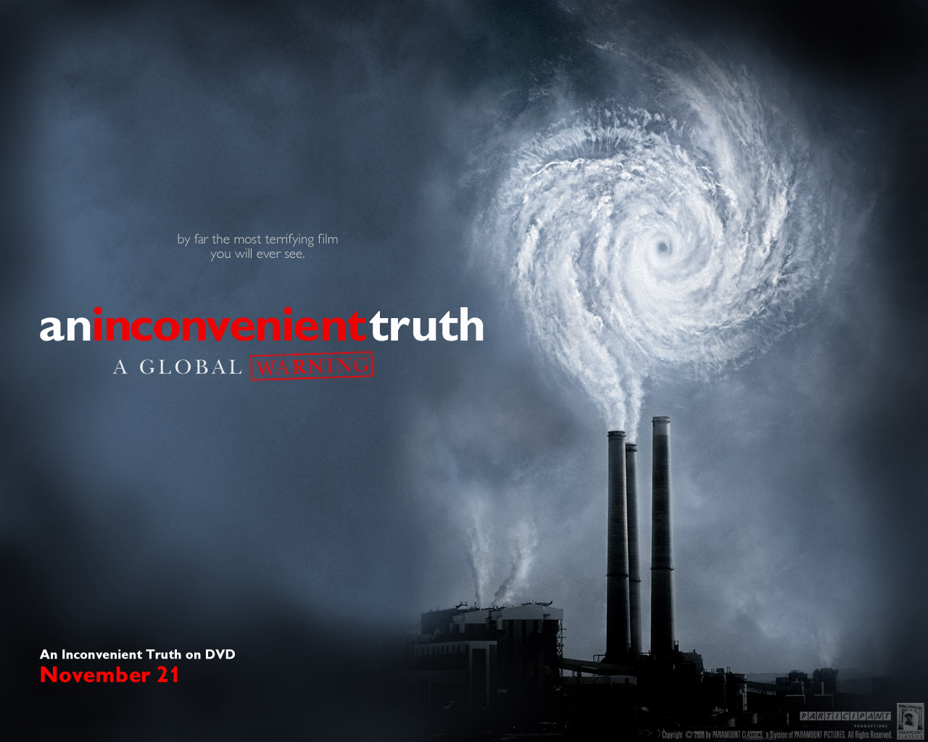
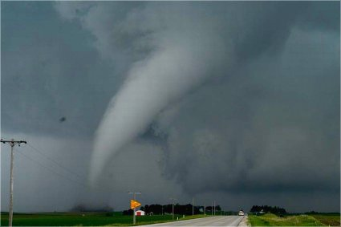
Spring 2007
Global Warming: An Inconvenient Truth
  Panel discussion
10 Days in Malawi
Tornadoes: Lessons Learned from a Storm Chaser
New Orleans: Reclaim or Rebuild?
Notes:
‘In house’ speakers

Slide 9
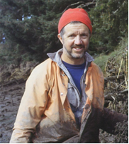
Fall 2007
The Orphan Tsunami of 1700 - A Trans-Pacific Detective Story
Dr. Brian Atwater
  USGS
IRIS Distinguished Lectureship Series
The Incorporated Research Institutions for Seismology
Seismological Society of America
Notes:
Atwater: Discover TV, Time magazine
Major EQ in Cascadia Subduction Zone, 1/26/1700, M~9 (8.7 – 9.2)
Proceeds from selling book to ‘Students for Diverse Society”
2nd presentation following 7AM on other tsunamigenic deposits he has studied around world
1st Renewable Energy Fair in Summer 2007

Slide 10
Spring 2008
Global Climate Change and the IPCC
Waterworld: Global Oceans, Ice and Climate Change
  Dr. Paul Loubere, NIU
Slowing Climate Change: Our Responsibility, Our Options
  Dr. David Goldblum, NIU
Notes:
Repeat of series of lectures @ NIU by Geography Dept (Spring 2007, ‘Are We On Thin Ice’)

Slide 11

Fall 2008
Second Annual Renewable Energy Fair
  Day long event
Flock of Dodos
  The Evolution - Intelligent Design Circus
  Panel discussion
    2 WCC sci faculty
    2 clergy
Notes:
Harrisburg, PA 2005 court decision
Rabbi & Presbyterian Minister

Slide 12
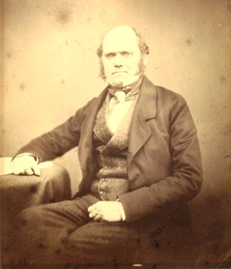
Spring 2008
Charles Darwin
  12 Feb 2009
  200th birthday
  3 performances
  Jr & Sr HS
Notes:
Brian Fox on actual 200th BDay
Voyage of Beagle

Slide 13
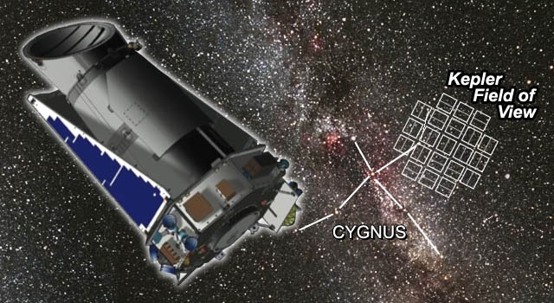
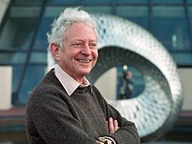
Fall 2009
IYA
  Joe DalSanto
    Space Shuttle
  Jason Steffen - 8 Oct
    NASA Kepler Scientist
  Dr Leon Lederman – 12 Nov
    Fermilab
Notes:
Steffen: Participating Scientist, Kepler Mission, FERMILAB: “Detecting additional planets in transiting systems using transit timing variations”

Slide 14

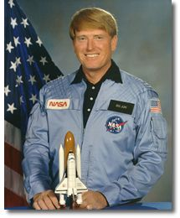
Spring 2010
Feb - Unlocking the Mystery of Life
  Film & panel discussion
Mar - Jon McBride
  STS 41G Pilot
Apr – Sallie Greenburg
  Carbon Capture and Storage in the Illinois Basin

Slide 15
Asset Earth
Successfully presents & demystifies
  Science
  Issues in news & politics
Successful
  Community & faculty response
  Student ‘response’
Critical in today’s society
  ESLI
Notes:
Student response positive in write ups (extra credit)

Slide 16
Questions?
For further information
  Contact me
    dvoorhees@waubonsee.edu
    630.466.2783
  Department web page
    http://chat.wcc.cc.il.us/~earth/index.html

