Slide 1
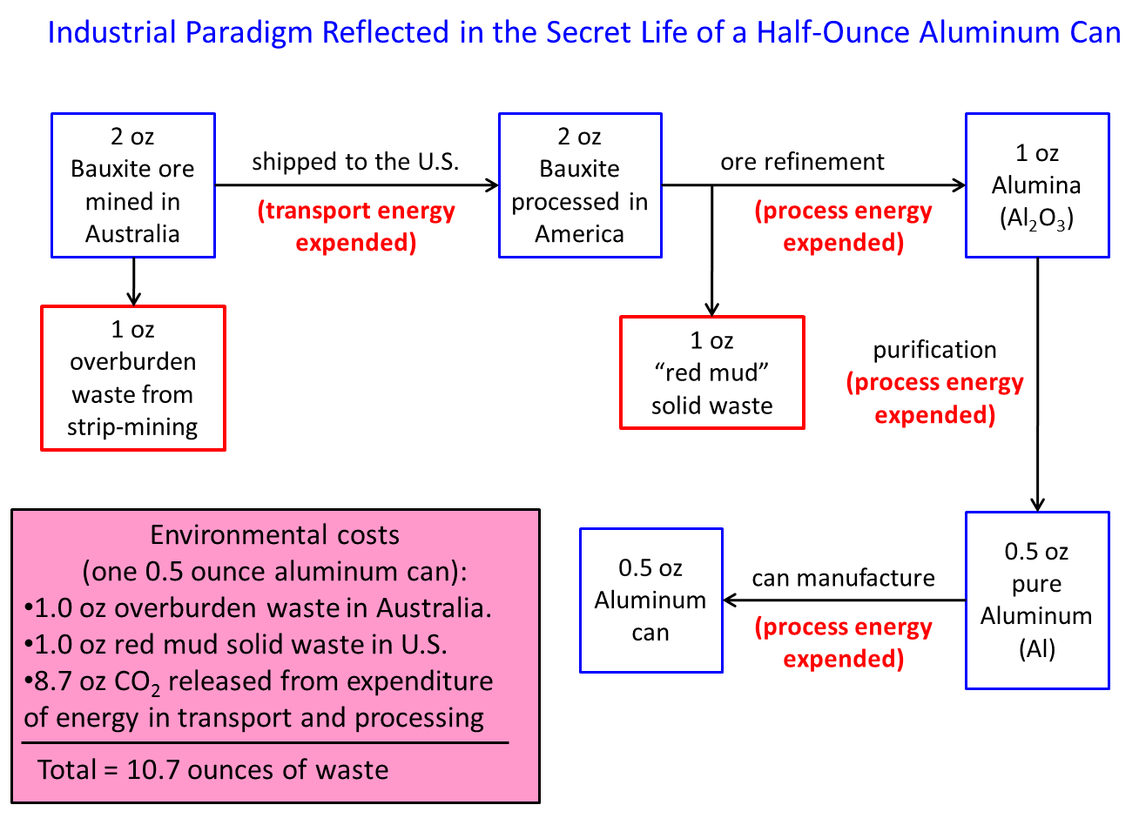
Source: W.M. Stigliani, from Visioning a Sustainable World, class lecture slide. University of Northern Iowa (spring semester, 2011).

