Slide 1
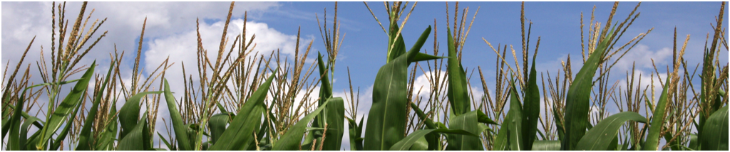
Ethanol & Sustainability teaching:
Integrating business, public policy, and science
Rick Oches
Department of Natural & Applied Sciences
Bentley University
With contributions from:
David Szymanski, Environmental Chemistry
Bryan Snyder, Economics
Jeff Gulati, American Government
et al.

Slide 2
Summer 2011 Faculty Workshop:
Will Corn Ethanol Fuel U.S. Energy Needs?
A Multidisciplinary Exploration of a Complex Problem
Created by faculty members of Bentley University
Participating Courses:
Principles of Geology American Government
Environmental Chemistry Macroeconomics
Green Biology/Ecology Natural Resource Policy
Science of Sustainability How Things Work

Slide 3
Program Goals
(Natural & Applied Sciences Department + NSF-CCLI grant):
Enhance Science Literacy.
Promote active- and problem-based learning by incorporating the use of technology and data analysis.
Improve problem-solving and critical thinking skills.
Integrate and apply scientific knowledge across students’ multi-disciplinary business + liberal arts & sciences curriculum.

Slide 4
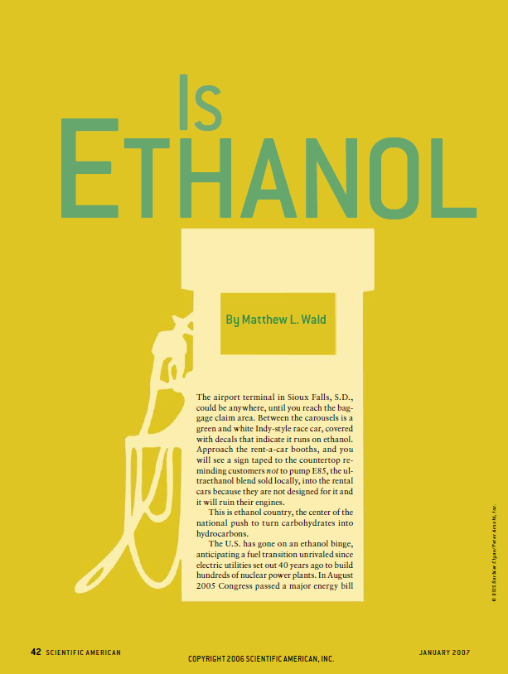
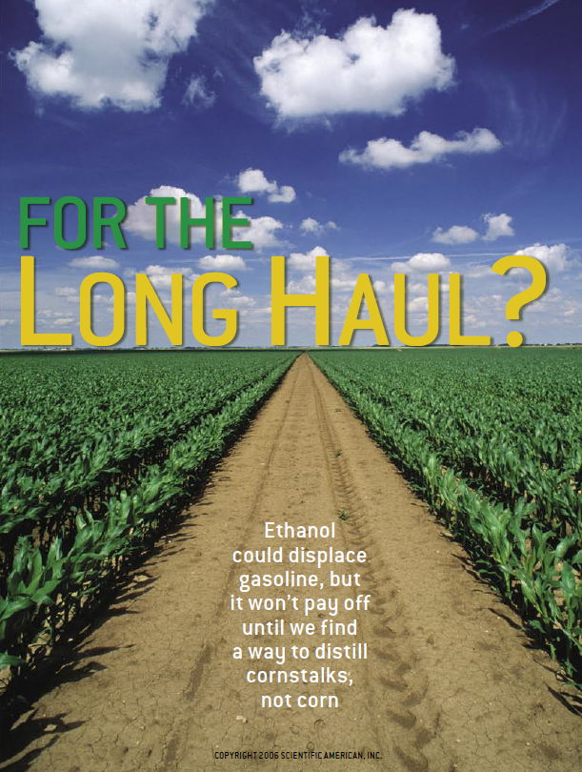

Slide 5
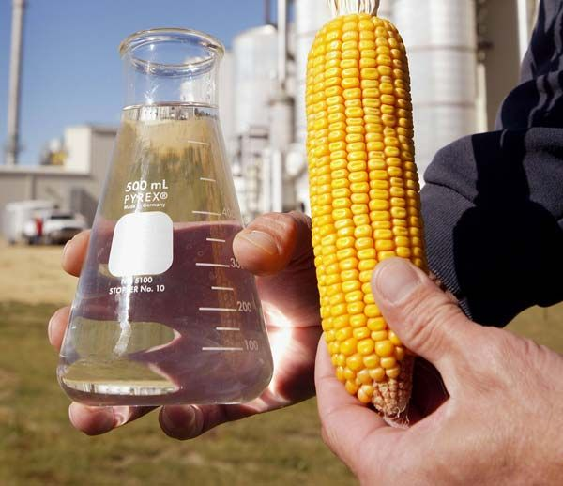
Ecology
Geology
Plant Biology
Economics
International
Studies
Political Science
& Public Policy
Finance
Chemistry
Climate Change
Physics &
Engineering
Environmental
Science

Slide 6
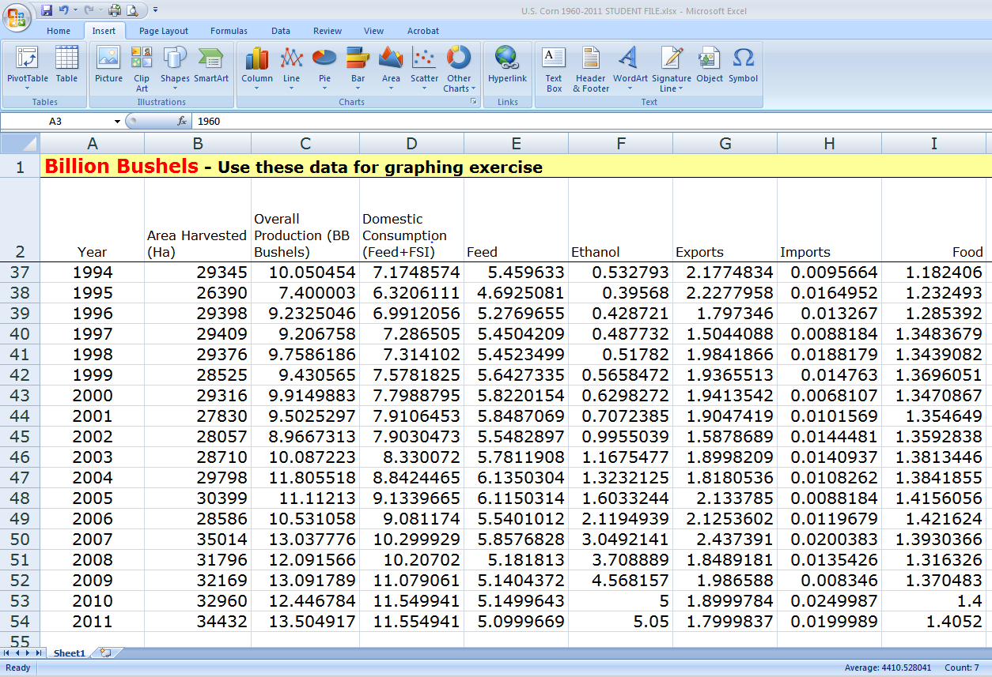
Getting started – Common overview activity:
Plot data
Observe trends
Calculations
Hypothesize relationships

Slide 7
Annual U.S. Corn Production & Use

Slide 8
Annual U.S. Corn Production & Use
Explore relationships:
  Environmental impacts
  Water resources
  Cost-Benefit analysis
  Food pricing & security
  International trade
  Public policy
  Fossil fuels
  Climate Change
  Agribusiness
  Commodities markets
  Nutrient cycling
  Engine performance

Slide 9
Will Corn Ethanol Fuel U.S. Energy Needs?
A Multidisciplinary Exploration of a Complex Problem
Created by faculty members of Bentley University
Discipline-based modules are developed for each course, linking to the common theme
Principles of Geology American Government
Environmental Chemistry Macroeconomics
Green Biology/Ecology Natural Resource Policy
Science of Sustainability How Things Work

Slide 10
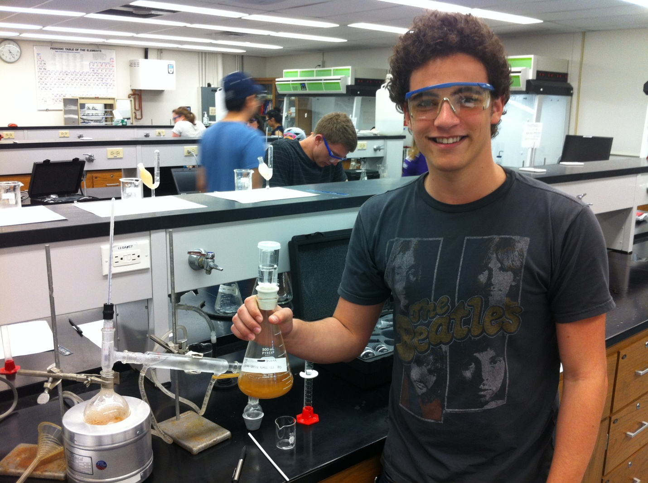
Ethanol & Sustainability teaching:
Integrating business, public policy, and science
Example 1: Environmental Chemistry
Produce ethanol in the lab
Compare process, energy inputs, and efficiency
using corn vs. raw sugar as feedstock

Slide 11
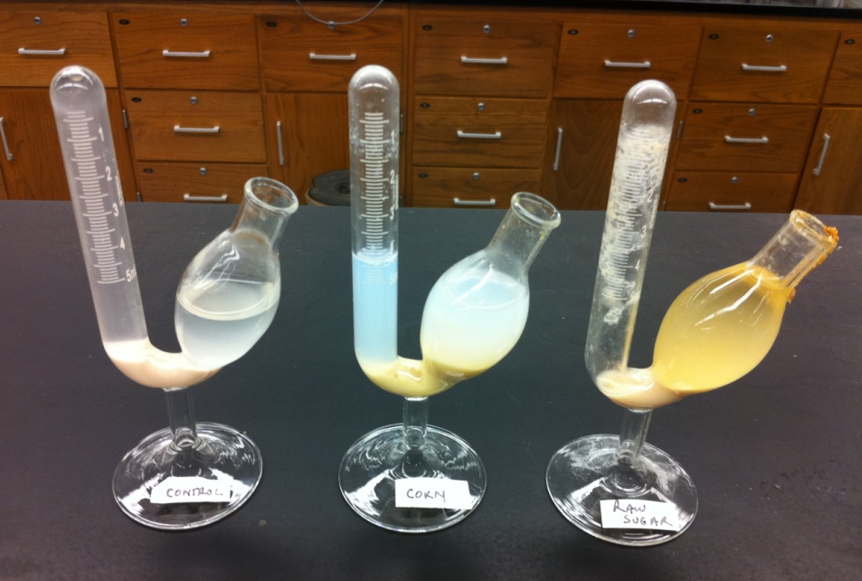
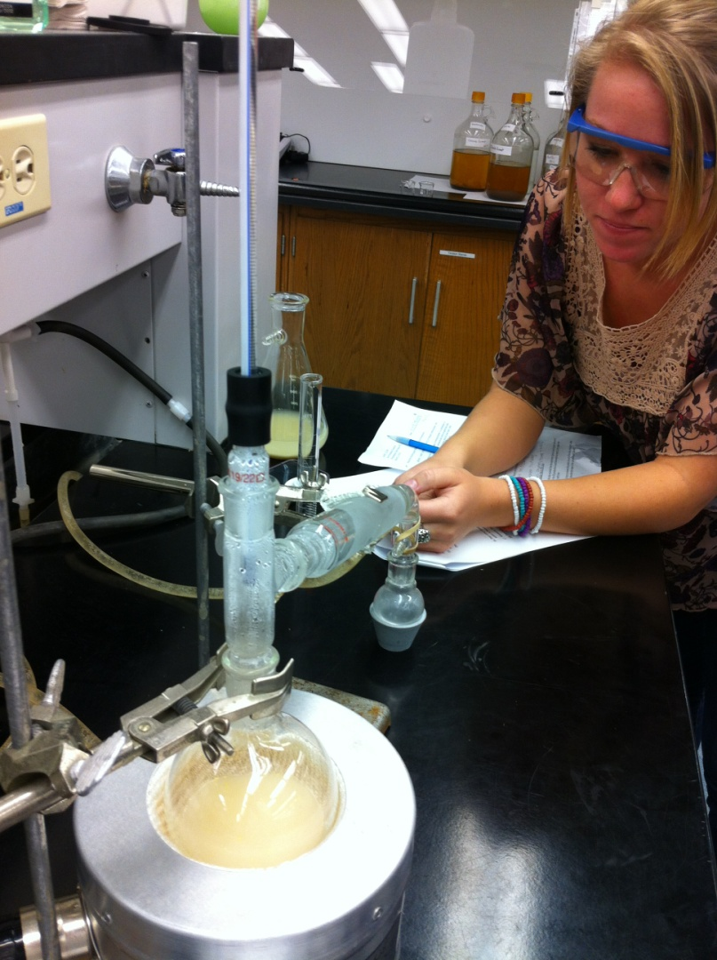
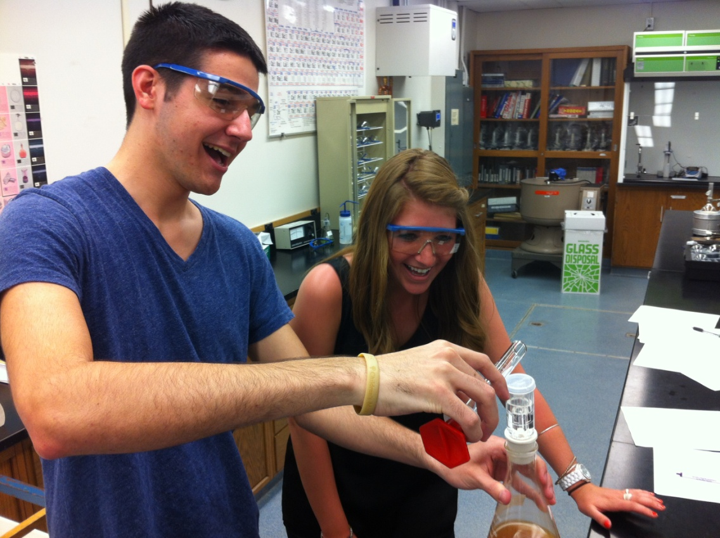
Control Corn Sugar
Fermentation
Distillation

Slide 12
Ethanol & Sustainability teaching:
Integrating business, public policy, and science
Example 2 : Microeconomics
Teaching economics concepts and Cost-Benefit analysis:
Opportunity Costs – food vs. fuel in corn production
Technical efficiency of corn-based ethanol
Economic efficiency of corn-based ethanol
Unintended consequences
Externalities – positive and negative
Cost-benefit analysis
Ethical issues – Food or Fuel?

Slide 13
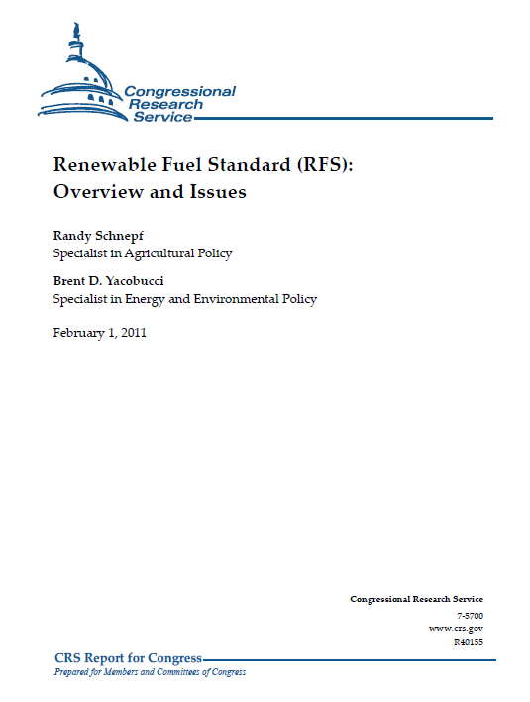
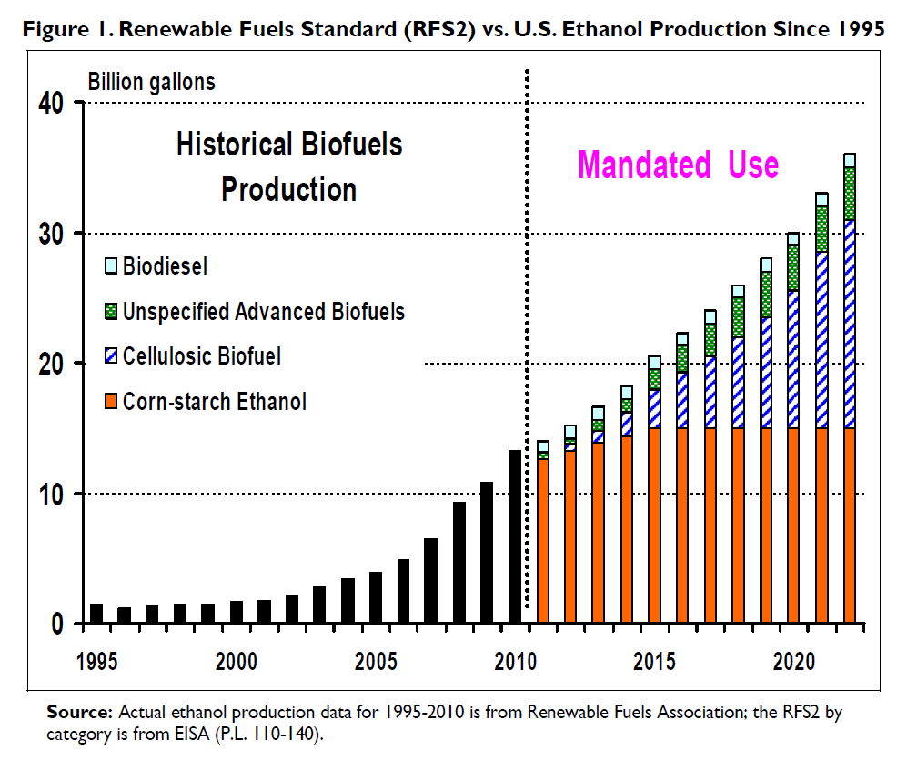
Ethanol & Sustainability teaching:
Integrating business, public policy, and science
Example 3: American Government – the legislative process
Energy Independence and Security Act of 2007
(EISA, P.L. 110-140)

Slide 14
Will Corn Ethanol Fuel U.S. Energy Needs?
A Multidisciplinary Exploration of a Complex Problem
Created by faculty members of Bentley University
Participating Courses:
Principles of Geology American Government
Environmental Chemistry Macroeconomics
Green Biology/Ecology Natural Resource Policy
Science of Sustainability How Things Work

Slide 15
Ethanol & Sustainability teaching:
Integrating business, public policy, and science
Example 4: Finance
Tracking commodities prices and impacts on food, fuel, durable goods, other products:
http://www.bloomberg.com/news/2012-07-16/corn-soy-surge-as-drought-threatens-crops-commodities-at-close.html
http://www.businessweek.com/news/2012-07-16/ethanol-rises-to-eight-month-high-as-heat-threatens-midwest-corn

Slide 16
Assessment
After completing this integrative module, students should be able to:
Describe the interdependence of the natural sciences and social sciences in decision-making for business, society, and the environment.
Provide examples of ways in which human modification of complex natural and established social systems may lead to unintended consequences.
Explain ways in which human decision making and natural systems impact one another on various time scales.
Evaluate proposals for moving society toward greater sustainability.

