Slide 1

Reviewing the NGSS
Audio call in number .... 1-800-704-9804 - toll-free (or 1-404-920-6604 - not toll free) and enter the access code: 446 59 657
Notes:
Dial the conference call number, 1-800-704-9804 and then enter the access code 446 59 657. If for some reason the 800 number does not work, an alternate number is 404-920-6604.

Slide 2
Blackboard instructions

Slide 3
NGSS reflects the vision of the Framework for Science Education:
“The framework is designed to help realize a vision for education in the sciences and
engineering in which students, over multiple years of school, actively engage in scientific
and engineering practices and apply crosscutting concepts to deepen their understanding of the core ideas in these fields.”

Slide 4
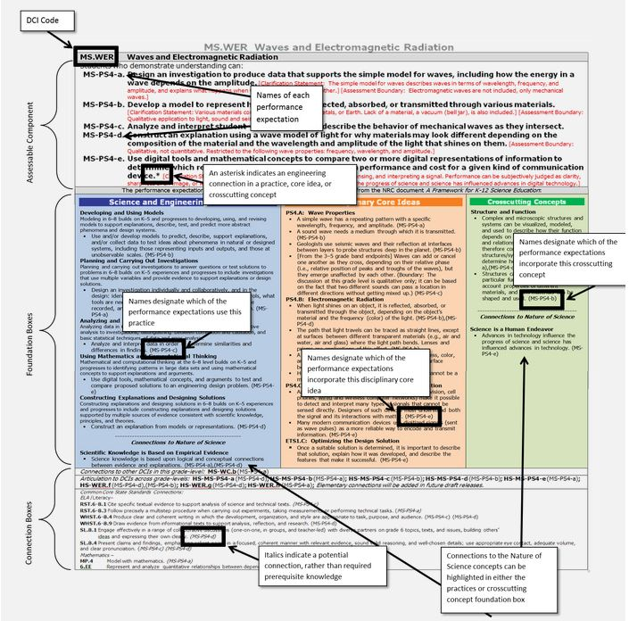
3 dimensions of student engagement
science and engineering practice
crosscutting concepts
disciplinary core ideas
These three dimensions are immediately evident in the architecture of the standards.
http://nextgenscience.org/search-standards?tid_1%5B%5D=15&tid%5B%5D=4

Slide 5
What's new with NGSS2?
Science and engineering content and practices are integrated throughout-not treated separately.
How to implement is key-Appendix J
Concepts build coherently across K-12
Earth and Space Sciences have the same prominence as Physical science
Engineering practices and Nature of Science are included throughout
Climate change, energy use and human sustainability are included.

Slide 6
Structure of the Review:
5 sections:
Introduction to the Standards
General survey on ALL Standards
Survey on individual elementary school standards
Survey on individual middle school standards
Survey on individual high school standards

Slide 7
Survey feedback categories:
Is the PE too prescriptive or too vague?
How grade appropriate is the PE?
How relevant is this crosscutting concept to the core idea?
How well would meeting this PE demonstrate a student’s understanding of the DCI?

Slide 8
How to provide feedback
Deadline NAGT feedback: January 27, Sunday
Send written comment to aawad@maine207.org or susan.buhr@colorado.edu
Write into discussion thread: http://nagt.org/nagt/policy/ngss.html#thread
Option to complete survey online at Achieve: http://interceptum.com/ngss/how.html
May send comment to Michael Wysession, Earth Systems Writing Team Lead michael@wucore.wustl.edu

