Slide 1

Implications of the Next Generation Science Standards
Professor Michael Wysession
Department of Earth and Planetary Sciences
Washington University, St. Louis, MO
michael@seismo.wustl.edu

Slide 2
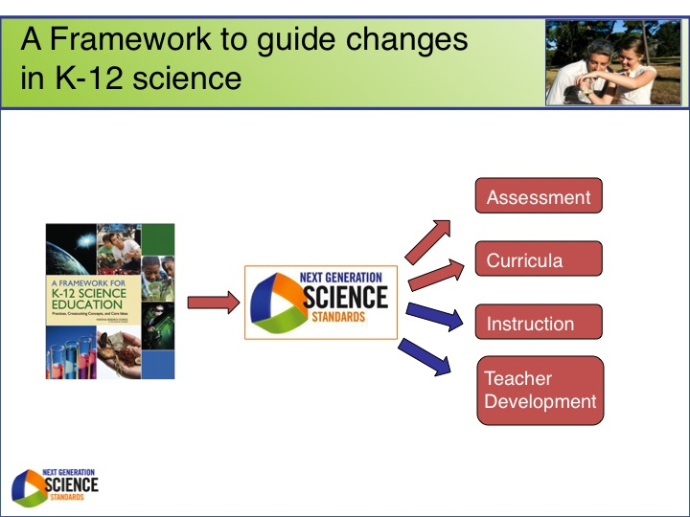

Slide 3


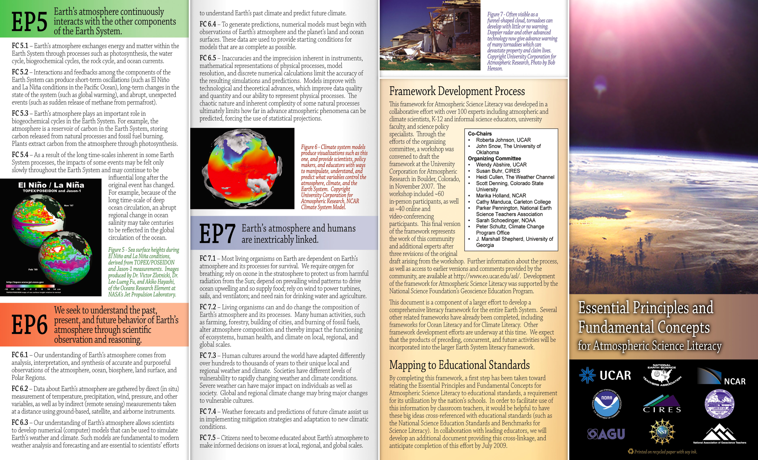

Current work is supported by several recent community-organized literacy efforts
→ Example, for Geoscience:

Slide 4

Nine “Big Ideas” and 75 Supporting Concepts
The Framework for new K-12 National Science Standards

Slide 5
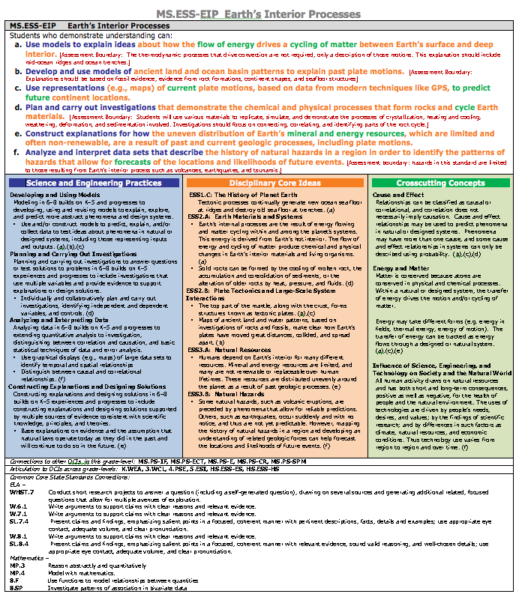
The Framework for new K-12 National Science Standards
The Next Generation Science Standards

Slide 6


Lead State Partners
  Arizona
  Arkansas
  California
  Delaware
  Georgia
  Illinois
  Iowa
  Kansas
  Kentucky
  Maine
  Maryland
  Massachusetts
  Michigan
  Minnesota
  Montana
  New Jersey
  New York
  North Carolina
  Ohio
  Oregon
  Rhode Island
  South Dakota
  Tennessee
  Vermont
  Washington State
  West Virginia

Slide 7

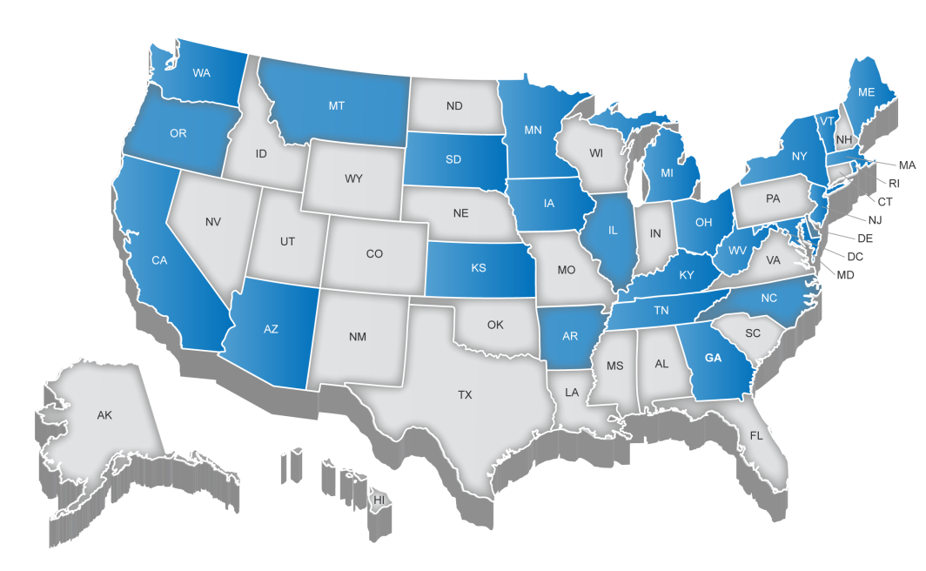
Lead State Partners

Slide 8

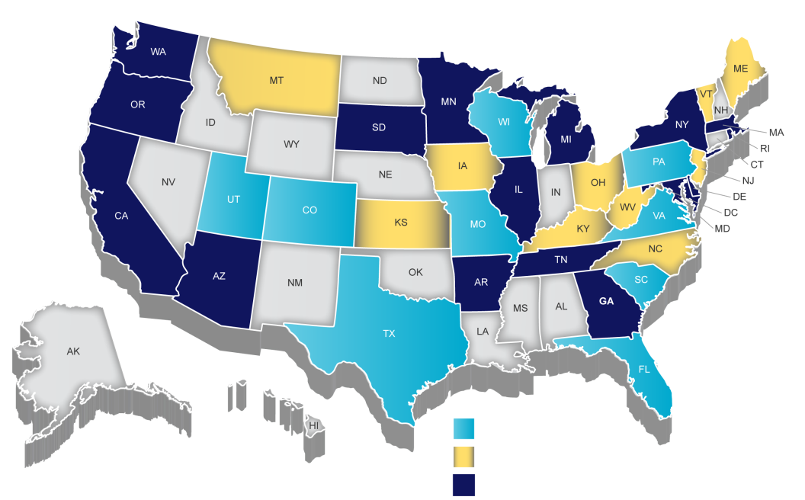
Lead State Partners and NGSS Writing Team
Writing Team Only
Lead State Partner Only
Lead State Partner and Writing Team

Slide 9
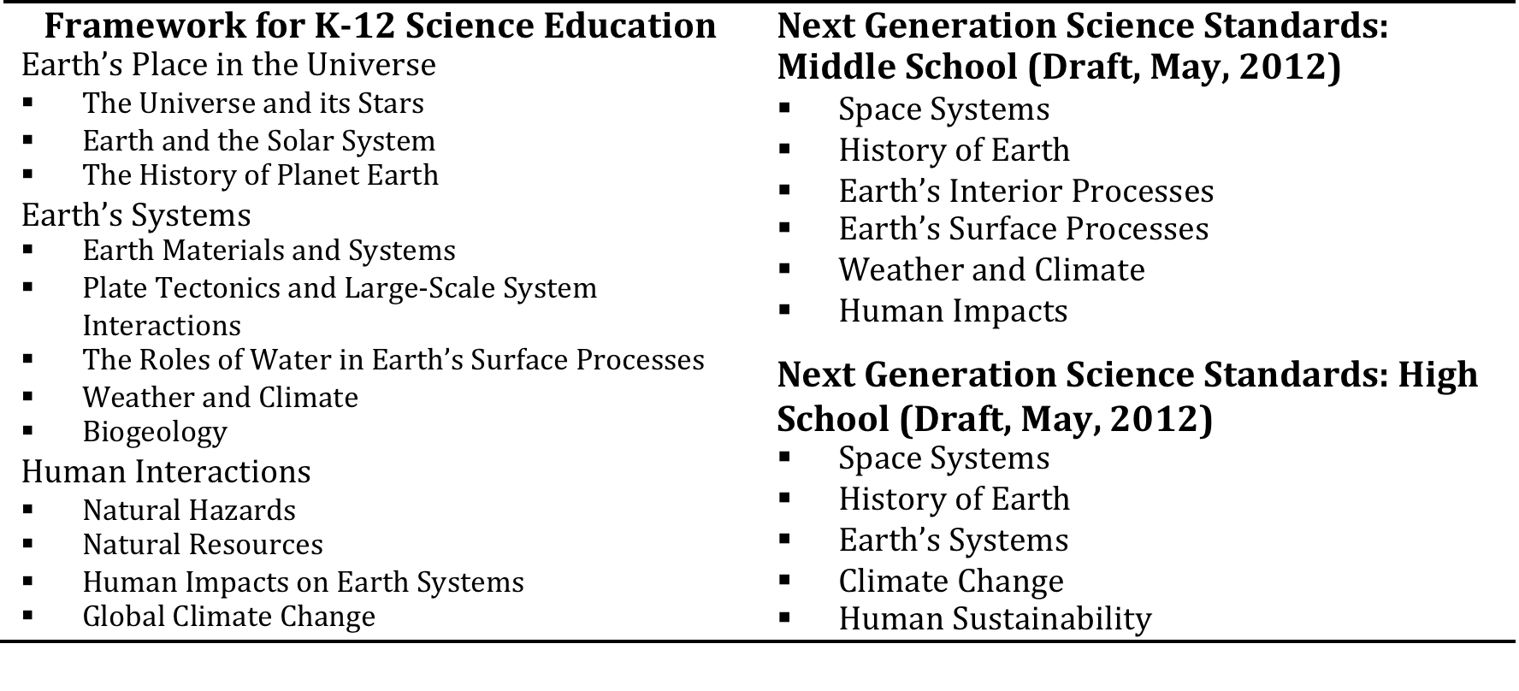
January 2013 Draft Change - (1): The Content can be presented by DCIs (Disciplinary Core Ideas, from the NRC Framework) or by NGSS Topics

Slide 10
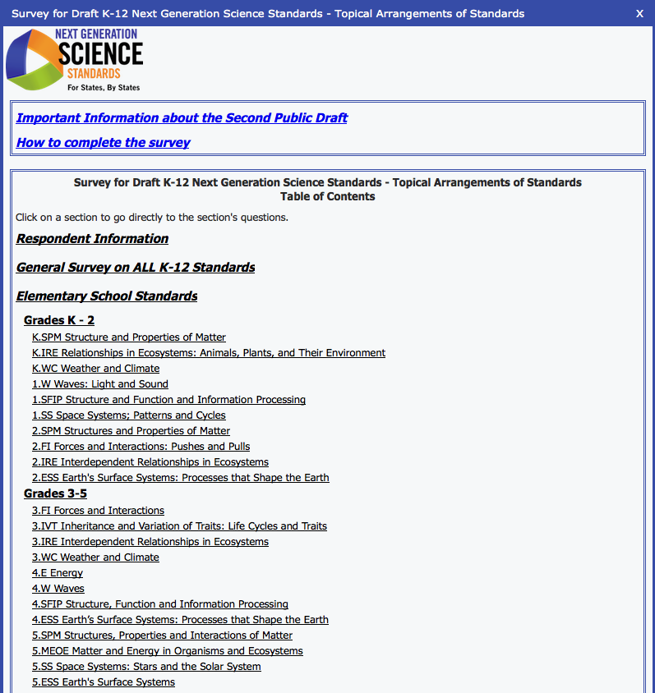

Slide 11
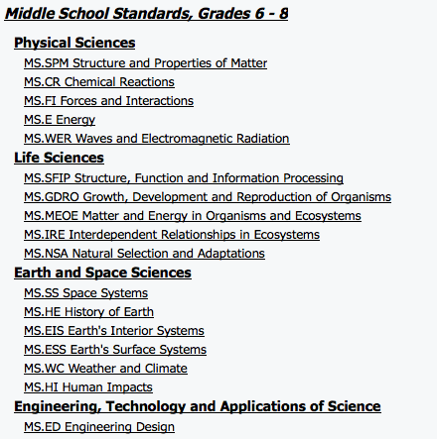

Slide 12
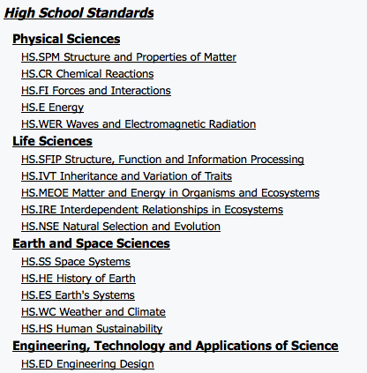

Slide 13
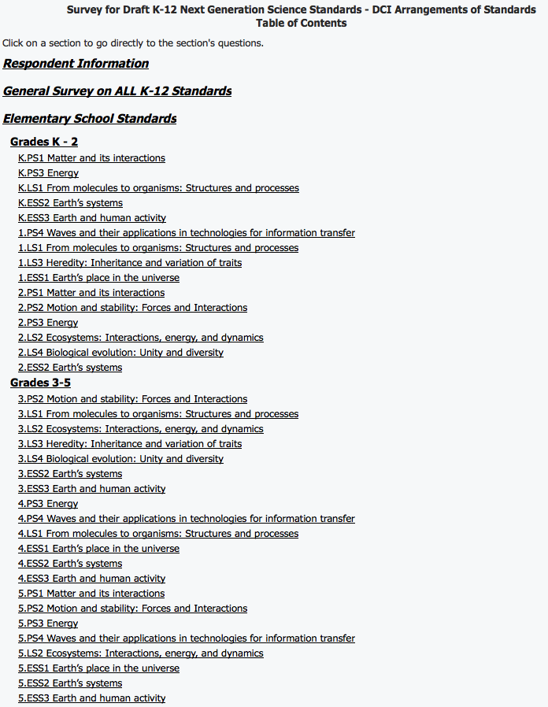

Slide 14
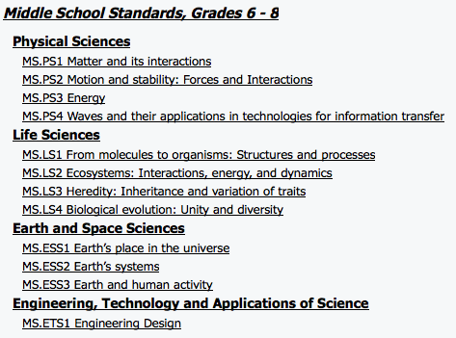

Slide 15
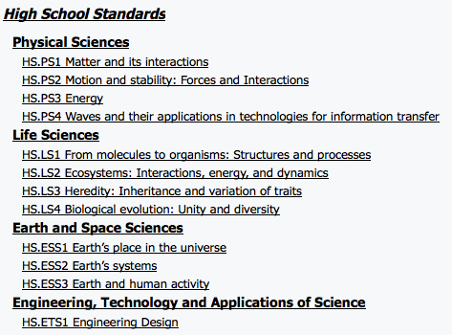

Slide 16
January 2013 Draft Change – (2): Performance expectations are written in a broader and more general tone, with further guidance provided by “Clarifying Statements” and “Assessment Boundaries”

Slide 17
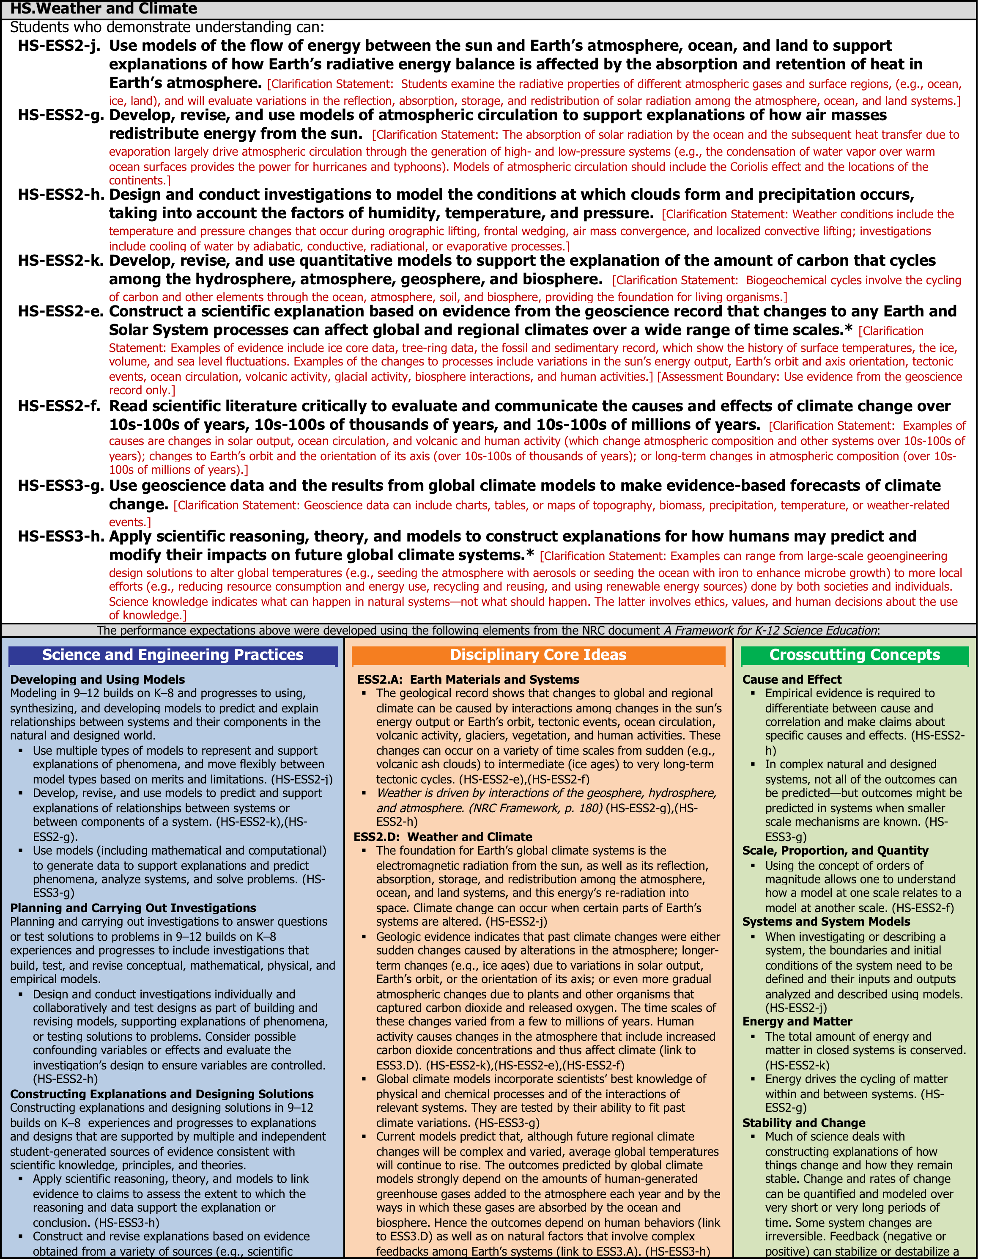

Slide 20
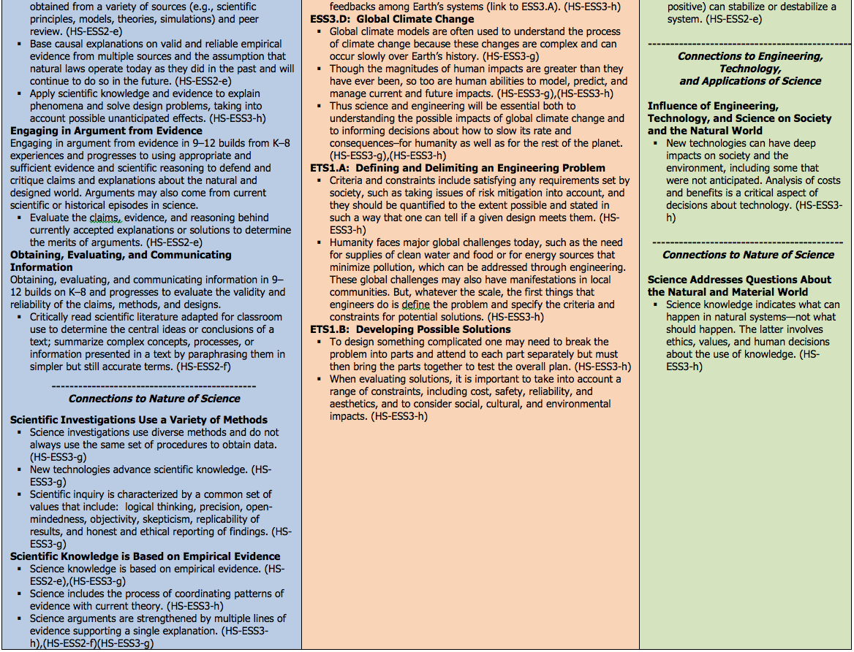

Slide 21
January 2013 Draft Change – (3): Engineering now appears in all 3 Foundation boxes - the Practices, the Disciplinary Core Ideas, and the Crosscutting Concepts, but does NOT add any new performance expectations.

Slide 24
January 2013 Draft Change – (4): “Nature of Science” concepts can appear in either the Practices or the Crosscutting Concepts, but there will be NO NEW performance expectations added for them. Instead, one or two PEs will be selected from each topic page as an opportunity for a Nature of Science connection.

Slide 27
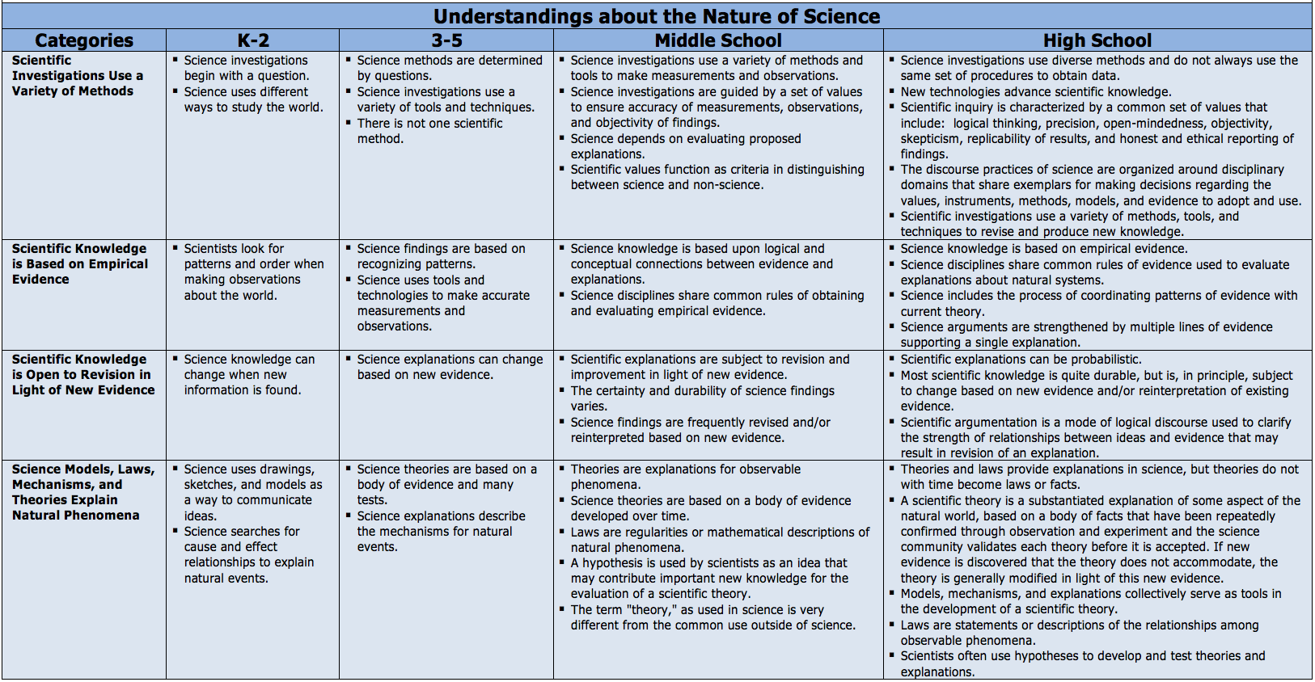

Slide 28
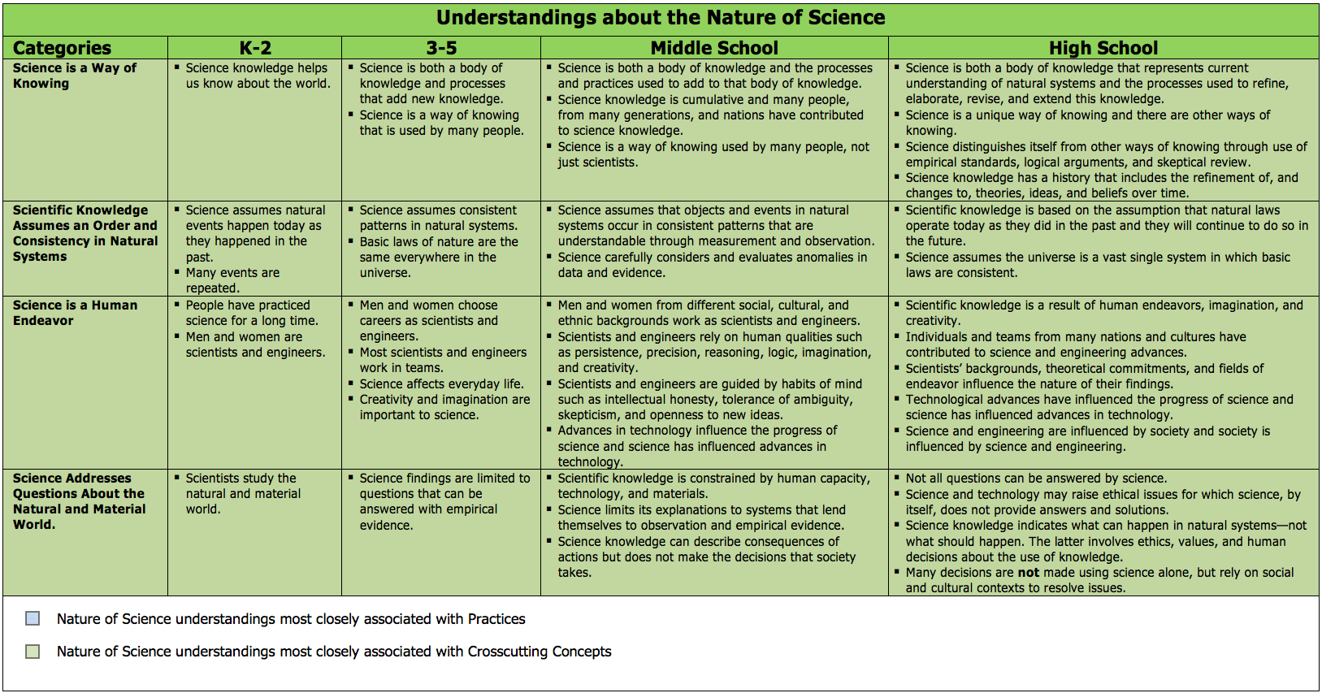

Slide 29
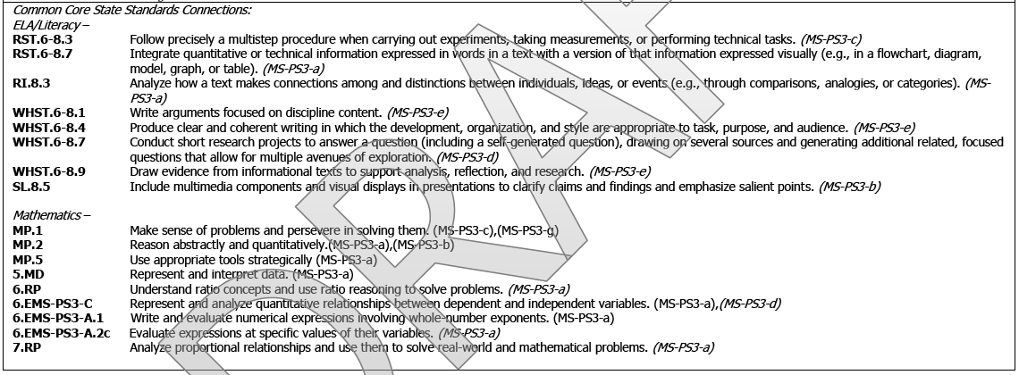
January 2013 Draft Change – (5): Stronger connections to math and English Common Core concepts

Slide 30
January 2013 Draft Change – (4): “Nature of Science” concepts can appear in either the Practices or the Crosscutting Concepts, but there will be NO NEW performance expectations added for them. Instead, one or two PEs will be selected from each topic page as an opportunity for a Nature of Science connection.

Slide 31
Challenges:
Greater emphasis on integration of science practices with science content → Assessment
New content (e.g., greater emphasis on human connections, engineering, and technology; greater emphasis on integration between sciences (i.e., cross-cutting concepts) and with math and ELA) → Professional Development
Inclusion of a year of Earth & Space Science in high school → Number of years of high school science

Slide 32
Number of Years of High School Science Required:
1987 1996 2006 2008
Local Decision 6 7 6 6
1 – 2 Years 40 33 16 13
3 Years 3 8 27 27
4 Years 0 2 1 4
Local decision means that graduation requirements are set by local districts and may vary within a state.
In 2008, all states with statewide requirements required ≥2 years of mathematics courses; only one state (Illinois) required 1 year of science.
NOTES: Data include Washington, DC. Column totals do not add to 51 because certain states did not participate in Council of Chief State School Officers (CCSSO) survey that year or used a different credit reporting system. (1987 – leaves off Vermont and Arkansas, which both required 5 total math or science years; 1996 – still leaves off Vermont for the same reason; includes DC)
SOURCES: CCSSO, Key State Education Policies on PK-12 Education: 2008 (2009); Snyder TD, Digest of Education Statistics 1988, NCES 88-600 (1988); and Snyder TD, Digest of Education Statistics 1998, NCES 1999-036 (1999).
Notes:
1987 – leaves off Vermont and Arkansas, which both required 5 total math or science years
1996 – still leaves off Vermont for the same reason; includes DC
2006 – all 50 states

Slide 33
January 2013 Draft Change – (6): Appendix J shows model Course Maps for organizing 6-8 and 9-12 science:
Conceptual Progressions Model (6-8 and 9-12) — the 6-8 and 9-12 grade band PEs are organized so that student understanding of concepts is built progressively throughout the course sequence. This model maps PEs into courses based on what concepts are needed for support without focusing on keeping disciplines separate.
Science Domains Model (6-8 and 9-12) — the 6-8 and 9-12 grade band PEs are organized into content-specific courses that match the three science domains of the Framework: Physical Science, Life Science, and Earth Science. Since the Engineering domain is integrated into the other three in the NGSS, it was not separated out.
Modified Science Domains Model (9-12) — the 9-12 grade band performance expectations are organized into content-specific courses that do not match the domains of the Framework, but rather match a common high school course sequence of biology, chemistry, and physics.

Slide 34
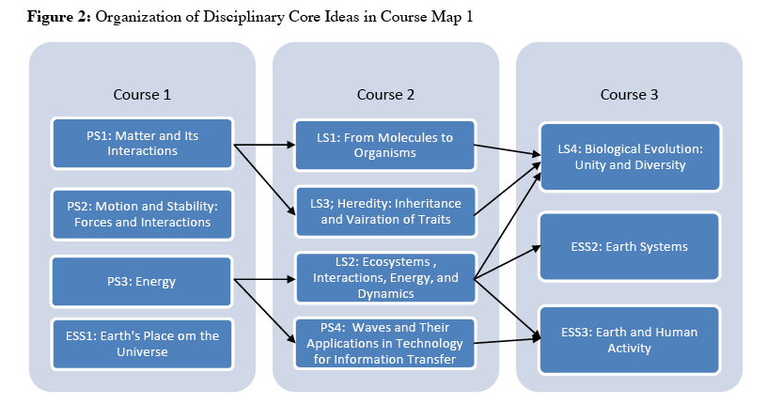
Conceptual Progressions Model (6-8 and 9-12) — the 6-8 and 9-12 grade band PEs are organized so that student understanding of concepts is built progressively throughout the course sequence.

Slide 35
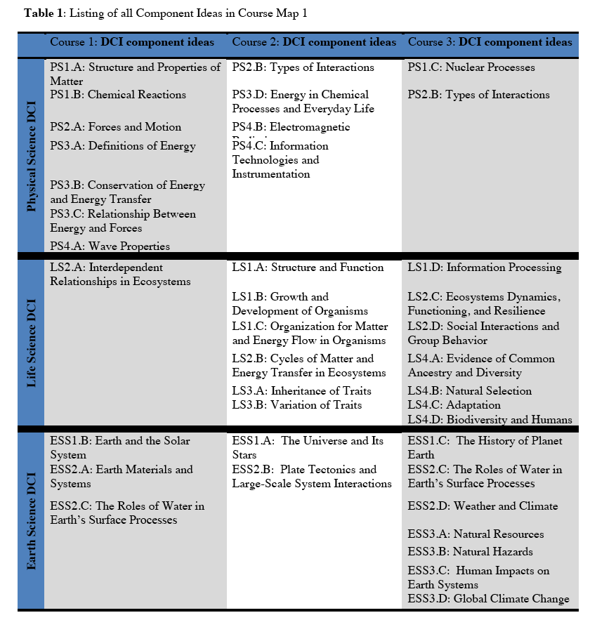

Slide 36
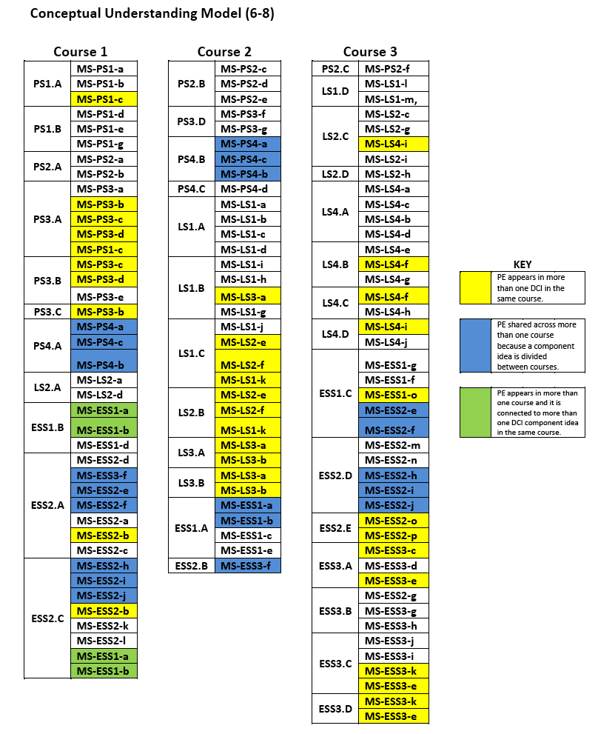

Slide 37
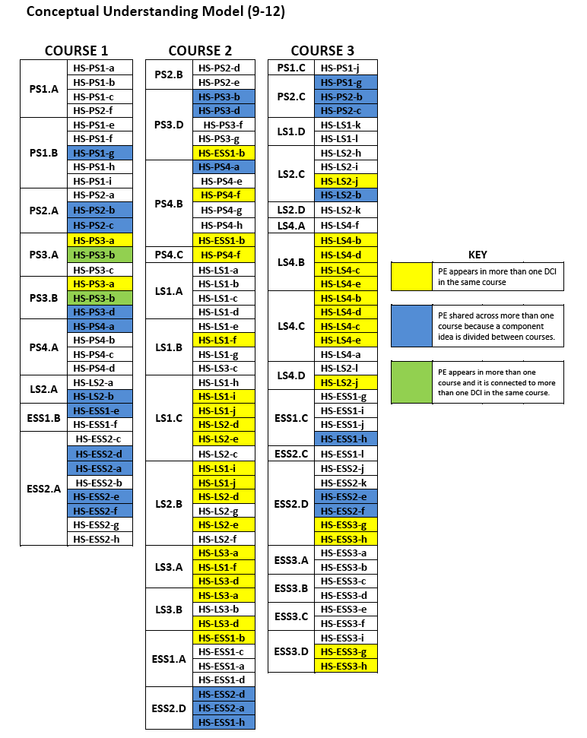

Slide 38
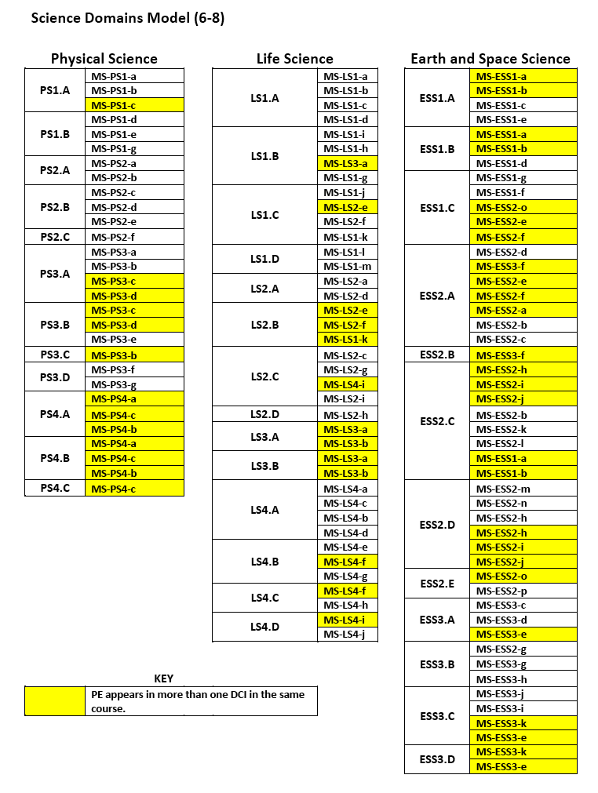
Science Domains Model (6-8 and 9-12) — the 6-8 and 9-12 grade band PEs are organized into content-specific courses that match the three science domains of the Framework: Physical Science, Life Science, and Earth Science.

Slide 39
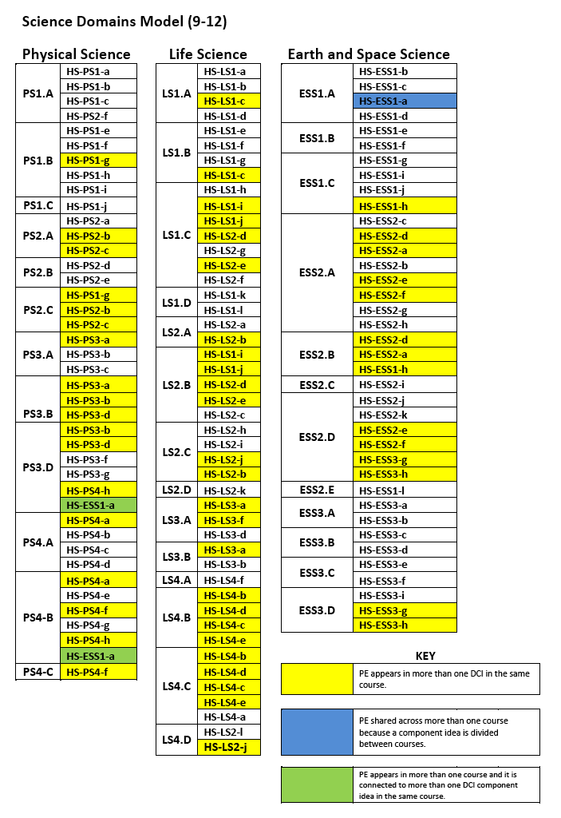

Slide 40
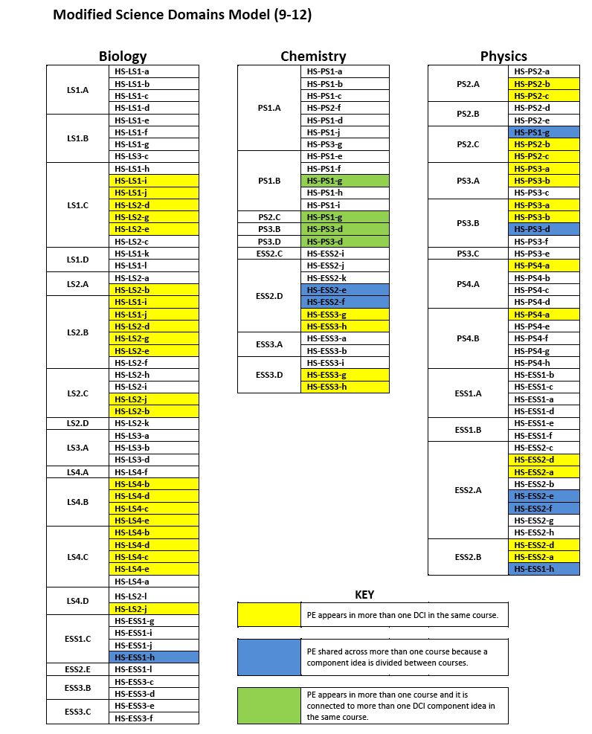
Modified Science Domains Model (9-12) — the 9-12 grade band performance expectations are organized into content-specific courses that do not match the domains of the Framework, but rather match a common high school course sequence of biology, chemistry, and physics.

