Slide 1
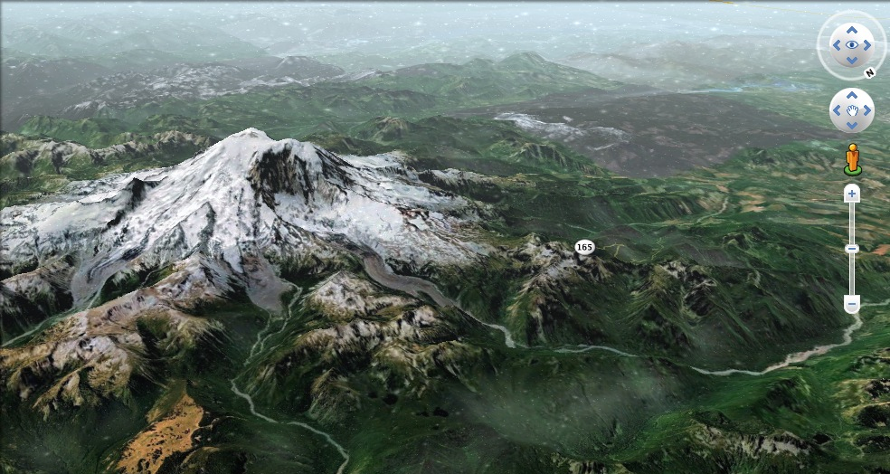
Teaching with Google Earth
Peter Selkin, University of Washington Tacoma
Declan De Paor, Old Dominion University

Slide 2
Most of you have used Google Earth:
N=26

Slide 3
While few use Google Earth in teaching:
6 never
N=26

Slide 4
Most of you can navigate and make basic placemarks:
N=26

Slide 5
Mostly focused on lower-division teaching:
Actual
Planned
N=26

Slide 6
How can Google Earth be helpful in the classroom?
What are its limitations?

Slide 7
What was Google Earth designed to do?

Slide 8
“[O]ne of the clear motivations behind GE was a shared desire to give people a vision of the Earth as a seamless whole and give them the tools to do something with that vision.”
Avi Bar-Ze’ev
Co-founder, Keyhole Inc.
>

Slide 9
Play Tour
>

Slide 10
What did you see?

Slide 11
What did you see?
What do you think your students might see?

Slide 12
Which of the following might not be best demonstrated using a tour?
Illustrating topography at plate boundaries
Demonstrating the idea of a topographic profile
Animating the process of river avulsion
Visualizing lithospheric thickness

Slide 13
Which of the following might not be best demonstrated using a tour?
e. Visualizing subsurface geology in 3D

Slide 14
>

Slide 15
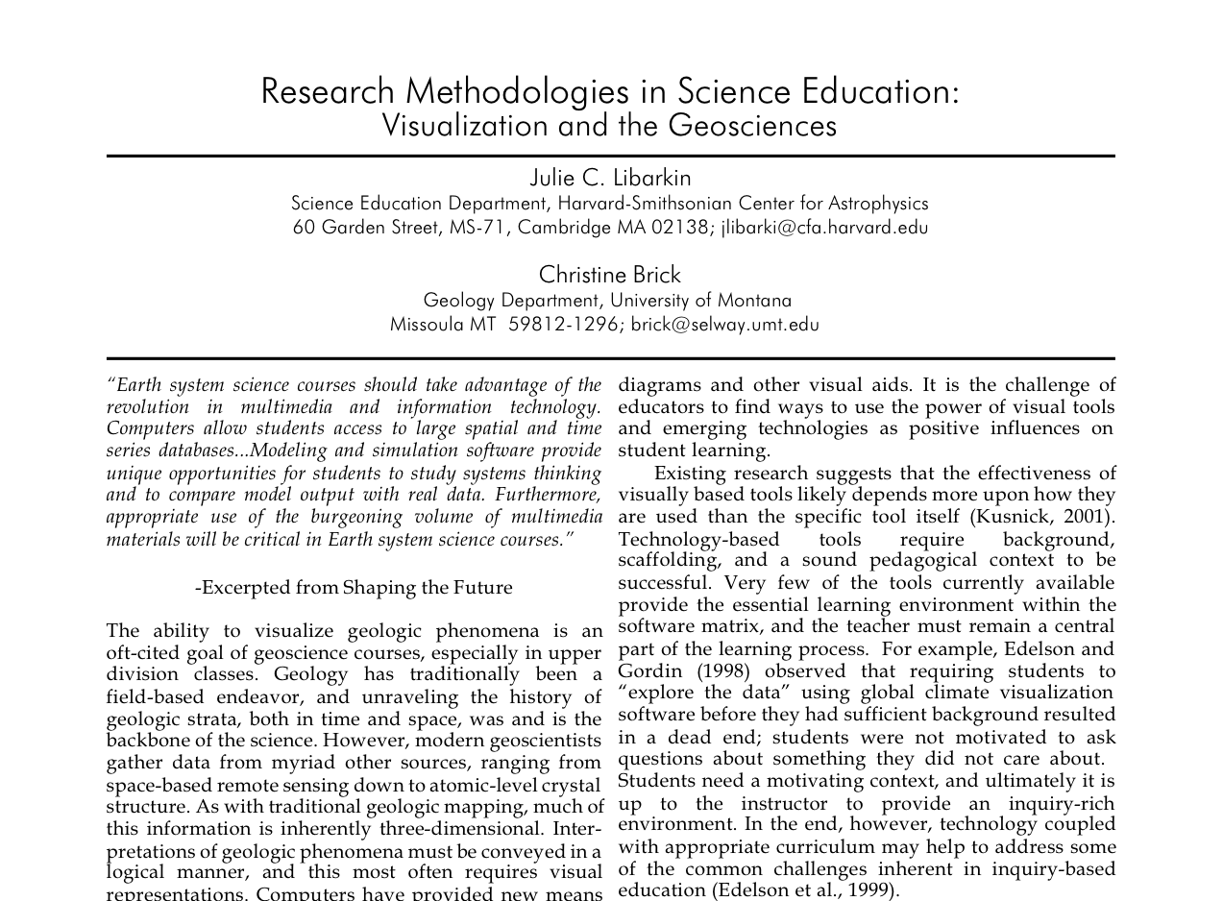
>

Slide 16
What gives students trouble?

Slide 17
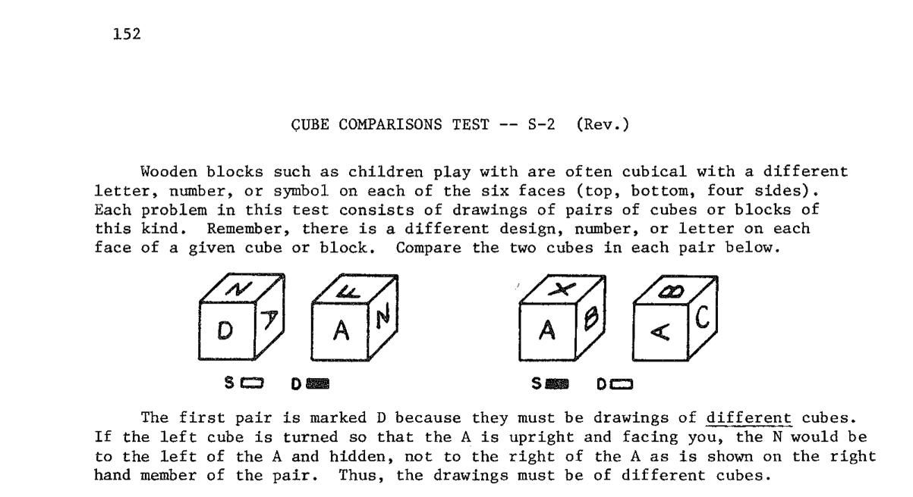
R.B. Ekstrom et al. 1976 Manual for Kit of Factor-Referenced Cognitive Tests

Slide 18
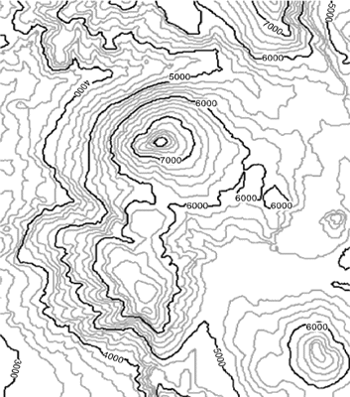
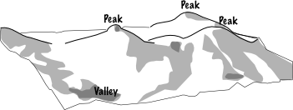
>

Slide 19
Google Earth is good for:
  Developing spatial skills
  Concepts that involve surface features
  Regional to local-scale patterns
  Illustrating process
  Integrating data from different sources

Slide 20
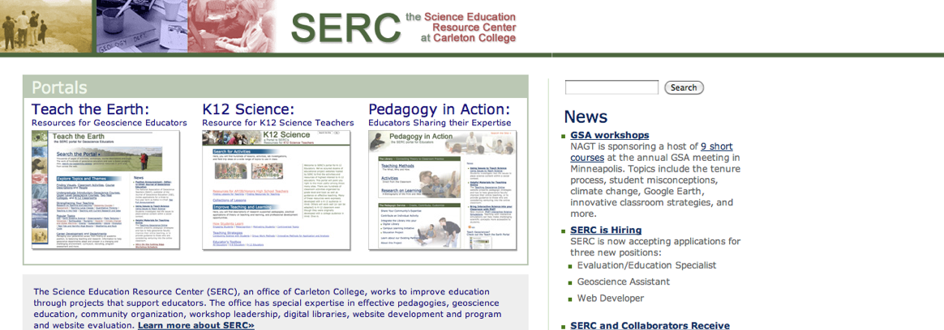
SERC resources for teaching with Google Earth
>

Slide 21
However…

Slide 22
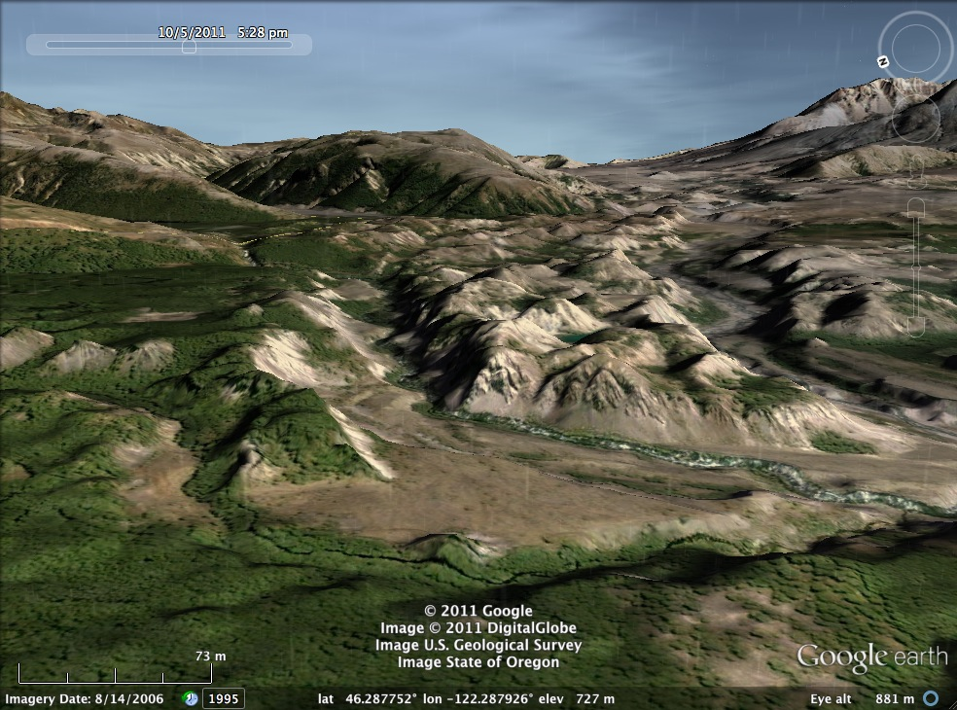
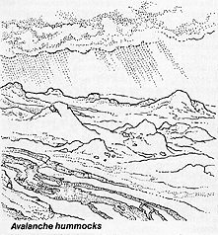
R. Hazlett
>

Slide 23
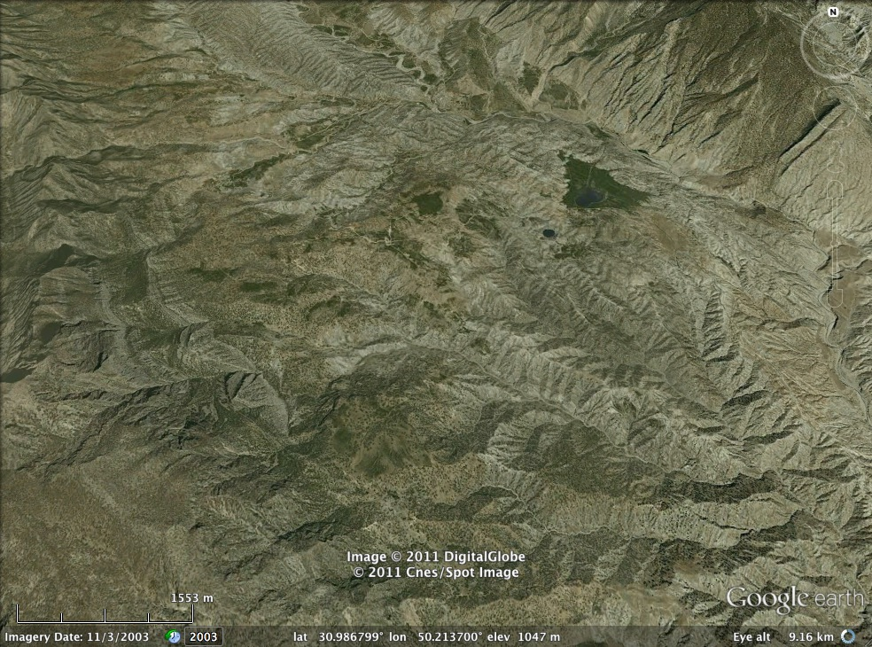
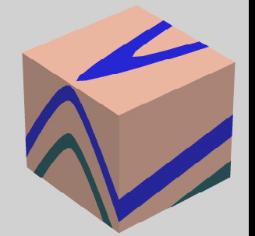
?
S. Reynolds
>

Slide 24
To prepare for some of the potential problems you might encounter using Google Earth, it’s worthwhile pretending to be a student.
Temporarily.

