Slide 1
Examples of Unexpected Near-Term Impacts of Global Climate Change: Sea Level Rise and Water Resource Issues in Southeast Florida
(Trying to connect using regionally relevant content and a focus on the built environment)
Jeff Ryan, Univ. South Florida
(PI, Coastal Areas Climate Change Education Partnership)

Slide 2
Problem: connecting with students on climate change…
Much of the good content is “distant” (i.e., happening in remote places, or focused on effects that are remote in time to non-geologists)
{Educational best practice: connect with learner’s experiences, needs, and concerns to facilitate their constructing new knowledge.}

Slide 3
The CACCE Topical Focus:
Low-lying coastal regions (FL, PR, VI, but more widely applicable)
The “built environment” (where people live and work)
Near-term impacts and responses (connecting with stakeholder experiences, empowering efforts at remedy) [Resiliency]

Slide 4
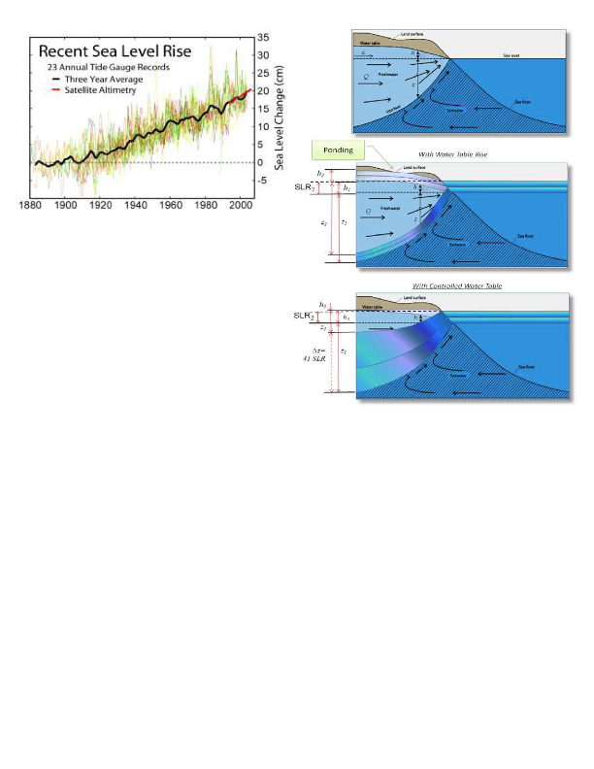
Major Emphasis: Sea Level Rise
Florida and Caribbean territories/nations are particularly vulnerable
Exacerbates storm effects
Impacts are near-term (5-10 years; already an issues with urban planners regionally)

Slide 5
Problem: Very few relevant educational resources!!
Florida Center for Environmental Studies at Florida Atlantic University (a CACCE Partner)
Substantial library of informational documents on FL-specific impacts of changing climate.
Accessible on their website or via the CACCE Information Portal (www.cacce.net)

Slide 6
Instructional Approach: Investigation/Interpretation
Resources: FCES report, Google Earth (.kml file of bookmarked features provided)
Learning Goals: greater understanding/appreciation of the interplay of climate and human activities; facility with reading technical literature for information; GIS skill development; critical analysis of data
Activity: A directed reading of the FCES document, with some Google Earth data collection/measurement activities to “discover” the veracity of the text and better understand the region’s geography/geology.

Slide 7
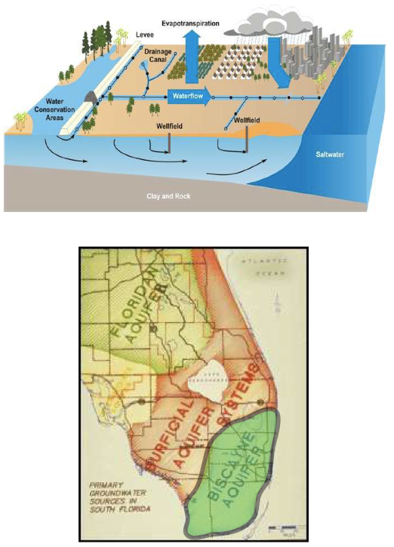
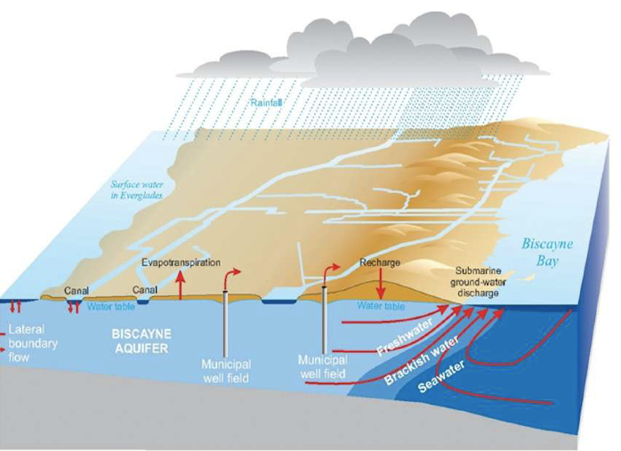
The Biscayne Aquifer: provides water for all of SE Florida (5.5 million people!
An Unconfined, Surficial Aquifer system

Slide 9
Big Issue 1: In an Aquifer with a constrained Water Table, (elevation: 1 meter above sea level; Land elevation: 1-2 meters above sea level!) small increases in Sea Level lead to HUGE (40:1) increases in Saltwater intrusion!
Result: potentially catastrophic losses of potable water with as little as 3-6 inches higher sea level (10-20 years).

Slide 10
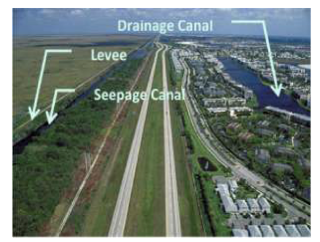
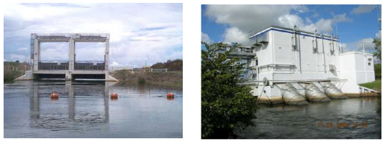
Big Issue 2: Even modest sea level rise will render most SE Florida flow/flood control structures largely ineffective.
  Limits removal of storm water (huge w/ hurricanes!)
  Greater saltwater intrusion into surface channels and water bodies
  Major Everglades habitat loss!

