Slide 1
Using Active Strategies to teach Climate Science
Karin Kirk¹ and Susan Buhr²
¹ Science Education Research Center, Carleton College
²CIRES Education and Outreach, University of Colorado, Boulder
Notes:
Give your introduction here-who you are, CIRES outreach and this topic.

Slide 2
Introductions
Glenn Richard, Stony Brook University
Teaching Climate Change with Google Earth, Northwest Passage
Kelly MacGregor, Macalester College
Isotope Fractionation using M&Ms
Jeff Ryan, University of South Florida
Unexpected Impacts of Sea Level Rise in South Florida
John McDaris, SERC, Carleton College
Climate Around the World
Stabilization Wedges Game
Susan Buhr, CIRES, University of Colorado
Graphing Atmospheric Carbon Dioxide in Lecture
Karin Kirk, SERC, Carleton College

Slide 3
Why are we here?
CLEAN Survey 2011

Slide 4
Why are we here?
CLEAN Survey 2011

Slide 5
Why use active strategies?
Take out your Prior Conception sheet
Try this:
Answer each question
Pick one of your answers
Describe how you know what you know

Slide 6

How do you know what you know?
What are some answers?
Take home message: We can judge the basis for our conceptions (we hope).
Notes:
We can identify when we simply heard something and don’t know where we heard it, something based on reading a sound source, something learned through research of credible sources or our own use of data. This is not always so for everyone on every topic though.

Slide 7
What causes global warming?
Leiserowitz, 2010

Slide 8
Amount CO₂ in atmosphere?
Leiserowitz, 2010

Slide 9
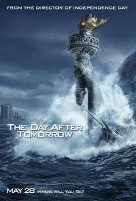
Sources of climate concepts
It ain't what you don't know that gets you into trouble. It's what you know for sure that just ain't so.
Mark Twain
“The greatest obstacle to new learning often is not the student’s lack of prior knowledge but, rather, the existence of prior knowledge” Angelo and Cross, Classroom Assessment Techniques, 1993
Everyday experience
Parents, friends
Vicarious experience- movies
Internet-blogs, websites
School, textbook graphics
Help or hindrance?

Slide 10

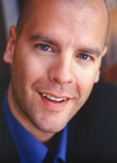
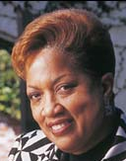

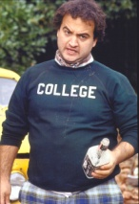
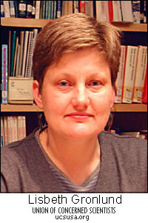
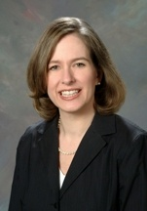


Who are your students?
Students probably did not learn geoscience in high school
Undergraduate conceptions similar to secondary students and public
Deep experiences for deeper learning
Know thy audience
Notes:
Less than 25% of students take a geoscience course in high school
Often, these are not the college-bound students
Less than 1.2% of college bound seniors identify physical or interdisciplinary science as their intended major (sources AGI Workforce report)

Slide 11
Why is active learning especially important for teaching climate science?
Is helpful for overcoming misconceptions
Is effective with controversial topics
Helps students understand complexity
Emulates the process of science
Can help take an abstract topic and make it relevant
Group work can simulate role play or negotiations

Slide 12
Some specific active learning strategies
Working with datasets, especially real-time or locally-derived
Using your campus as a lab or local field trip
Working in groups
Role play or structured academic controversy
Simulations or interactive visualizations (PhET or Google Earth)
Cooperative learning
Place-based learning
Service learning
Problem-solving
Policy-related scenarios
Jigsaws
Working with models
Lecture tutorials
Think-pair-share
Gallery walk

Slide 13
Demos
Teaching Climate Change with Google Earth, Northwest Passage
Glenn Richard
Isotope Fractionation using M&Ms Kelly MacGregor
Unexpected Impacts of Sea Level Rise in South Florida
Jeff Ryan
Climate Around the World
John McDaris
Stabilization Wedges Game
Susan Buhr
Graphing Atmospheric Carbon Dioxide in Lecture
Karin Kirk
9:10 - 9:30 - Round 1
9:35 - 9:55 - Round 2
10:00 - 10:20 - Round 3
10:25 - 10:45 - Round 4
10:50 - 11:10 - Round 5

Slide 14
Report out
What was most effective for your learning?
Would you use this activity in your course? How?
What are your next steps?

Slide 15
Upcoming events
CLEAN-ICEE Interactive webinars for teachers of grades 6-12. Held monthly, Sept-May
Online workshops for college faculty
    Climate Communication – April 2-11, 2012
    Interactions within the Climate System – May 7-16, 2012
ICEE online course for teachers of grades 6-12. “Climate Science in Your Classroom: Essential Teaching Strategies” January 2011- March 2012
Cutting Edge webinar - November 18, 2011: Climate Change Risk in an Unknowable Future - Risk Perception Strategies in the Classroom.

Slide 16
Learn more here
CLEAN reviewed collection
On the Cutting Edge – Teaching Climate Change
SERC Guide to Climate Change
Pedagogy in Action – many types of active learning pedagogies are presented here
Inspiring Climate Education Excellence Forum http://iceeonline.org/forum

Slide 17
effective climate education
is:
is not:
Strategic: where are students starting?
Inquiry and evidence-based
Dialogue and experience focused
Examines learning
Lock-step
Superficial
Privileging authority over reasoning
Thank you!

Slide 18
Questions?

Slide 19
Contact information
Karin Kirk
kkirk@carleton.edu
Susan Buhr
Susan.buhr@colorado.edu
303-492-5657

