Slide 1

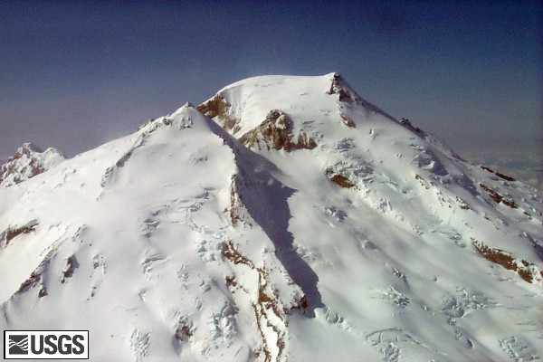
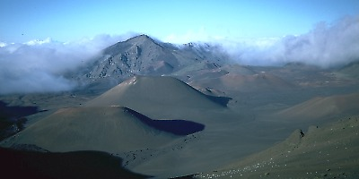
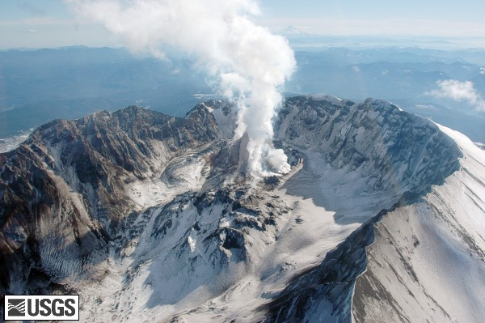
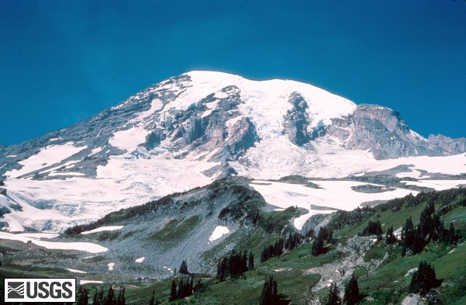
Experiencing Volcanoes
using
Lyn Gualtieri
Seattle University
and
Cascadia Community College

Slide 2
Assignment
Visit Mt. Baker, Mt. Rainier, Mount St. Helens and Haleakala Crater (Hawaii) using Google Earth and answer the following questions.
1. List your observations about all three volcanoes. Observe the summits,
glaciers (if any), foothills of the mountains, vegetation, rivers and any other
natural features.
2. Compare and contrast the landscapes based on your observations above. How are the three Cascade volcanoes similar? How are they different?
3. How do the three Cascade volcanoes compare with Haleakala Crater?
4. Suggest reasons for similarities and differences as answered above.
5. It is May 18, 1980 at 8:30 am. You are standing at the base of Mount St. Helens. Describe what you would experience. What do you see, feel, hear, smell?

Slide 3
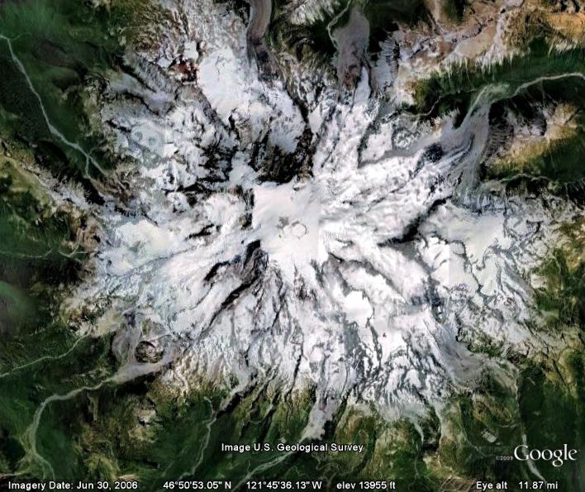
Mt. Rainier

Slide 4
Assignment outcomes
• Develop and hone skills in making observations about the natural world
• Understand how observations of physical characteristics of volcanoes lead to
interpretations about plate tectonic setting, chemical composition of magma,
rock type and weathering factors
• Link observations with textbook concepts
• Link landscape evolution with eruptive styles and tectonic settings and understand
the difference between Cascade and Hawaiian volcanoes
• Linking concepts to visuals helps students to learn

Slide 5
Unexpected problems
• From what altitude should observations be made?
• Students can’t find Mt. Baker
• Students rely on published photo captions or labels for
“observations”
• Focus on climate and not long term geologic history
• Students think there is a right answer

Slide 6
Assessment
• Did they understand that physical differences are attributed to
a number of factors and not just climate? Did they research
plate tectonics and volcano types? Did they make the connection?
• Did they make observations about large-scale landscape
features, glaciers, rivers, weathering, vegetation?

