Slide 1
A Few Examples of Using Online and Near Real-time Data in Homework and Lab Assignments
Jascha Polet
California State Polytechnic University, Pomona

Slide 2
Challenges
No access to computer classroom
Small number of students are uncomfortable using technology
Some students have trouble dealing with the imperfect nature of data
  how to get a perfect grade with imperfect data
  discuss nature of scientific process
But: many students (geology majors as well as non majors) enjoy using “real” data and interacting with websites

Slide 3
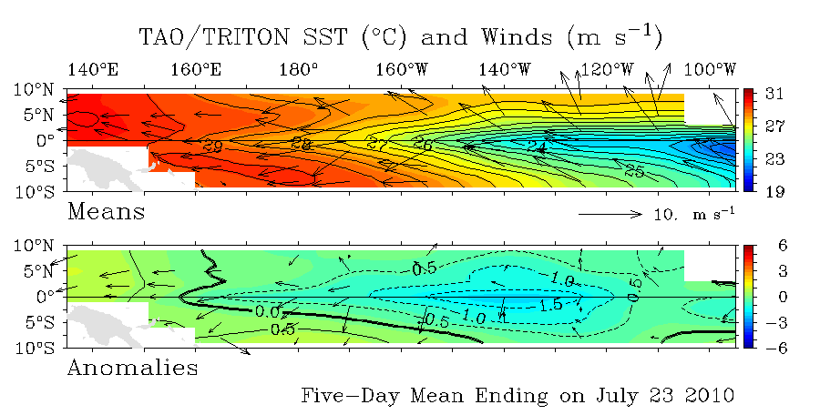
Sea Surface Temperature and Wind
Tropical Atmosphere Ocean project
Real-time data from moored ocean buoys for improved detection, understanding and prediction of El Niño and La Niña.
http://www.pmel.noaa.gov/tao/disdel/disdel.html

Slide 4
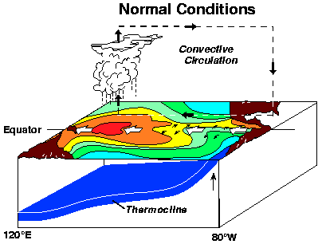
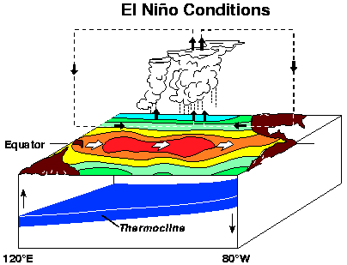
El Niño
In normal conditions, trade winds blow towards the west across the Pacific and pile up warm surface water in the west Pacific
During El Niño, trade winds relax leading to a rise in sea surface temperature off the coast of South America
Notes:
During El Niño (bottom panel of the schematic diagram), the trade winds relax in the central and western Pacific leading to a depression of the thermocline in the eastern Pacific, and an elevation of the thermocline in the west. The observations at 110W show, for example, that during 1982-1983, the 17-degree isotherm dropped to about 150m depth. This reduced the efficiency of upwelling to cool the suface and cut off the supply of nutrient rich thermocline water to the euphotic zone. The result was a rise in sea surface temperature and a drastic decline in primary productivity, the latter of which adversely affected higher trophic levels of the food chain, including commercial fisheries in this region. The weakening of easterly tradewinds during El Niño is evident in this figure as well. Rainfall follows the warm water eastward, with associated flooding in Peru and drought in Indonesia and Australia. The eastward displacement of the atmospheric heat source overlaying the warmest water results in large changes in the global atmospheric circulation, which in turn force changes in weather in regions far removed from the tropical Pacific.

Slide 6
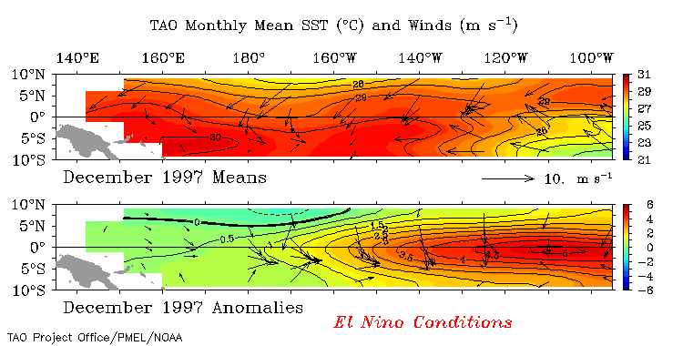
TAO Maps
Students can generate plots of current sea surface temperature and winds (mean and anomaly)
Compare with examples of El Niño, Normal and La Niña conditions
Notes:
Pacific Ocean in early stages of a La Niña eventIssued on Wednesday 21 July 2010 | Product Code IDCKGEWWOOTropical Pacific Ocean temperatures continued to cool over the past fortnight, and are now approaching levels typical of a La Niña. Similarly, other ENSO indicators are also at or exceeding La Niña thresholds. As computer models predict the central Pacific will continue to cool over the coming months, it is now highly likely that the Pacific is in the early stages of a La Niña event, and that 2010 will be considered a La Niña year.Signs of an emerging La Niña event have been apparent in the equatorial Pacific for several months. Pacific Ocean temperatures have cooled steadily throughout the year and are now more than 1°C cooler than average in some areas on the equator. The Southern Oscillation Index (SOI) has increased in value and is currently around +14, trade winds continue to be stronger than average and cloudiness has remained suppressed over the central Pacific. All of these key indicators are at levels typical of the early stages of a La Niña event.La Niña periods are usually, but not always, associated with above normal rainfall during the second half of the year across large parts of Australia, most notably eastern and northern regions. Night time temperatures are typically warmer than average and Tropical Cyclone risk for northern Australia increases during the cyclone season (November-April).

Slide 7
Tides
Real time tide data may be obtained from the NOAA Tides and Currents website: http://tidesandcurrents.noaa.gov/station_retrieve.shtml?type=Tide+Data

Slide 8
Tidal Data Interpretation
Students can generate graphs and from these determine:
  tidal range
  tidal period
  type of tidal pattern

Slide 9
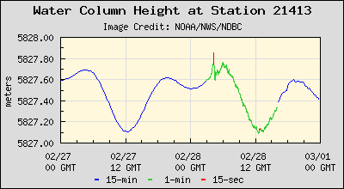
Tsunami Arrival
Students may create time traces of water column height for a specified time period: http://map.ngdc.noaa.gov/website/mgg/dart/viewer.htm
Tsunami heights and arrival times may be calculated
  comparison with seismic wave arrival time to illustrate difference in wave velocity and discuss tsunami warning
Notes:
Chile tsunami recorded near Japan on DART station

Slide 10
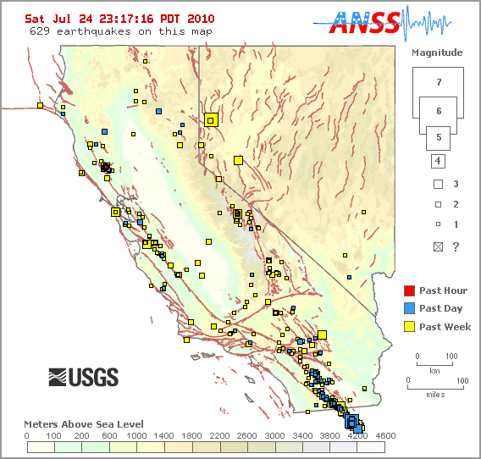
Earthquake Catalogs
Global and local earthquake catalogs are available near real-time online
  http://earthquake.usgs.gov/earthquakes/recenteqsww/
  http://earthquake.usgs.gov/earthquakes/recenteqscanv/

Slide 11
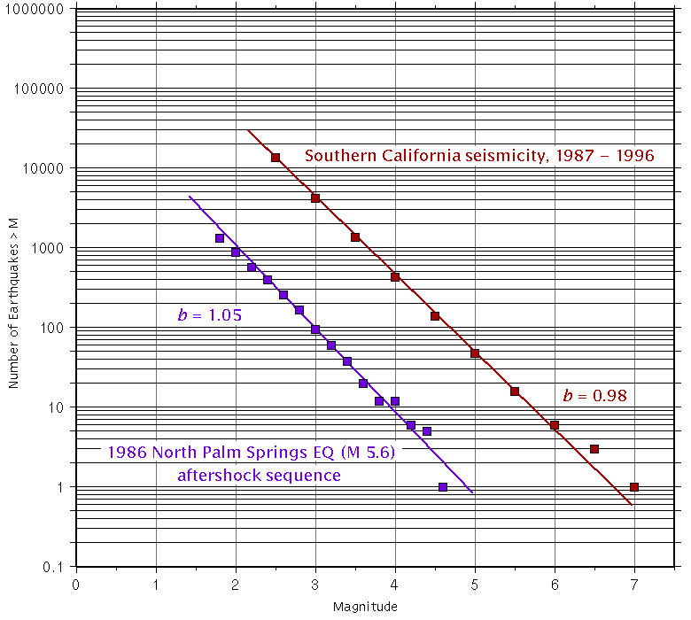
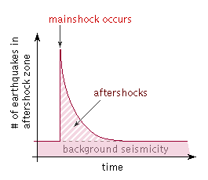
Aftershock Statistics
log N(M) = a - bM
Using catalog search interface, students can generate aftershock catalogs
Using Excel, they can determine b value of Gutenberg Richter relationship and rate of decay of Omori’s law and compare to those of other sequences
  requires understanding of log and power-law
Notes:
From: http://www.seismo.ethz.ch/staff/stefan/volcanic.html
The earth's crust is strongly heterogeneous at scales of 1 to 100 km. New results [Wiemer and Benoit, 1996; Wiemer and McNutt, 1997; Wiemer and Wyss, 1997] suggest that some of these heterogeneities can be mapped by variations in the frequency-magnitude distribution (FMD) of earthquakes. The equationlog₁₀N = a - bM (1)[Ishimoto and Iida, 1939; Gutenberg and Richter, 1944], where N is the cumulative number of earthquakes having magnitudes larger and equal to M, and a and b are constants, describes the power law decay of frequency of occurrence with increasing magnitude. The b-value is the slope of the straight line that usually fits observed data well, and is inversely proportional to the mean magnitude m, given the minimum magnitude, M_{min}, of the data setm = M_{min} + 1/2.3b (2)[Utsu, 1965; Aki, 1965]. Thus, mapping the b-value is equivalent to mapping the mean magnitude, i.e. the mean crack length.The gridding technique we use [Wiemer, 1996] constructs high resolution images of b-value distributions as a function of space, in map and in cross section views. In subduction zones, Wiemer and Benoit [1996] found anomalously high b-values in the upper part of the deep seismic zone beneath the volcanic arc. Along fault zones, anomalously low b-values seem to correlate with asperities [Wiemer and Wyss, 1997], whereas creeping segments of the fault commonly show high b-value [Amelung and King, 1996; Wiemer and Wyss, 1997]. The subject of this paper is the correlation of anomalously high b-values with active magma chambers, an observation documented thus far for Mount St. Helens [Wiemer and McNutt, 1996].It is generally believed that b does not vary much from its usual value of b = 1 [e.g. Froehlich and Davis., 1994], except for volcanic areas where high values, up to b = 2, are commonly reported [e.g. Warren and Latham, 1970]. However, in all seismogenic areas where we mapped b-values, we found a great deal of statistically significant variation. In volcanic areas, most of the crust shows normal or even low b-values (b<1), with rather small volumes of anomalously high b-values (b>1.3). We believe that the ubiquitous observation of b» 1 results from mixing crustal volumes with low and high b-values. By mapping the b-values in detail on a fine scale, we recover the information contained in the variation of b, or the mean earthquake size, as a function of space.Factors that can cause perturbations of the normal b-value are the following. Increased material heterogeneity results in high b-values [Mogi, 1962]. An increase in applied shear stress [Scholz, 1968; Urbancic et al., 1992], or an increase in effective stress [Wyss, 1973] decreases the b-value. Also, an increase in the thermal gradient causes an increase in b [Warren and Latham, 1970]. Thus, it may not always be clear which of these factors causes an observed b-value anomaly, unless other clues are available. Therefore, we seek to compare b-value anomalies to other known parameters of the crust, with the aim of developing evidence for the cause of the anomaly.

Slide 12
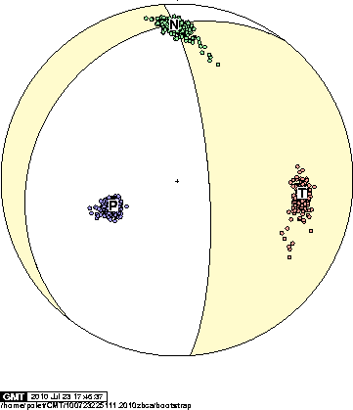
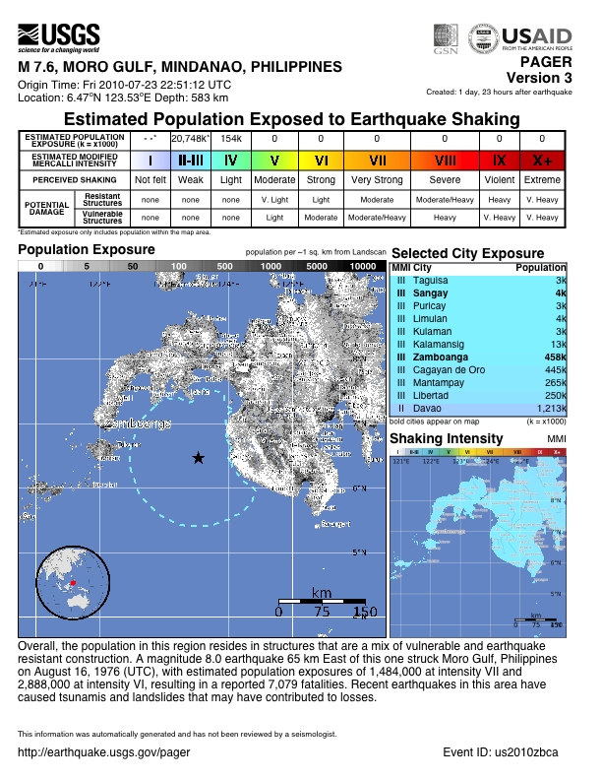
Near Real Time Earthquake Source Parameters
Earthquakes that occur during class will have been analyzed within one hour of origin time
Can discuss likely impact, seismotectonics, tsunami warnings….

Slide 13
Assessment
Students complete graded homework and lab exercises
Common sequence:
  replicate and interpret clear example dataset/plots
    includes simple graph reading/interpretation questions
  generate dataset/plots for current date and time or location of choice
  interpret new dataset

