Slide 1
USGS Water Data and Flood Frequency Analysis
Susan Schwartz, UC Santa Cruz
Introduction to USGS real-time water data
Use of these data in a flood frequency analysis exercise
  Exercise goals
  Advantages and challenges
  Assessment
Possible refinements that would incorporate real time data in a more significant way

Slide 2
Why use real-time streamflow data for engaging students?
Streams are important and visible parts of Earth’s surface and discussed in introductory Earth/Environmental Science through lower division hydrology and geologic hazards classes.
Stream gages are abundant and sample watersheds of varying sizes from the Mississippi River to local creeks. Streams in the vicinity of where students live can be analyzed providing a more meaningful experience.
Data from stream gages are available on-line from the USGS and can easily be downloaded and processed in a spreadsheet.

Slide 3
http://waterdata.usgs.gov/nwis/rt

Slide 4
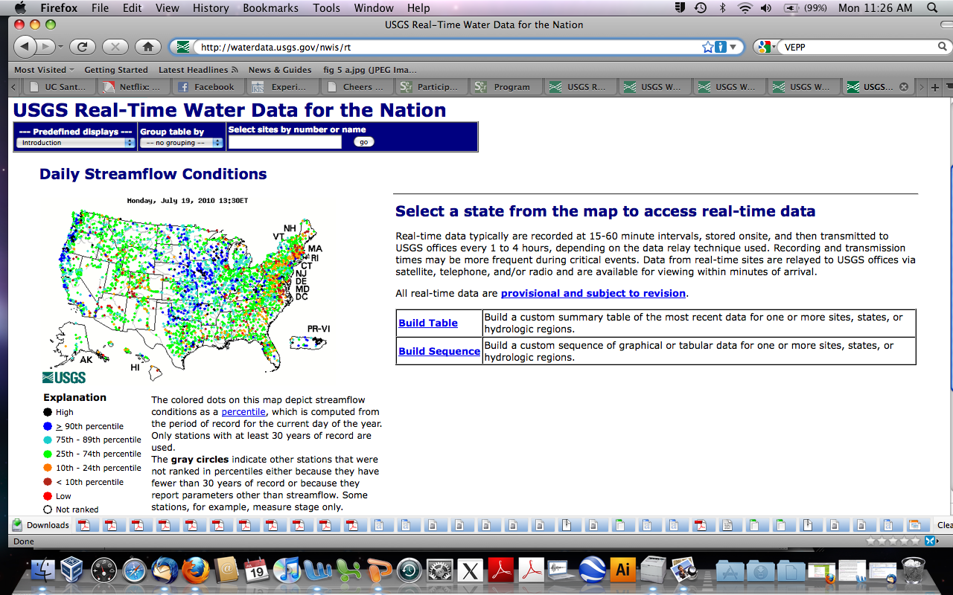

Slide 5
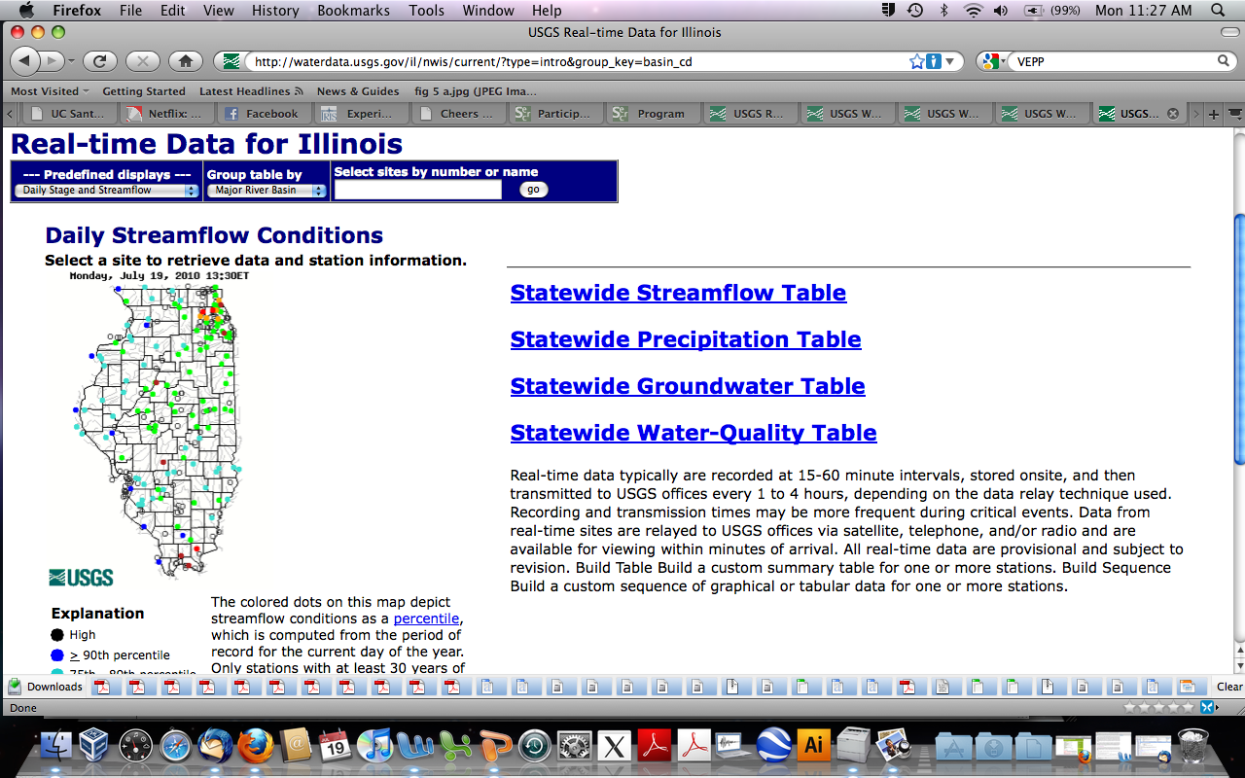

Slide 6
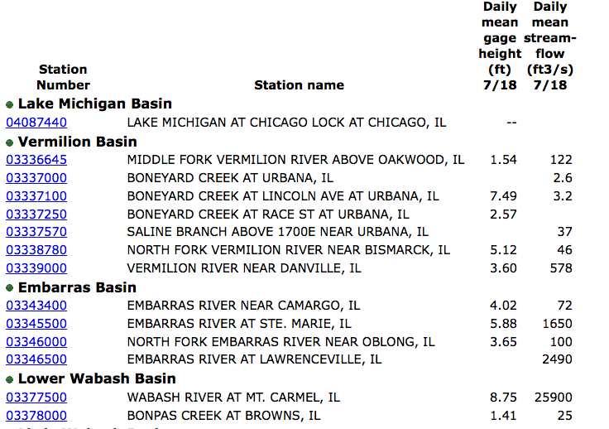


Slide 7
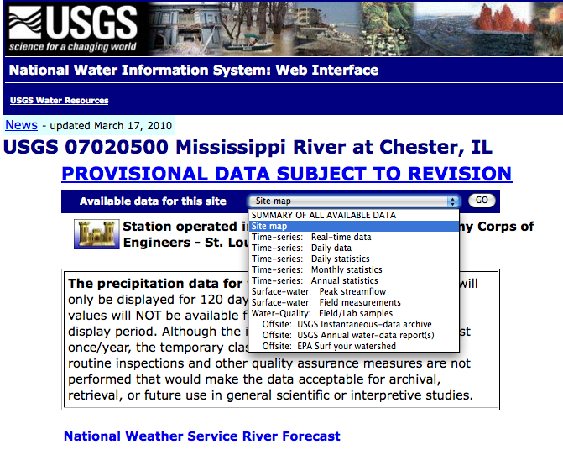

Slide 8
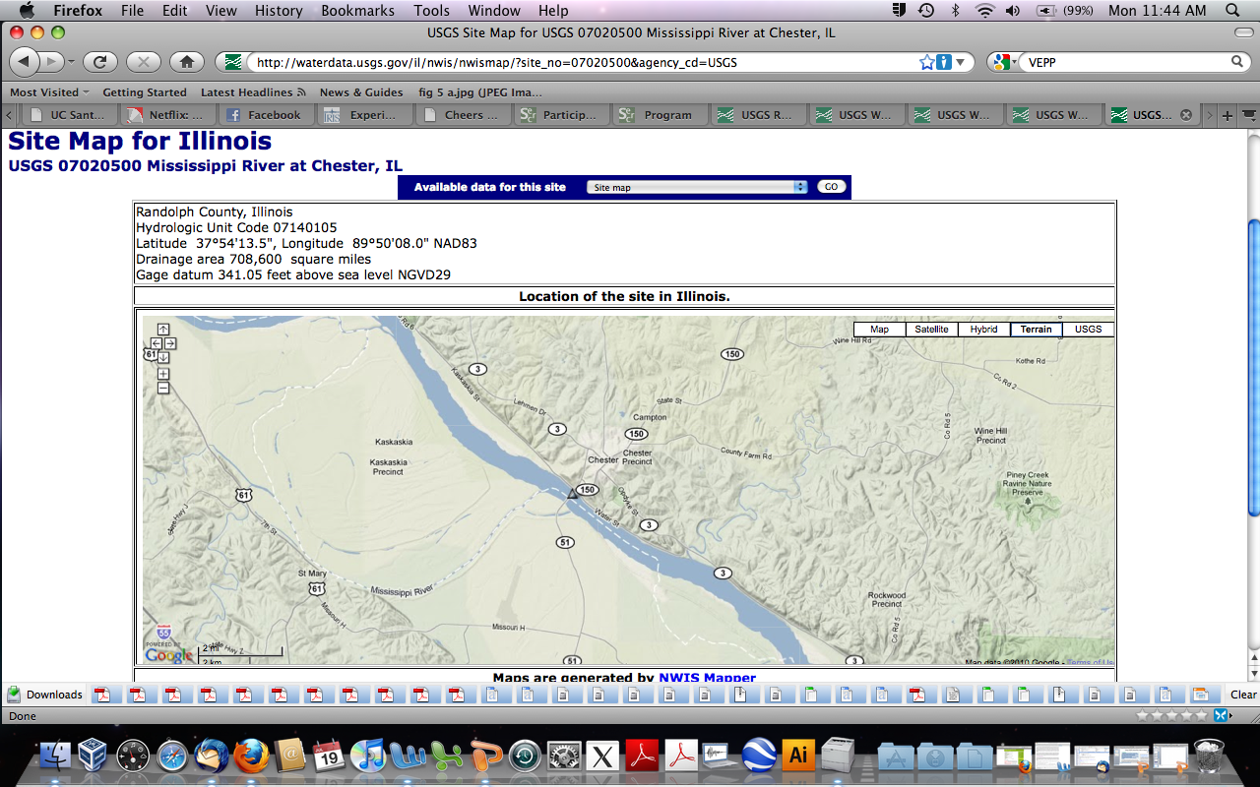

Slide 9
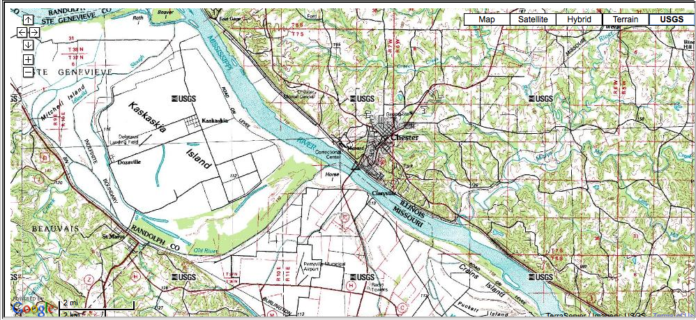

Slide 11
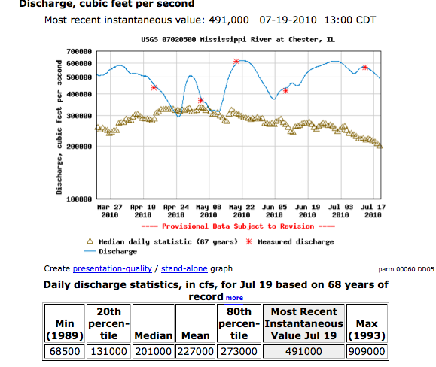

Slide 12
Geologic Hazards: Predicting River Flooding
Flood Frequency Analysis- Uses long record (>10 years) of peak yearly discharges to determine the recurrence intervals of different severity floods
Flood Hazard Mapping- Used to determine areas susceptible to flooding when discharge exceeds the flood stage

Slide 13
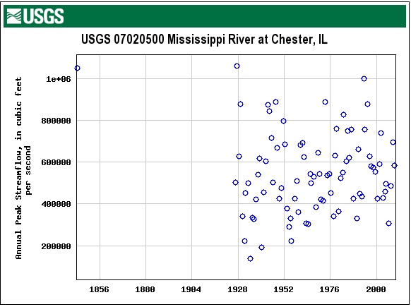

Slide 14
Flood Frequency for the Mississippi River at Chester, Illinois
Modified from an EarthInquiry Exercise from AGI and published by W.H. Freeman and Company.
View Nova video “Flood!” describing the impact of the 1993 Great Mississippi Flood.
Examines flood levels of the Mississippi during the 1993 flood to address questions of how often an event of this size can be expected and whether it makes sense for particular communities to relocate given their risk of future flooding.

Slide 15
Educational Goals
Understand basic concepts in hydrology/river mechanics by analyzing real data from familiar places/events.
Understand how flood hazards are determined.
Gain experience navigating web sites with important scientific data.
Practice basic skills with Excel including importing data, applying formulas, creating charts, and adding trend lines.

Slide 16
Advantages/Challenges of Using Internet/Real Time Data
Enhanced interest in topic working with real and meaningful data.
Gain experience navigating web sites with important scientific data.
Unpredictability of real-time data- the dynamic nature of Earth systems makes it so you never know what you will be seeing.
Changing website layout, server unreliability, and student inexperience downloading this type of data result in difficulties using this data and require enhanced professor involvement.

Slide 17
Assessment
Canvass students about their experience.
  Students usually like hands-on exercises even if they are unsuccessful in accomplishing teaching objectives.
  This will establish if use of real-time data has engaged the students
Can students apply what they have learned in other situations?

Slide 18
How can this exercise be changed to better incorporate the “real-time” data?

