Slide 1
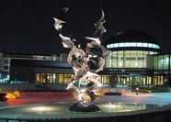
The Alverno Story
Sue Mente
PKAL/QuIRK Workshop
October 8 – 10, 2010

Slide 2

Session Overview
About Alverno
Making a case: QL across the curriculum
Faculty Buy-in
Sustainability
Visibility

Slide 3
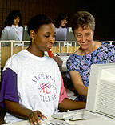
Alverno College
Demographics
Philosophy
Brief history of QL
(See criteria page 67)

Slide 4
Making our case
Transferability concerns from faculty
Anecdotal evidence from outside
Limited graduation requirement
Survey of graduates (see page 78)
What evidence do you have/could you gather to show need at your institution?

Slide 5
Faculty Buy – in
Recruit faculty →show QL strengthens student learning → able to pay an initial group to attend training and develop materials
Address faculty math anxiety & possible deficits→ provide resources and support
Show relevance to their field → broaden perception of QL

Slide 6
Faculty’s taste of Quant Lit
Scan the activity that uses data on pages 69 - 70 and the provided data from the CIA World Factbook. (Another activity on page 72)
Scan the faculty response sheet “The Story Behind the Numbers” on page 73.
How might this bring faculty on board?

Slide 7
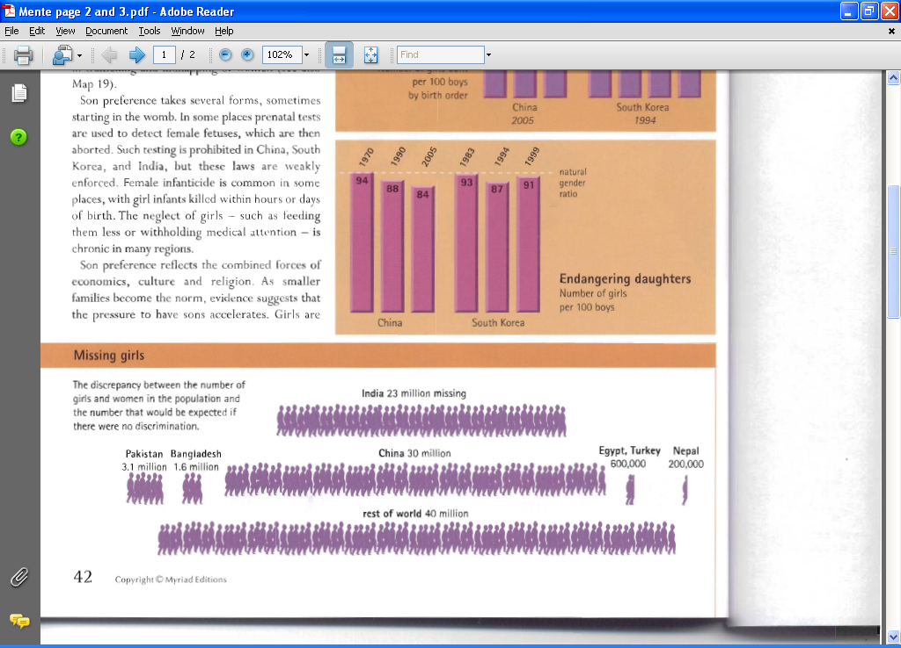
How might exploring examples like these help bring faculty on board?

Slide 8
Faculty Buy-in
Show meaningful vs. trivial/central vs. tangential use of QL in their courses → highlight tool for analysis
Get faculty to take ownership of QL → target key faculty, model use, purposefully cross barriers

Slide 9
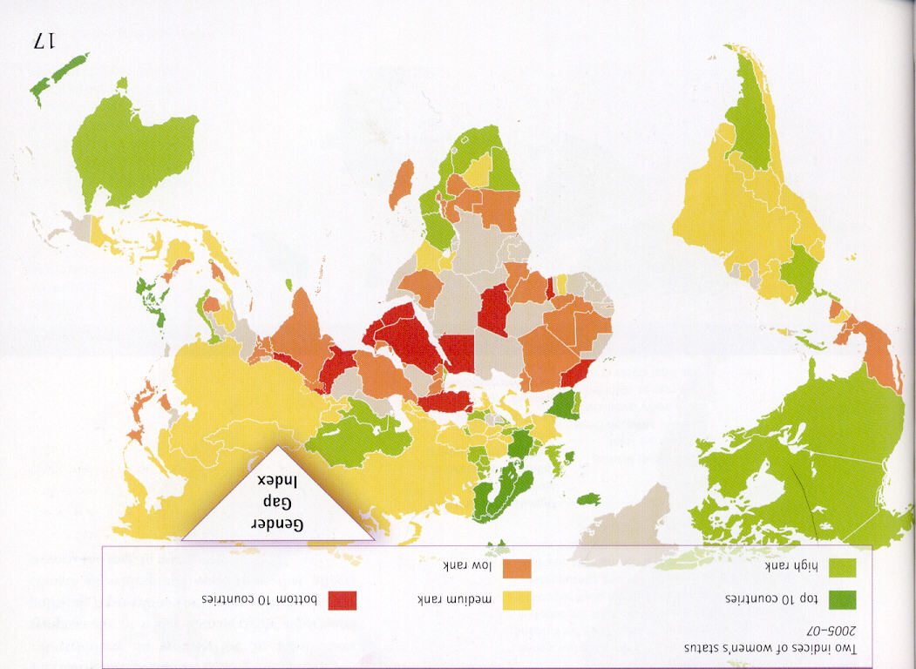
QL as analysis -- Visiting a class
Gender Gap Index

Slide 10
“Everywhere, boys tend to be privileged over girls.” (Seager, p. 42)
This is a bold statement that may not stand up well on its own. Whether you agree or disagree with this statement, supporting your position with quantitative evidence, gives it legs. Quantitative support helps to define privilege, convince readers of the existence or lack of existence of that privilege, and show the magnitude of that privilege if it exists. The Penguin Atlas of Women in the World contains a wealth of information on which to base that support.
Page 17: Gender Gap Index (GGI) = percent of gender gap closed
Examples (The Gender Gap Report. World Economic Forum. 2009)
Iceland ranked #1 in the world in 2009.
Economic participation and opportunity ratio = 0.7502
Education attainment ratio = 1.0000
Political empowerment ratio = 0.5905
Health & survival ratio = 0.9697
GGI =

Slide 11
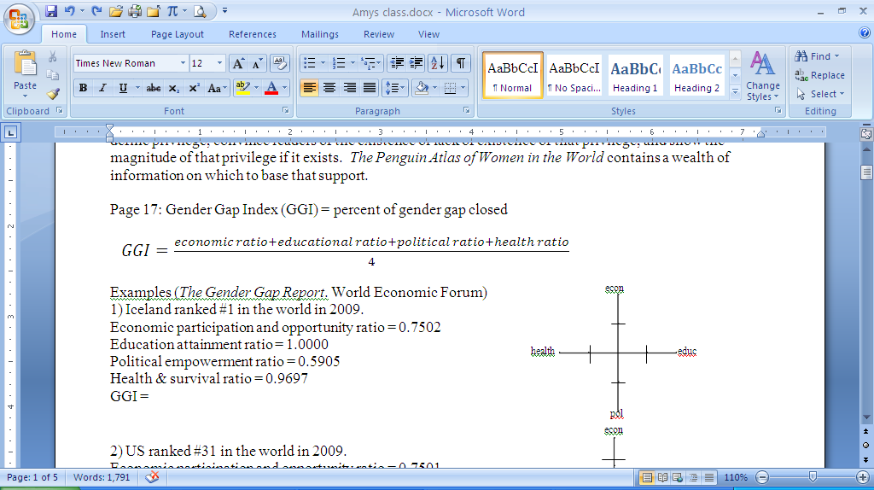
Saudi Arabia ranked #130 in the world in 2009.
Economic participation and opportunity ratio = 0.3096
Education attainment ratio = 0.9745
Political empowerment ratio = 0.0000
Health & survival ratio = 0.9765
GGI =
Iceland Saudi Arabia
What does the quantitative information on the Gender Gap Index tell you about privilege?

Slide 12
Sustainability
Train new/new to QL faculty – see QL through the levels on pages 76 - 77
Gather faculty feedback & follow-up – see survey on page 79
Create ongoing opportunity for cross-disciplinary conversation
Continue to help non-math/science faculty see QL as a communication tool.

Slide 13
Faculty Buy-in
What strategies can you use to bring your faculty on board?

Slide 14
Sustainability
Maintain visibility
  AC 309 Mid-Program Assessment –see pages 74 – 75
  Research Center for Women Project – see page 71
  Gen Ed conference

Slide 15
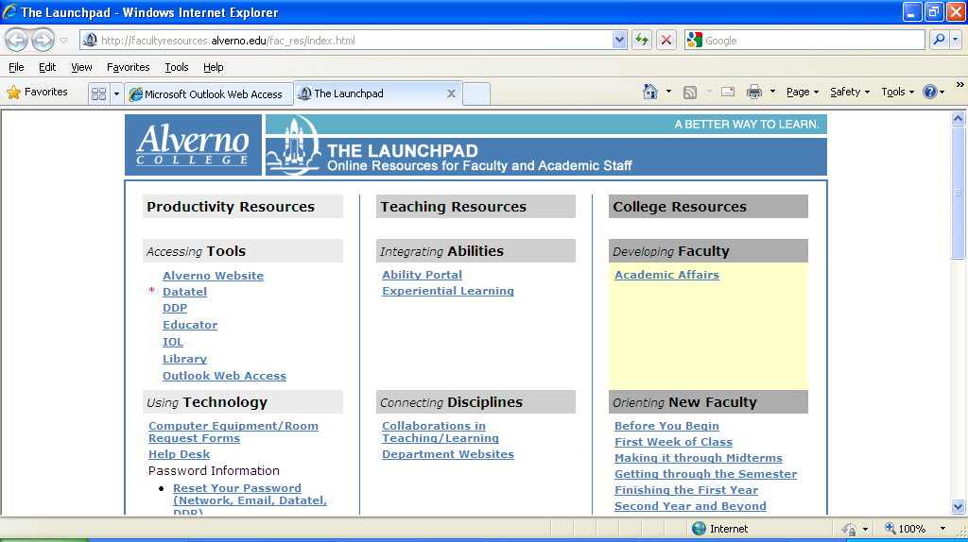
Sustainability
Provide resources/examples
Creating a virtual QL resource center here

Slide 16
Sustainability
How can you make your project visible at your Institution?
What are other sustainability strategies?

