Slide 1
A Framework For Classifying Spatial Gestures
Kinnari Atit – Temple University
Tilbe Goksun, Carol Ormand, Cathy Manduca, Ilyse Resnick, Tim Shipley, & Basil Tikoff

Slide 2
Spatial Information is Communicated in Speech and Gesture
Notes:
We communicate and highlight spatial information in speech and gesture. Spatial information is expressed in gesture both for communicating with others and for individual problem solving (Alibali, 2005). Common spatial activities, such as giving directions, often include gesture (e.g. Lavergne & Kimura, 1987),

Slide 3
Why do People Gesture?
To communicate!
  Spatial words are qualitative and do not easily convey metric spatial information.
  Language is limiting because of its categorical and segmented nature.
Scientists are faced with language’s limitations.
  They verbalize complex spatial relations by using discipline-specific terminology.

Slide 4

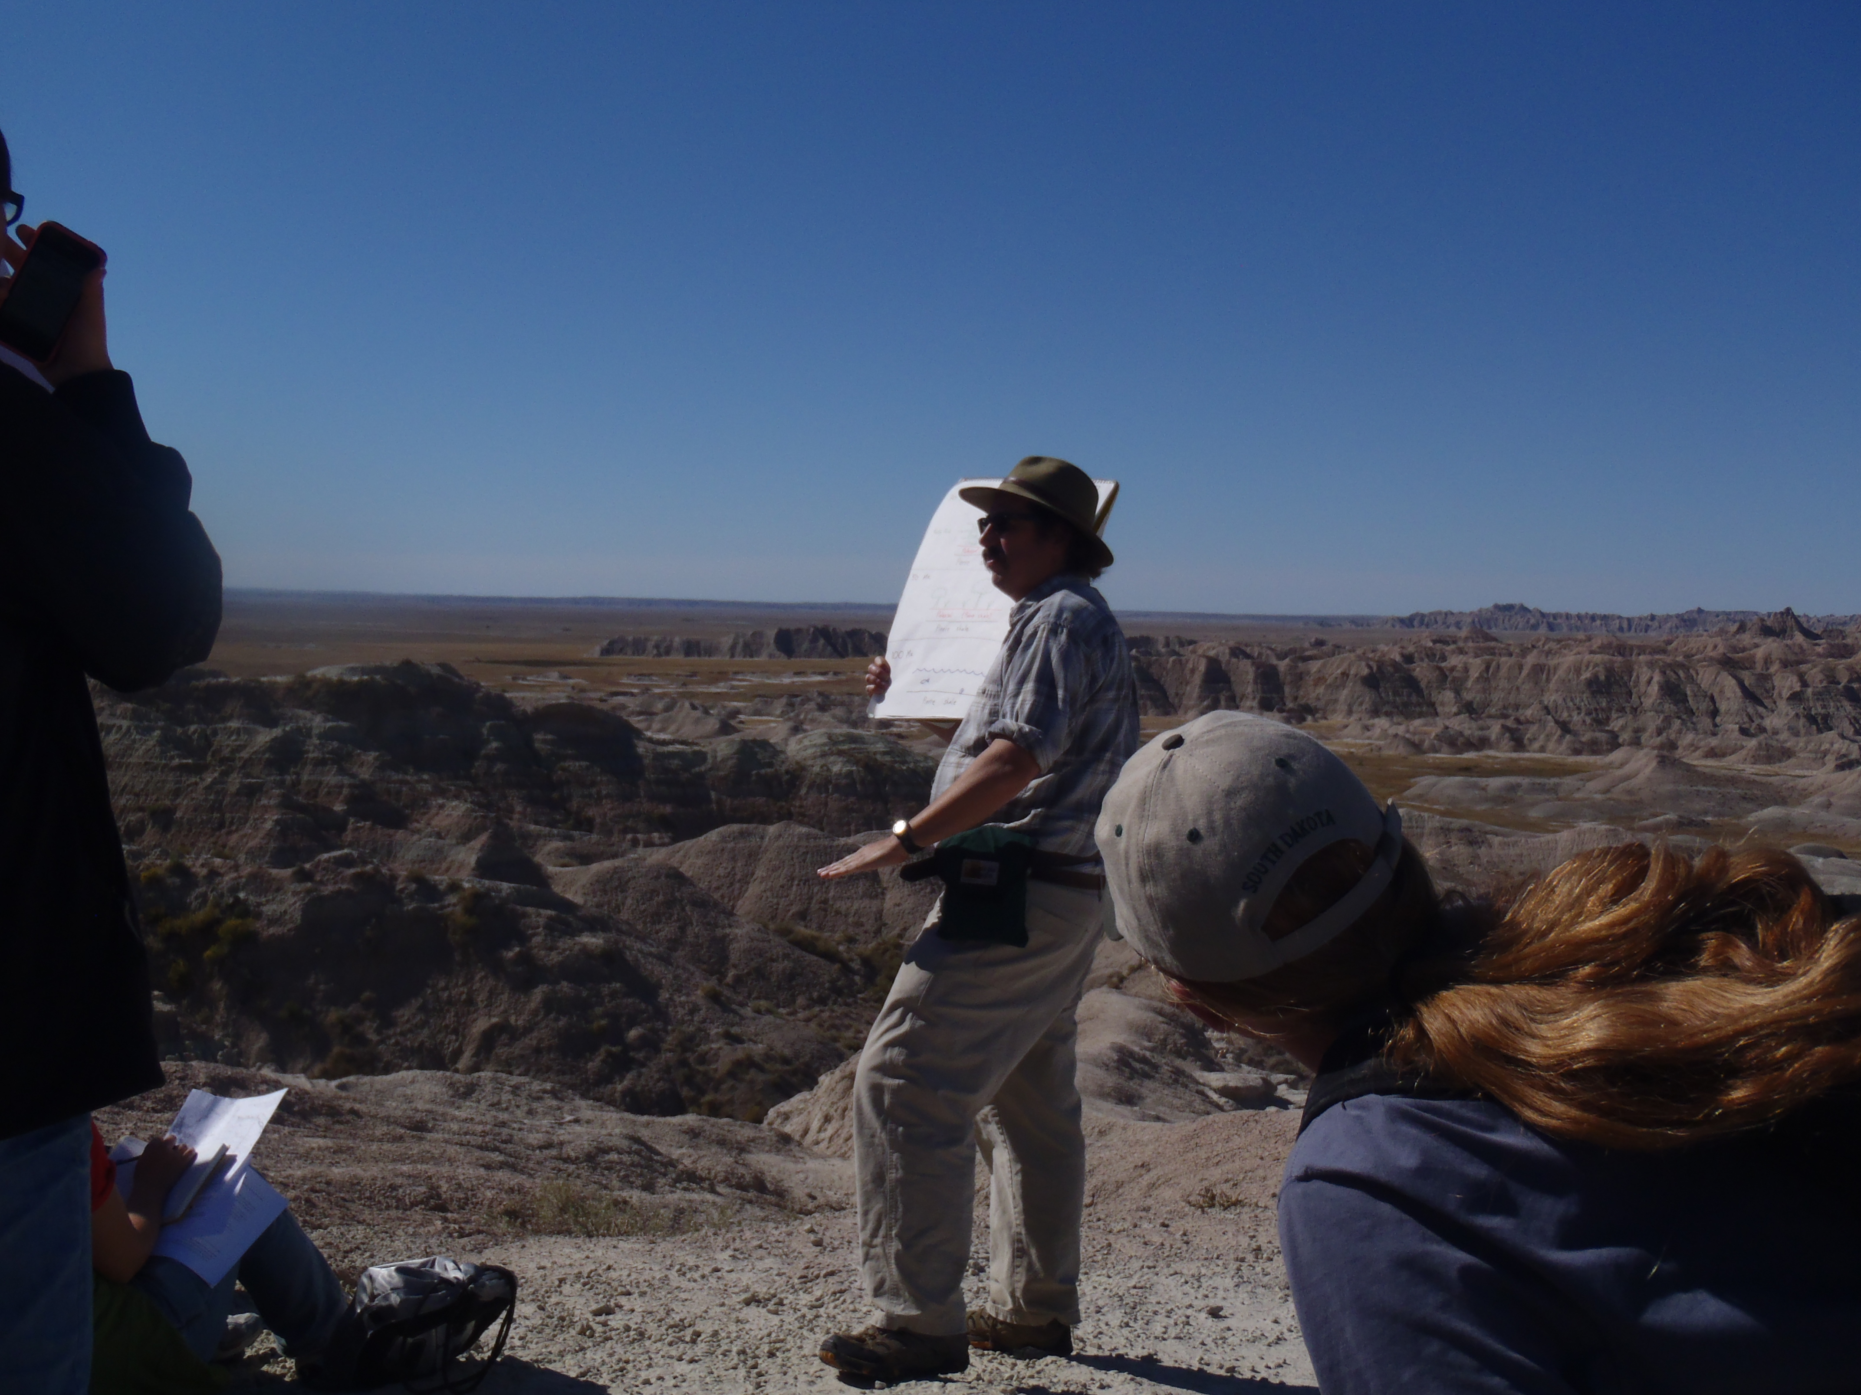
Geologists Use Gesture!

Slide 5
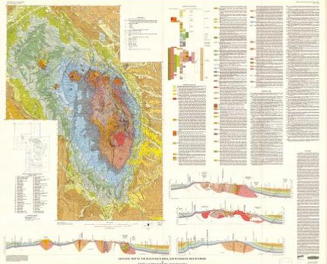
Black Hills, South Dakota

Slide 6
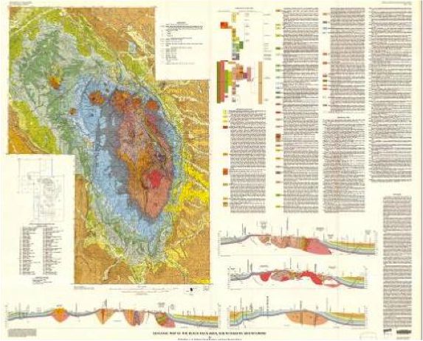
Methods
Participants = 43
  23 Experts (Practicing Structural Geologists)
  20 Novices (Undergraduate and Graduate Geology Students)
Task: Would you explain what are the geologic structures under the ground, along this line of cross section (c to c’), and how do you know?

Slide 7
Everyone Gestures! Regardless of Expertise
69.7%
30.3%
But Experts Gesture More!

Slide 8
Gaps in the Literature
Few studies have examined what spatial information is conveyed in gesture (Trafton et al., 2006).
Much research explores how spatial information is communicated in speech (e.g. Chatterjee, 2008)
 | Intrinsic (Single) | Extrinsic (Many)
Static (Stationary) | Object, proper | Locative relations
Dynamic (Moving) | Manner of Motion | Path of Motion

Slide 9
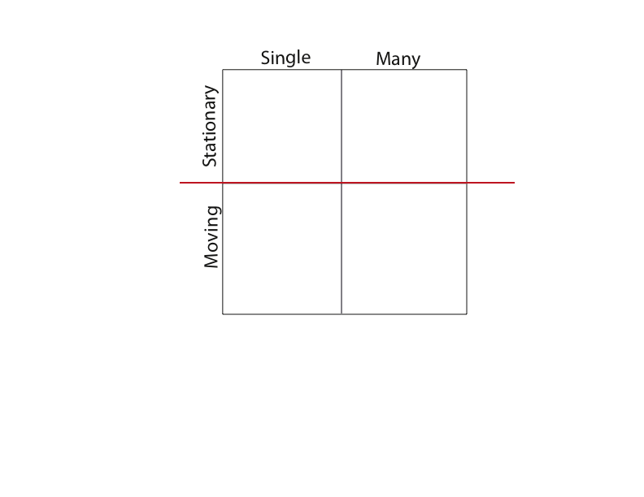
Representation of Spatial Properties

Slide 10
Representation of Spatial Properties

Slide 11
Representation of Spatial Properties

Slide 12
Representation of Spatial Properties

Slide 13
Representation of Spatial Properties

Slide 14
Representation of Spatial Properties

Slide 16
Representational Gestures
Notes:
Make sure to mention that there are two types of gestures: highlighting vs. representational

Slide 17
We know that gestures help with learning → Expert vs. Novice ?

Slide 18
Experts vs. Novices
Novices gesture more about “Moving” properties!

Slide 19
Geology has a HUGE Vocabulary!
Vocabulary presented to introductory geoscience students varies with each textbook, making it difficult to learn the jargon (Kortz, 2011)
Notes:
One field that is particularly known for its substantial vocabulary is the geosciences. Furthermore, the vocabulary presented to introductory geoscience students varies with each textbook, making it very difficult for students to grasp the common language (Kortz, 2011). As students struggle to learn this new vocabulary, experts consistently use gestures to supplement discourse to foster understanding. It is important to investigate the types of information experts and novices convey in gesture to inform how science concepts are taught in the classroom.

Slide 20
Novices use less discipline specific vocabulary!

Slide 21
Do novices’ and experts’ gestures differ between “single-moving” and “many-moving” properties?

Slide 22
Experts vs. Novices
Everyone tends to use 2 hands to represent “many-moving” spatial properties.
Notes:
Make into two slides.

Slide 23
Experts vs. Novices
Experts tend to use 2 hands “single-moving” gestures, while novices use 1.

Slide 24
Summary
Everyone represents all four categories of spatial information in gesture
Novices gesture more about “moving” properties than Experts
  Use less discipline-specific vocabulary
  Represent “single-moving” properties differently than experts

Slide 25
Open Questions
Are novices using gesture to compensate for their limited vocabulary?
  OR do they like jump to making inferences which is why they make more moving gestures?
Reflect a difference in the way this spatial property is mentally represented?
Notes:
Novices tend to work off the cross-section → struggle with 2D to 3D translation?
Does this reflect difficulties in connecting the cross-section to the map?

Slide 26
Educational Implications
Instructors could use gesture to scaffold students’ poor understanding of terminology
Instructors could also use simpler gestures
  Gestures could be confusing!
  Use 1 hand when speaking about one object

Slide 27

Thank You!
Tim Shipley
Basil Tikoff
Kelly Bower
Carol Ormand
Cathy Manduca
Tilbe Goksun
Ilyse Resnick
Spatial Cognition, Action, and Perception Lab
Spatial Intelligence and Learning Center

